Slide 1



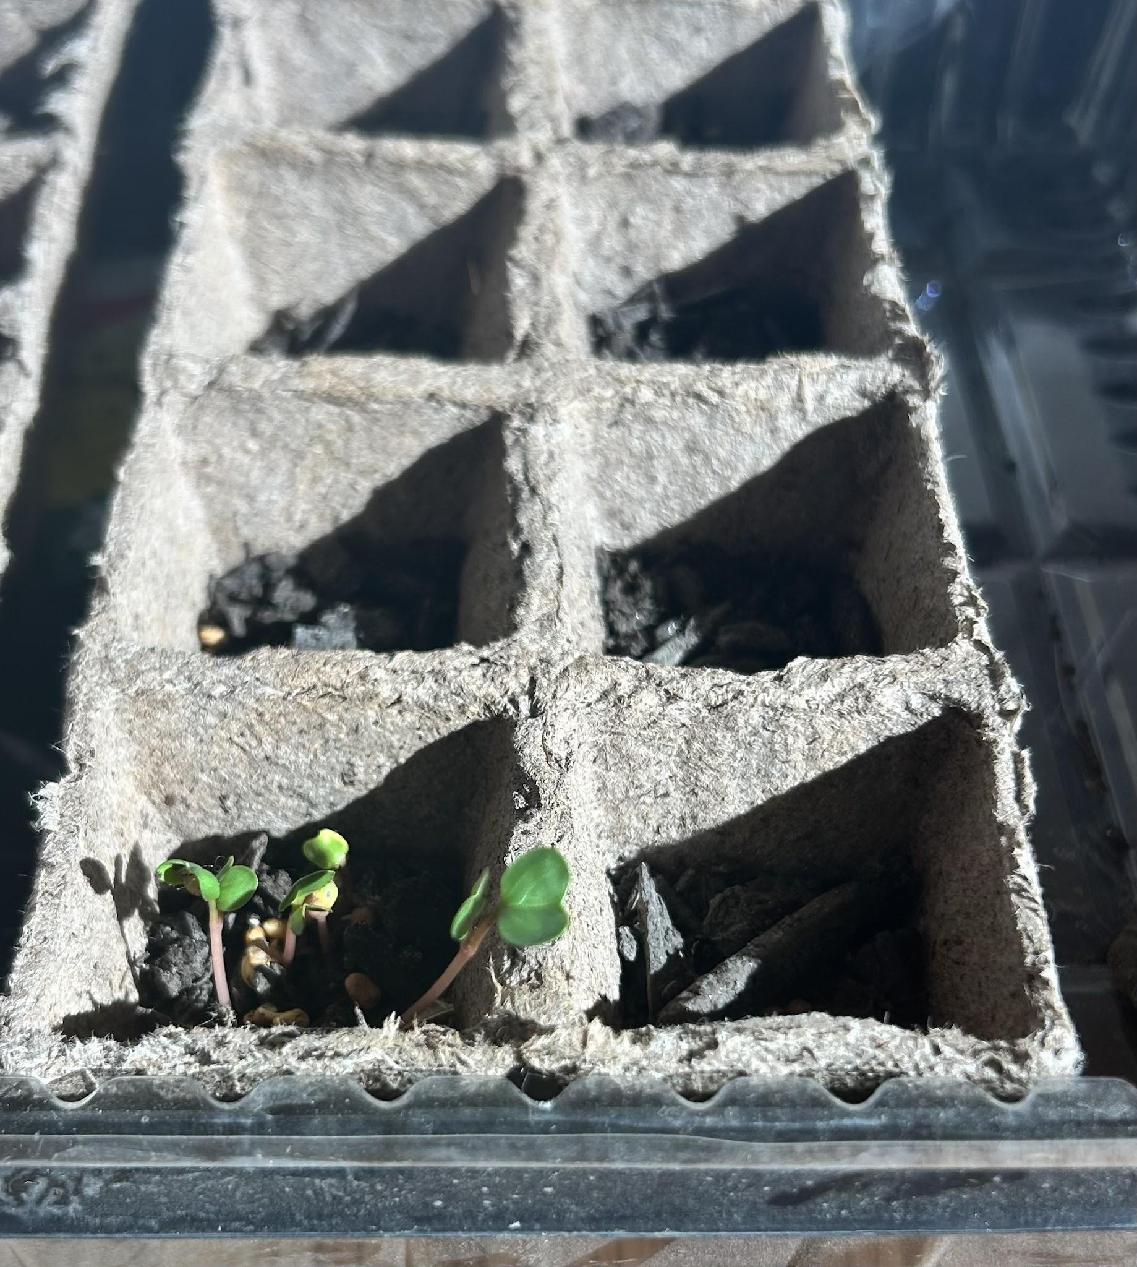
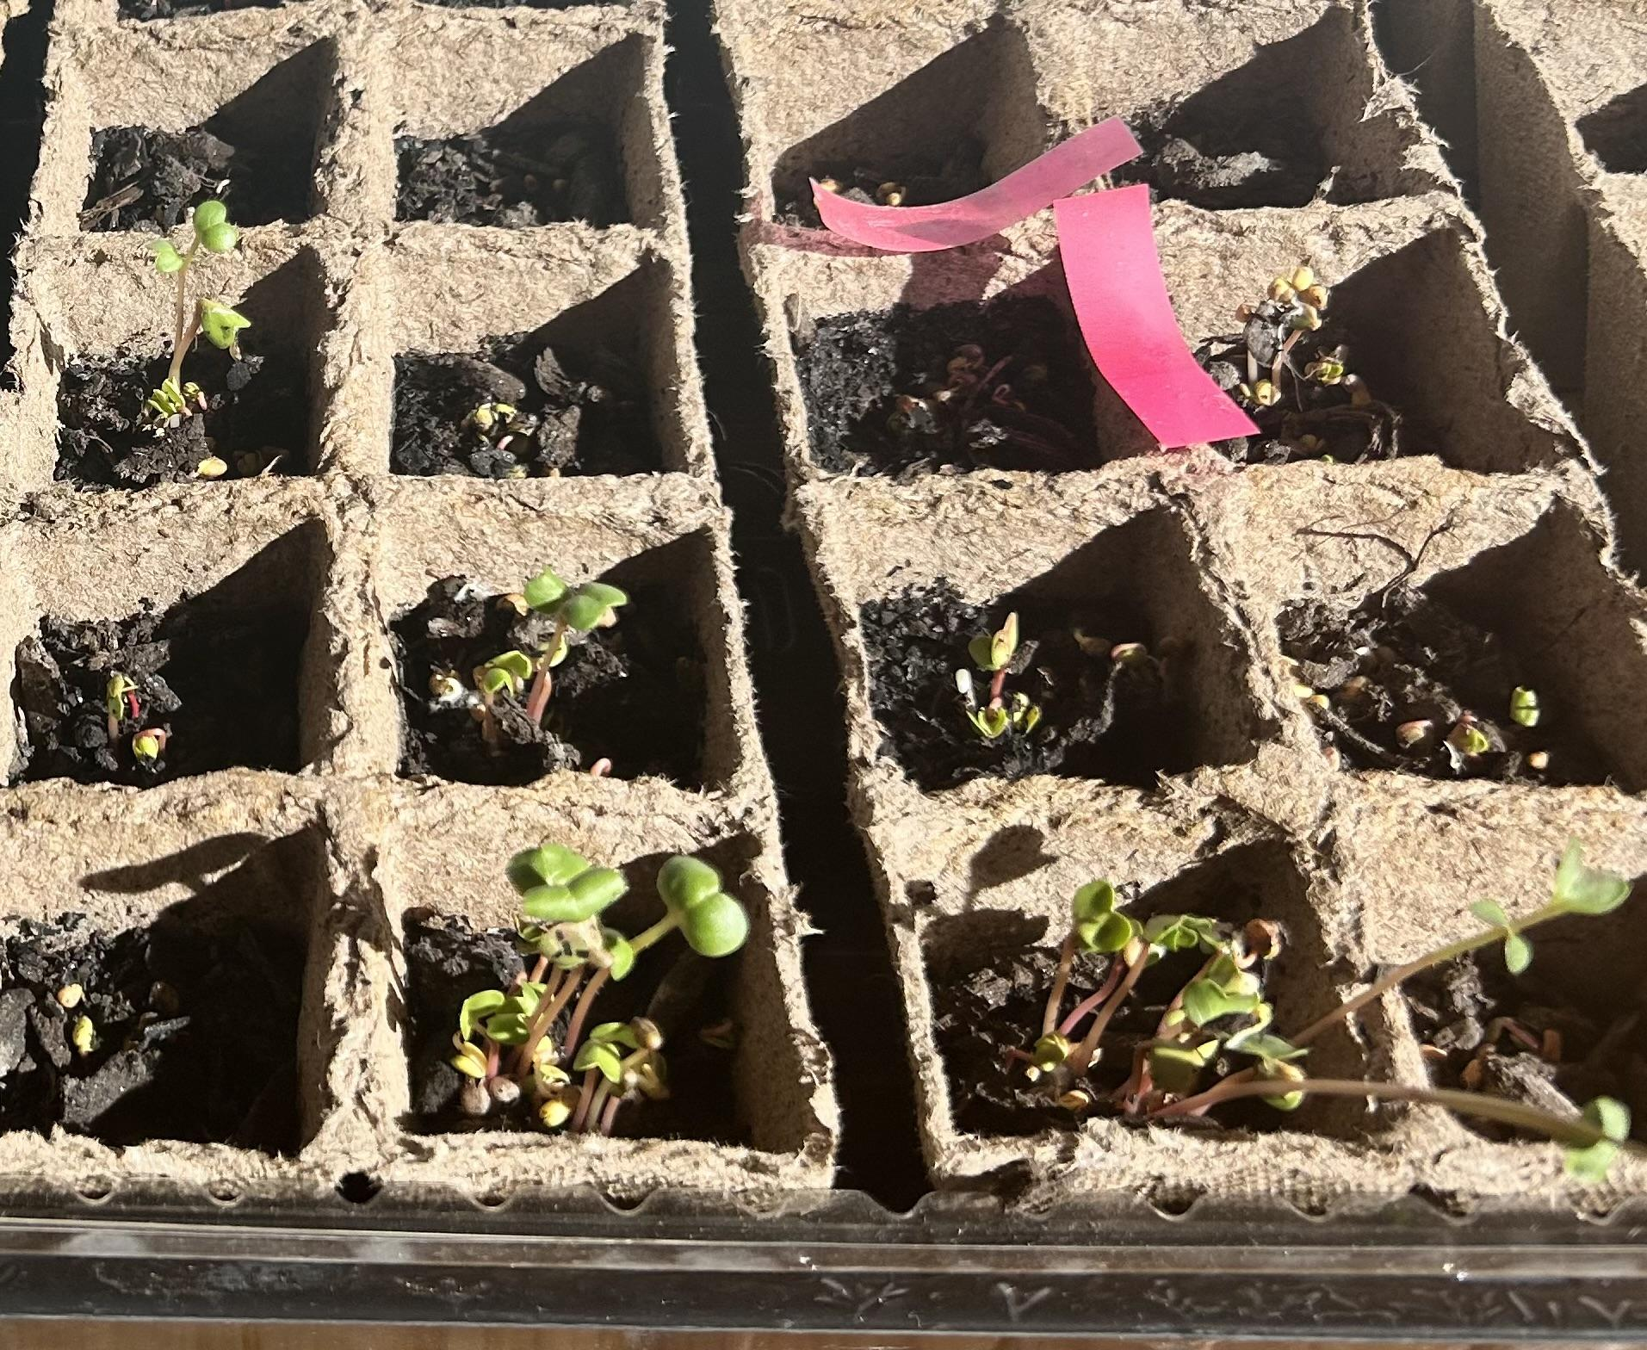






Bio-Char(ming) New England’s Soil Fertilizer
Shrewsbury High School, Shrewsbury, MA, USA
By: Aadrishma Dahal, Aashi Gupta, Aleena Shaikh, Amal Nadaf, and Rachael Laikangbam
Special Thanks to our mentor Dr. Anna Li and teacher advisor Dr.Duggan!
Abstract
This study explores the effects of plant growth-promoting bacteria (PGPB) and nutrient-infused biochar on Red-Arrow radish plant growth as a sustainable alternative to synthetic fertilizers for at-home plant growth. Tomato extract and compost were used to inoculate biochar with naturally occurring Bacillus, Stenotrophomonas, and Ralstonia species. Pea plants were grown in three conditions: (1) biochar-infused soil, (2) soil with “Miracle-Gro All Purpose Water Soluble Plant Food” fertilizer, and (3) untreated control soil. Growth was measured weekly based on height and leaf count. Plants grown in bacteria-infused biochar showed significantly greater growth compared to the fertilizer and control groups. These results suggest that biochar inoculated with naturally occurring PGPB could be an eco-friendly soil amendment for improving plant growth.
Science Content
Experiment details:
Infusing substances into biochar in order to deliver key nutrients to soil:
  Soak biochar in water for 1-3 days
  Add PGPB derived from Tomato extract (including bacteria of Bacillus and Stenotrophomonas species) to the mixture
    Bacillus thuringiensis is a soil-dwelling bacterium that produces toxins harmful to insects, making it a natural pesticide, while also being safe for plants, animals, and humans, thus supporting sustainable agricultural practices.
    Stenotrophomonas is a microbial biocontrol agent against many plant pathogens naturally occurring in many fruits, vegetables, and plants.
  Let the mixture settle for 2 days
  Combine the mixture with soil in a 1:4 ratio (biochar:soil)
  Prepare control groups with just soil, and soil and fertilizer, and soil and the PGPB infused biochar
  Grow plants for 3 months
  Weekly collect data on height of plant
Results:
Plants grown in the biochar with bacteria treatment performed significantly better in all measured areas than our control groups. The soil with nothing had an average growth of 15.12 cm tall whereas the fertilizer had an average growth 16.27 cm, the one with Biochar had 16.97 cm.
Application:
New England soil lacks calcium, potassium, magnesium, and is also high in acidity. This project utilizes Biochar by infusing it with these nutrients and PGPB (plant growth promoting bacteria) strains and doubles as a buffer for soil which will help increase the pH for at home plant growth.
Team Content
We are a group of 5 hailing from Shrewsbury High School. Our team is completely student-led, however we still have persevered through our circumstances! WIth the aid of our teacher advisor, Dr. Duggan, and assigned team mentor, Dr. Anna Li, we have put many hours into this project. Whether it be hours in our local library, evening zoom calls, or early morning FaceTimes, we made it our goal to finish this project while still having fun!
Next steps
Whether it be families gardening at home, local farmers planting crops, or large corporations mass producing – produce that BioChar in a way widely accessible way to be used by all!
Experiment compatibility with New England Soil and different crops grown in New England.
Experimentation in different times of the year
Introduction/Background
Problem: New England soil is known to be rocky and uneven, which leaves it lacking in nutrients for growing plants. In a world that is changing due to global warming, it is vital that we preserve crop growing in the U.S at home for consumers and households.
Solution: Biochar has been used throughout history by to enrich the soil.
What is BioChar: Biochar is made from organic material that has been combusted in the presence of limited oxygen which changes the structure of the carbon atoms to create a compound that is sponge-like and absorbs nutrients well. When placed in the soil, the spongy carbon releases these nutrients into the soil, supplying it, and enabling it to grow.
What is PGPB: Plant Growth-Promoting Bacteria promote plant growth through nitrogen fixation, phosphate solubilization, and the production of plant hormones. It can be easily and cheaply extracted best from Tomato plants, which is what was used in this experiment.
References and acknowledgements
Works Cited:
Thanks again to our mentor Dr. Anna Li and our teacher advisor Dr. Duggan!
Control group (left) vs Biochar (right) Week 1

