Slide 1

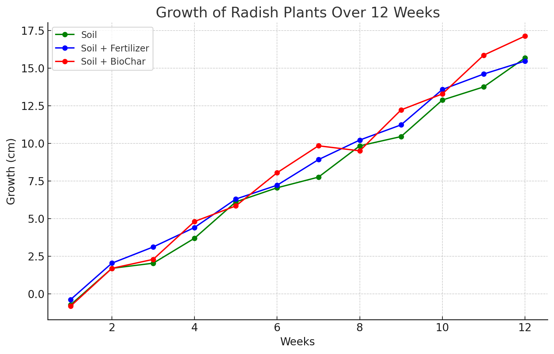
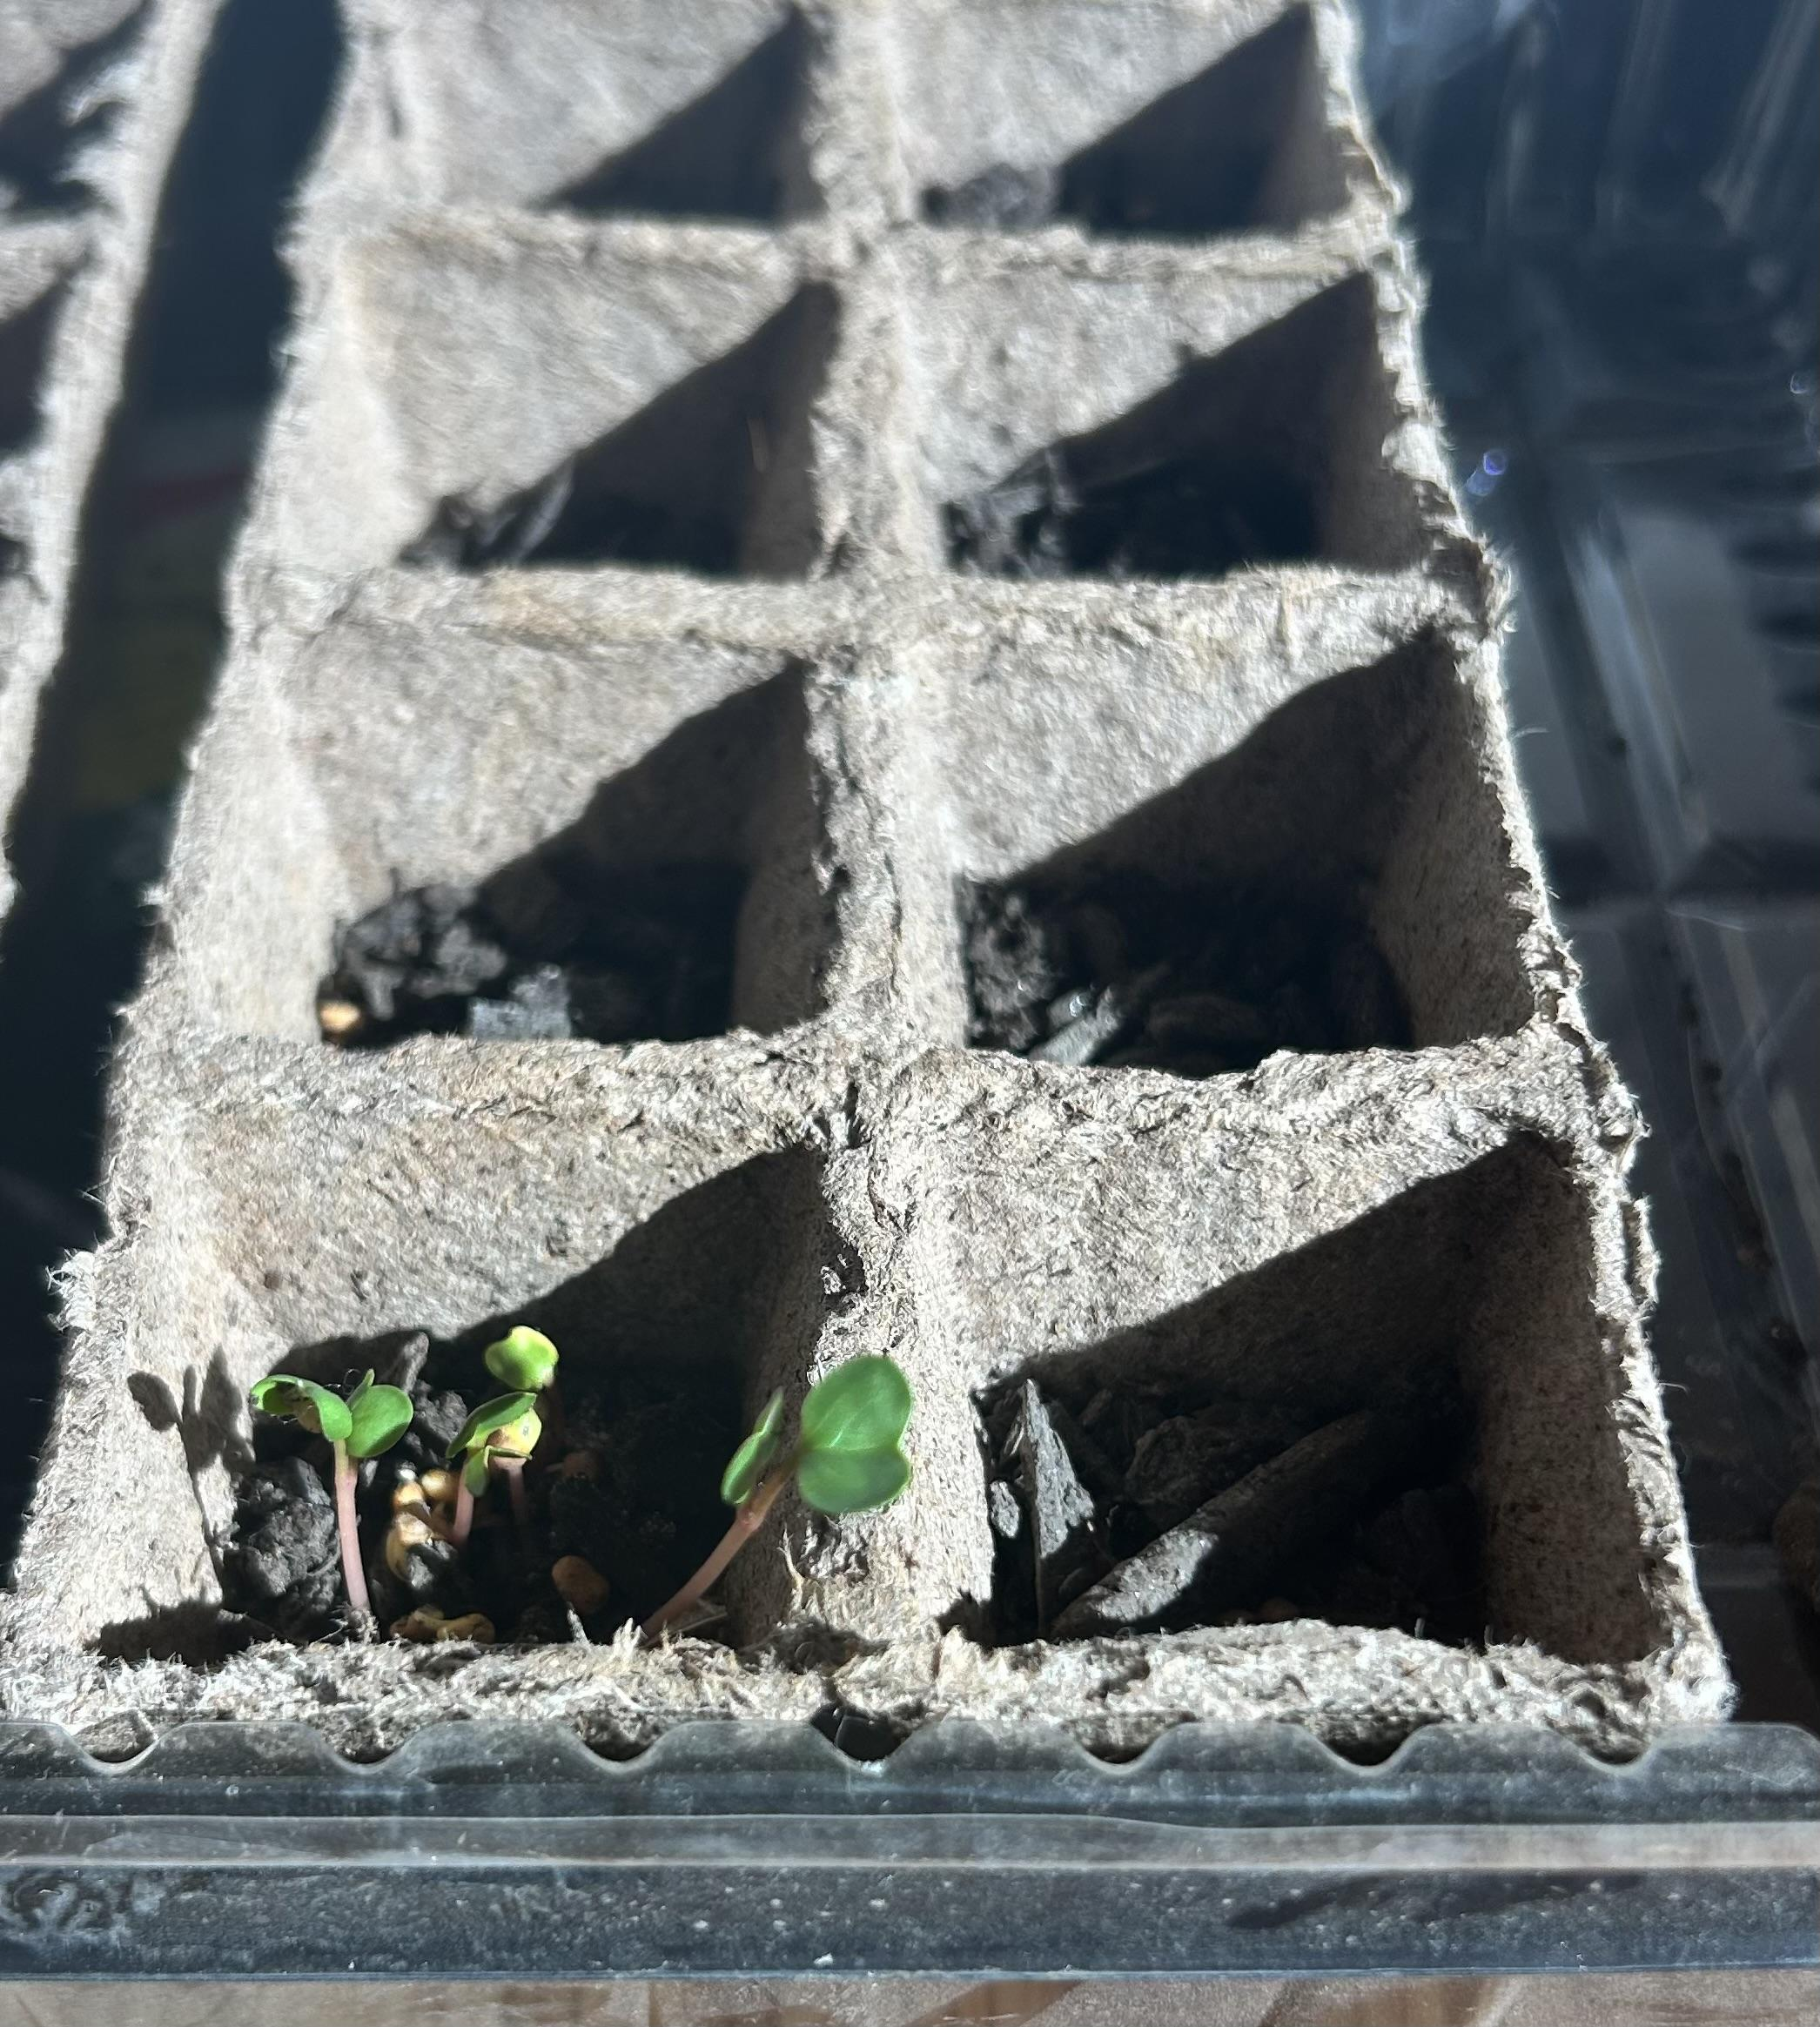
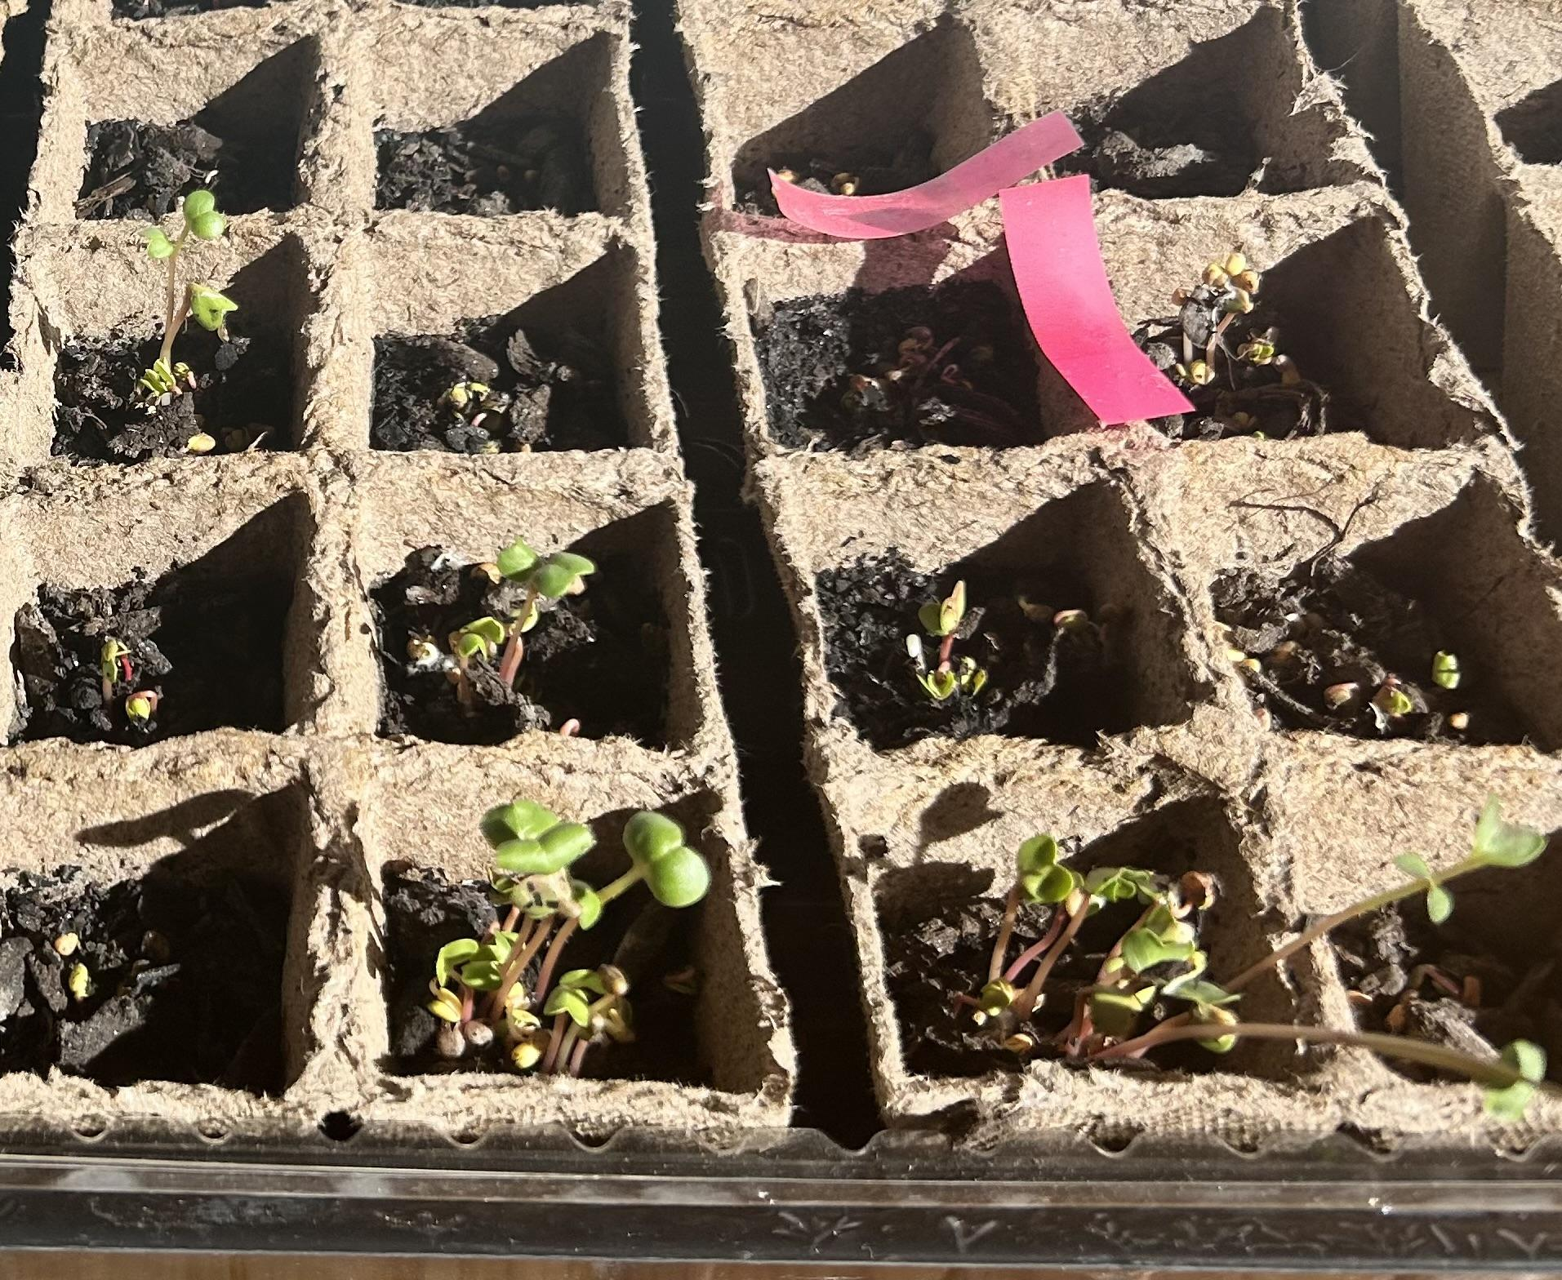






Bio-Char(ming) New England’s Soil Fertilizer
Shrewsbury High School, Shrewsbury, MA, USA
By: Aadrishma Dahal, Aashi Gupta, Aleena Shaikh, Amal Nadaf, and Rachael Laikangbam
Special Thanks to our mentor Anna Li and teacher advisor Dr.Duggan!
Objective: The objective of the project is to explore the effects of plant growth-promoting bacteria (PGPB) and nutrient-infused BioChar on Red-Arrow radish plant growth as a sustainable alternative to synthetic fertilizers for at-home plant growth. The study aims to determine if BioChar inoculated with naturally occurring PGPB can improve plant growth in nutrient-poor and rocky soils typical of New England, providing an eco-friendly solution for consumers.
Techniques Used:
Inoculation of BioChar with tomato extract and compost containing naturally occurring Bacillus and Stenotrophomona species (PGPB).
Growing radish plants in three conditions:
Biochar-infused soil
Soil with synthetic fertilizer (“Miracle-Gro All Purpose Water Soluble Plant Food”)
Untreated control soil
Weekly measurement of plant growth over three months, assessing plant height.
Technical Needs / Limitations:
Access to high-quality PGPB strains for better control over inoculation, more precise measurement tools for plant growth (e.g., digital growth measurement), and a controlled environment to mitigate the impacts of external variables like climate.
Limited access to commercial PGPB strains may reduce the scope of the study, and the challenging winter climate could have interfered with plant growth and yield, introducing variability in the results.
Expected Results: The study find that plants grown with BioChar inoculated with PGPB will show greater growth (in terms of height) compared to plants grown with synthetic fertilizer or untreated soil. This would suggest that biochar with PGPB is a viable and eco-friendly alternative to traditional fertilizers for improving plant growth in nutrient-deficient soils. The soil with nothing had an average growth of 15.12 cm tall whereas the fertilizer had an average growth 16.27 cm, the one with BioChar had 16.97 cm.
Control group (left) vs Biochar (right) Week 1

