Slide 1

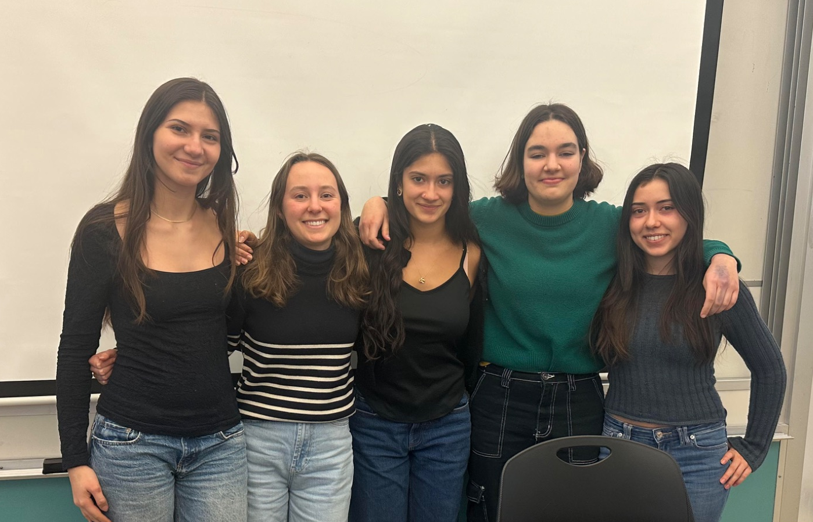
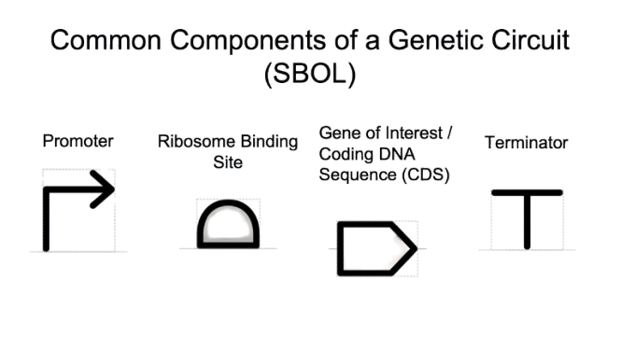






Echoing PETase!
Charlotte Eggimann, Nyla Tait, Roma Hatton Rueda, Nina Minsky, Jasmine Rancourt, Karin Schinkmann, Carine Robichon-Iyer, NEB, Mark Cherepashensky, BU
International School of Boston, Cambridge, MA, USA
Abstract:
This project aims to engineer cyanobacteria to express PETase and degrade ocean plastic. Cyanobacteria are adaptable, self-sufficient, and easily genetically modified, making them ideal for this application. As a proof of concept, E. coli will be used to test PETase expression and activity on PET films. Following successful results, the project will transition to Synechococcus sp. PCC 7002. The PETase gene will be modified with a secretion signal and inserted into a cyanobacterial plasmid. Engineered cyanobacteria will be evaluated for PET degradation under marine conditions.
Our Project
Part 1: Testing PETase expression and function with a cell free lysate applied to a thin PET film
GOAL: To express and test the function of the PETase gene from addgene: pET21b(+)-Is-PETase
We will test plasmid expression and function using cell-free expression with an E. coli lysate (e.g., NEBExpress system)
We will verify the expression of the plasmid using SDS-PAGE electrophoresis
The function of PETase will be tested with thin PET Films. The cell-free lysate can be applied directly to the PET films and we can check for degradation by looking for physical changes (e.g., surface roughness).
Part 2: Cloning PETase into Cyanobacteria
Chassis: Synechococcus sp. PCC 7002: widely used cyanobacteria for genetic modification and expressing foreign proteins like PETase due to high transformation efficiency and well-characterized genetic systems, naturally adapted to marine environments.
PETase Gene Expression in Cyanobactieria
  In part 2 we will clone the PETase gene into a suitable plasmid that is compatible with cyanobacteria. (like pPMQAK1). The plasmid should have a cyanobacterial promoter for expression, an antibiotic resistance gene for selection, and a secretion signal for protein export.
  The product will be verified using agarose gel electrophoresis to confirm the size of the insert.
  Finally, we need to check the extracellular medium to confirm the secretion of the PETase enzyme by performing activity assays (using thin PET films) to confirm the functionality of the secreted PETase enzyme.
Team Content
The Genies are happy to return for our second year at the BioBuilder Club Conference!
Next steps:
Looking to perform proof of concept in the lab
Publishing results of proof of concept
If our project is taken up by another team, and our proof of concept is successful, we would like them to complete part two of the experiment!
Introduction/Background
Plastic pollution is a major environmental issue, particularly harming marine life. This project aims to engineer marine-adapted cyanobacteria to express PETase, an enzyme that breaks down polyethylene terephthalate (PET), a common plastic. Cyanobacteria offer a renewable, biodegradable solution to plastic pollution. The project will begin by testing PETase expression in E. coli, then scale up to Synechococcus sp. PCC 7002 for larger-scale plastic degradation in marine environments.
Why cyanobacteria and not microalgae:
Cyanobacteria are preferred over microalgae for oceanic plastic degradation due to their adaptability, rapid reproduction, and ease of genetic modification. They also self-sustain through photosynthesis, making them ideal for marine applications. Microalgae, in contrast, require more specific nutrients and are harder to genetically modify. Cyanobacteria are well-studied for genetic engineering, whereas microalgae present more challenges.
References and acknowledgements
https://microbialcellfactories.biomedcentral.com/articles/10.1186/s12934-020-01355-8
https://earth.org/plastic-eating-enzyme/
We’d like to thank Carine Robichon-Iyer, Karin Schinkmann, and the BioBuilder team for helping us throughout the program.
Promoter
RBS
Signal peptide
PETase gene
Terminator

