Slide 1

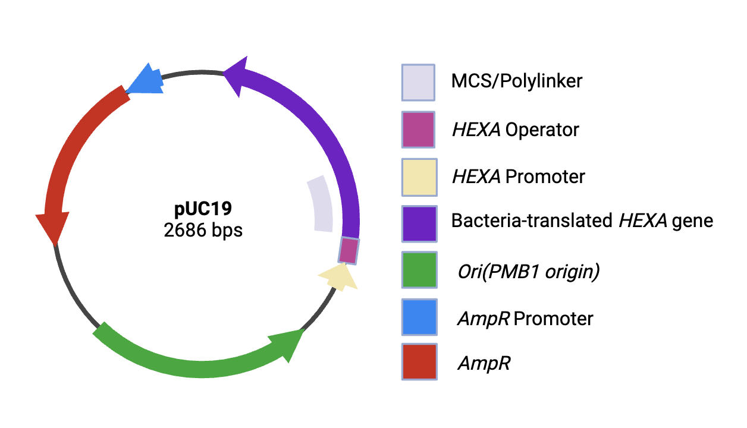







A Novel Synthetic Biology Approach for MPRA-Optimized Protein Cloning to Stop the Progression of Tay-Sachs Disease
Abhinav Dubba, Aditya Mukker, Nimal Murugan, Miya Nithin, Nila Prabhu, Vishesh Sood, Abhinav Yamujala, Catherine Sharer, Alyssa Morrow(Ginkgo Bioworks)
Lambert High School, Suwanee, Georgia, United States
Abstract
Tay Sachs, a rare neurodegenerative genetic disease caused by mutations in the HEXA gene, affects 1 in every 320,000 babies in the United States. To combat this problem, we propose engineering a plasmid to overproduce the alpha subunit of β-HexA and using MPRA arrays in order to increase the plasmid specificity. We plan to insert the modified plasmid into E.coli. We will then evaluate protein production using SDS page gel electrophoresis and a western blot. The MPRA arrays will be used for validation of plasmid efficiency. Using a neuron-specific cell line and comparing it to a liver cell line would allow us to test off-target effects.
Experiment Details/Plans
Learn: Our team researched an innovative solution to Tay-Sachs disease by engineering a plasmid to overproduce the β-HexA protein via bacterial cloning.
Design: Edit the pUC19 plasmid using the BL21(DE3) strain (an E.coli cloning vector that expresses the Amp resistance) by replacing the lacZ gene, a reporter gene which encodes beta-galactosidase with the HEXA gene, a gene that encodes the production of the alpha subunit of β-HexA.
Test/Build: Using materials from the BioBricks parts registry, our team plans to build a plasmid to overproduce the alpha subunit of β-HexA and uses MPRA arrays in order to increase the plasmid specificity and test its efficiency. We will test the effectiveness of the plasmid by using gel electrophoresis and a western blot to test for the presence of β-HexA. From both of these tests, we aim to maximize the output of the HEXA gene.
Team Content
We are a new team with seven members, two of whom are returning from last year. Our experience with iGEM and BioBuilder has been very inspiring, and we have enjoyed working together to find new solutions. After extensive research and brainstorming, we settled on studying Tay-Sachs disease due to its uniqueness and complexity. We split our team into 2 subgroups based on our individual strengths: synthetic biology and artificial intelligence. Our first subgroup focused on finding an optimal plasmid to use for testing and creating graphics that accurately represented our solution. Our second subgroup focused on programming an AI model to validate plasmid efficiency. By splitting up our team, we were able to be more efficient and ensure that our solution was accurate and realistic.
Next steps:
Insert the modified plasmid into E.coli and evaluate protein production
Test the plasmid in mammalian cells (This is not something that we can do while in high school, however, it is something we would like to test in the future.)
Test insertion methods and create a solution that can house the β-HexA to reach the CNS safely through the spinal cord.
Lessons
One major lesson we learn from this experience is how to stay resilient despite the challenges that occur. We ran into many issues while finding the parts for our plasmid, but with the guidance of our mentors, we continued to push through and eventually solved the issues.
Problem
Tay-Sachs disease can be caused by 210 different mutations to the alpha subunit of the HEXA gene, causing a deficiency in the beta hexosaminidase-A(β-HexA) enzyme found in the nervous system lysosomes. This enzyme works to clear GM2 gangliosides out of the brain and spinal cord and, when unregulated, can cause widespread neuronal death and decreased lifespan.
Tay-Sachs has no known cure, and finding a way to target every individual mutation and cure it would take years of research without factoring in development, as well as having no way to revive the dead neurons.
Instead of focusing on an unsolvable problem, we chose to stop the progression of the disease and increase the life expectancy of Tay-Sachs victims. By inserting a healthy bacteria-translated HEXA gene into a cloning plasmid, we can produce as many copies of the gene as needed and produce β-HexA. After production, we can extract the β-HexA and put it into a solution that can be injected into the spinal cord. Once administered, the enzymes will function naturally and regulate the gangliosides in the CNS, stopping the advancement of the disease.
Model
References and Acknowledgements

