Slide 1

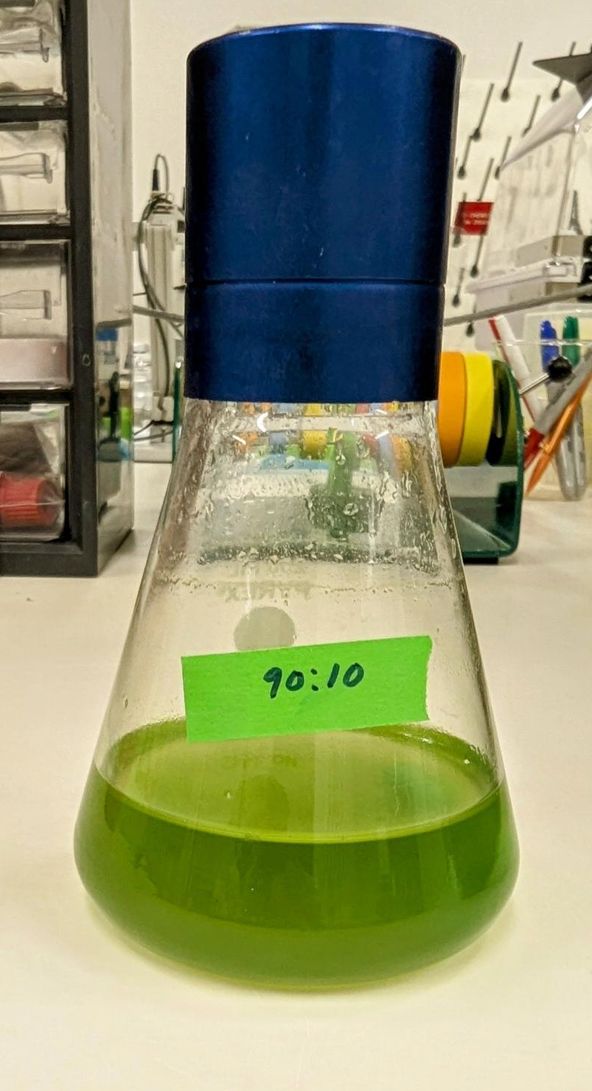
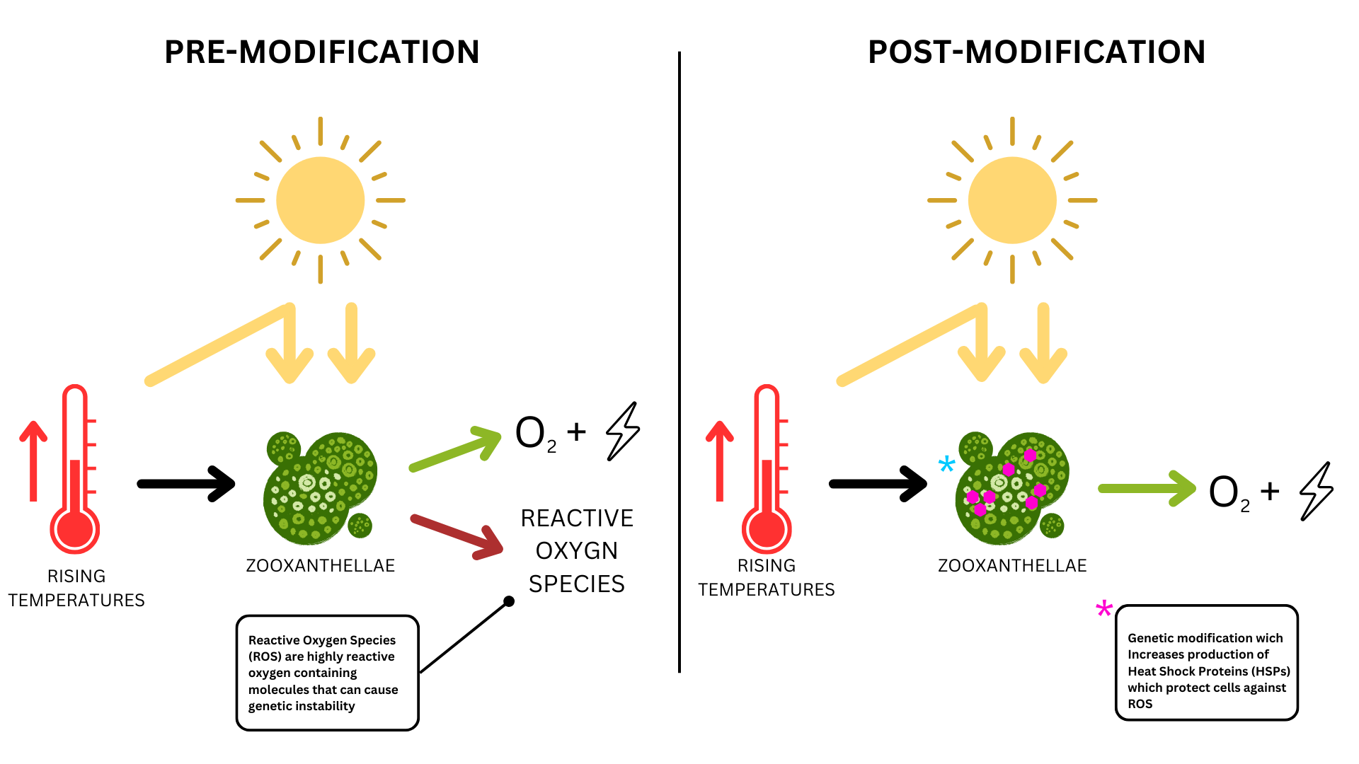
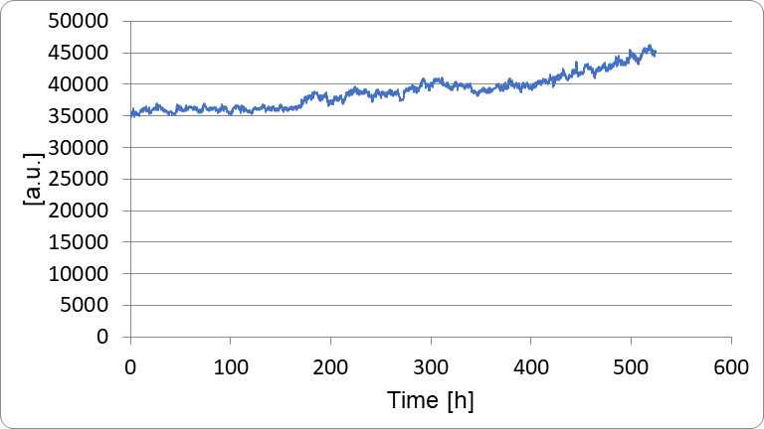






PRJCT SCRaPES
Mia McVey, Liam Klug, Lyle Musesengwa, Ellen Klug, Eric Jorgenson (ETSU Research Corp.)
Dobyns-Bennett, Kingsport, TN, USA
Aim to reduce coral bleaching
Used commercial algae supplement, quadrant streaking, and flasks for incubation
Able to experiment and model algal growth, but unable with current equipment to simulate a complete ecosystem
Results showed the successful isolation of Zooxanthellae, the first step in the genetic modification process

