Slide 1

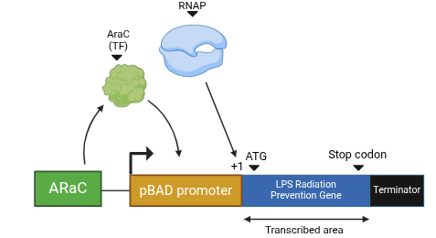
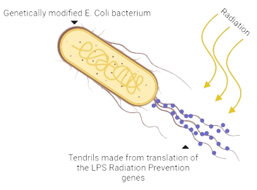
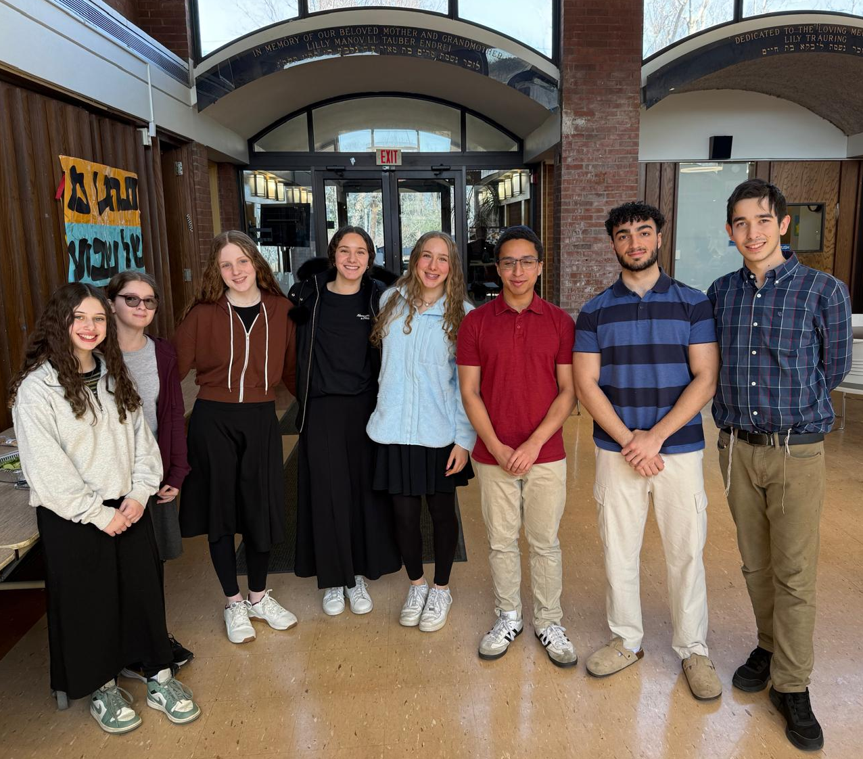
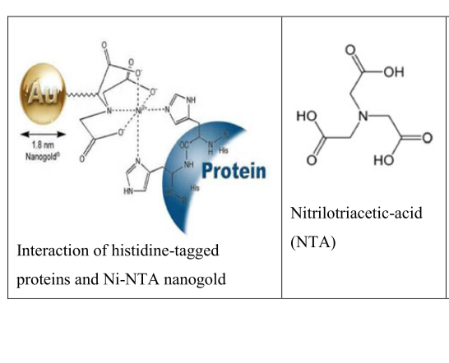
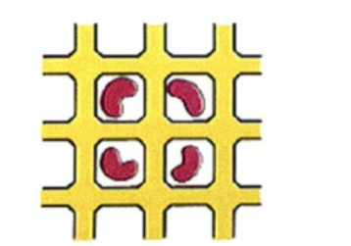
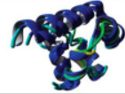







Next-Gen Bioremediation: Regenerable LPS Vesicles for Uranium Sequestration
Hayim Sims¹, Amalya Fischer, Eliana Goldenholz, Rebecca Gold, Shlomo Vedol, Aaron Missaghi, Leah Kaplan, Shaindle Kaplan,
Maria Lazebnik², Scott Gaines³ (Boston University)
Maimonides School, Brookline, Massachusetts, United States of America
Abstract
Design
Discussion and Future Outlook
Nuclear power is a source of alternative energy. However, atomic energy releases harmful byproducts, such as uranium. Exposure to heightened levels of uranium damage the kidney, and act as a carcinogen. Lead-lined storage containers store uranium until radioactive decay; however this also causes harmful health effects. Our study shows a novel, scalable way to reduce radiation pollution through synthetic biology-based bioremediation. We leverage proteins characterized in the Geobacter bacteria (Clark et. al, 2021), which produce a lipopolysaccharide (LPS) vesicle that traps uranium and prevents it entering and damaging a cell’s contents. Through this, our system uses Eschericschia coli (E. coli) and a pBAD inducible promoter system to express genes from Geobacter, efficiently providing bioremediation sought. Sequences are modified with Nickel-NTA (Ni-NTA) tags to allow for purification of the product, and Sterile Alpha Motif (SAM) for embedding in materials to construct vesicles capturing uranium. An E. coli-based system ensures mass production, and embedding enables the LPS vesicle to be regenerated after use for continuous utilization in safely dispersing and remediating uranium waste. Our study’s approach aids nuclear facilities and devices geared towards radiation protection. Moreover, this study presents a simple, effective methodology for designing protein systems through techniques in synthetic biology for potent, wide-scaled waste remediation.
Figure 1. Genetic circuit pathway for expression of Geobacter genes.
This study investigates embedding proteins in materials for radiation reduction. Geobacter exhibit the ability to absorb or dissipate radiation, making them promising candidates for integration into protective and remediating structures. The primary application of this approach is environmental, focusing on cleaning up uranium radioactive contaminants. With the SAM-embedded proteins, this methodology presents a structured and efficient pathway addressing radioactive waste, making bioremediation precise and adaptable. Nevertheless, the same methodology is applied beyond radiation reduction to other remediatory pathways.
Beyond radiation remediation, this concept could extend to tackling waste management. This could contribute to a cleaner, efficient industrial disposal process. With proper application, SAM-embedded proteins facilitate controlled degradation for plastics, improving breakdown strategies by producing Serine Hydrolase, an enzyme known for its catalytic ability to break down specific contaminants, sourced from certain worm species.
Despite its potential viability, this design requires extensive testing. Stability must be evaluated to ensure proteins function in real-world conditions. With strong foundations, genetic circuits engineering with SAM protein integration, this technology presents a route for radiation reduction and bioremediation solutions.
(A)
(B)
In this genetic circuit (Fig. 1A), an inducible pBAD operon in which the araC gene is responsive the the levels of arabinose sugar present (more arabinose accounting for araC expression), produces the araC protein functioning as transcription factor - binding to the pBAD promoter to attract RNA polymerase.. Once RNAP binds to the start site (+1), transcription of LPS radiation prevention genes begins. We are inserting the genes characterized for vesicle-construction in their structure which has been saved in the NCBI database.
Once genes of interest are transcribed, radiation prevention proteins translation begins. E. coli is used as a chassis (Fig. 1B), as it works with the pBAD operon. pBAD is also a well studied system and allows for removing an radiation through bioremediation on a scale which has never been attempted before.
References & Acknowledgements
Introduction
Irradiated materials have dangerous, carcinogenic effects. Current technology abating radioactivity consists in shielding behind lead-laden containers, and waiting for decay to reduce radiation. These methodologies, effective over the long-term, are not suitable with increasing radiation, and lead is harmful to humans and the environment. By assembling specialized lipopolysaccharide (LPS) tendrils, Geobacter prevents harmful substances penetrating into its membrane and remediates the element through reduction reactions in vesicles. This study uses characterized proteins of Geobacter and synthetic biology to construct a pathway for efficient LPS vesicle construction. Using an inducible pBAD operon system in E. coli, genes coding for bioremediation are expressed. Novelly, this study suggests pathways for production and embedding of bioremediatory proteins to reduce environmental pollution.
Our Team!
We want to thank Dr. Scott Gaines for mentoring us the past two years in projects, and Dr. Maria Lazebnik for all of her assistance organizing and teaching us. Thank you to Dr. Natalie Kuldell for founding this program for students such as ourselves, and Chloe Franklin for setting everything up!
Figure 2. Bioremediatory constructs by systemic vesicle-embedding.
(A)
(B)
(C)
While the genetic circuit allows construction of radiation-reducing proteins, purification and embedding applies its use to devices in the long term. Sequences are modified with histidine-tagged proteins and Nickel-NTA nanogold (Fig. 2A) for purification, and Sterile Alpha Motif (Fig. 2B) for embedding in constructed devices (Fig. 2C). These additions ease the process of creating technology, preserving proteins for regeneration.

