Slide 1





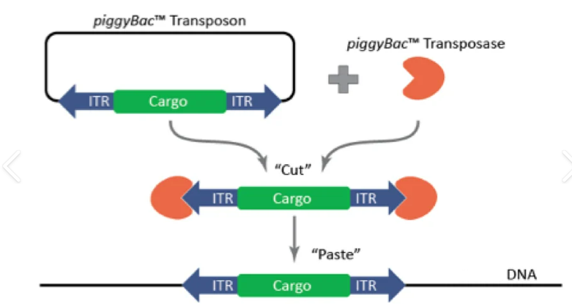
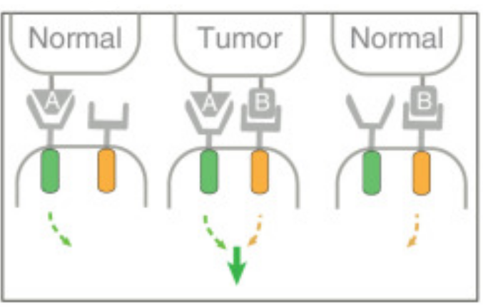

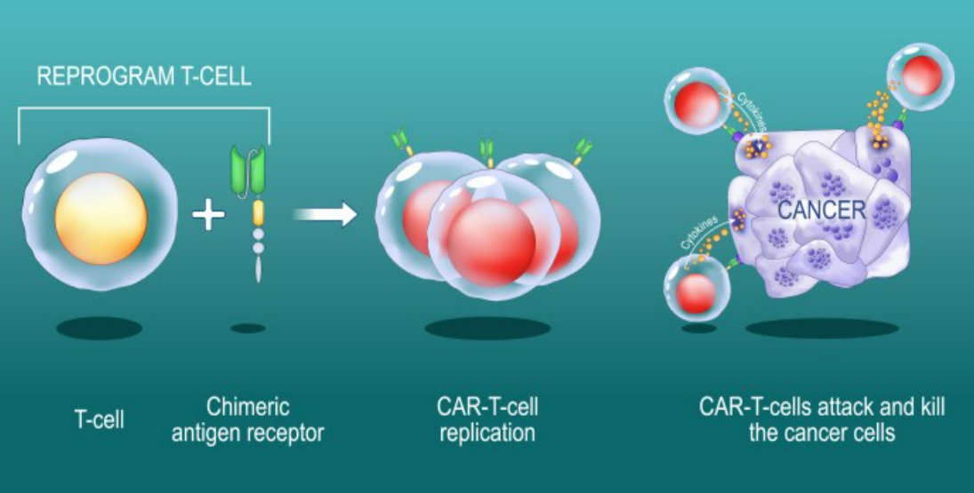






Boolean-Logic Gated Engineered CAR T-Cells for Pancreatic Ductal Adenocarcinoma Therapy
Adhithi Arun, Jerry Ji. Dr. Pavithra Natarajan
Livingston High School, Livingston, NJ, USA
Pancreatic Ductal Adenocarcinoma (PDAC) is a highly aggressive form of cancer responsible for nearly half a million deaths annually worldwide. Chimeric Antigen Receptor (CAR) T-cell therapy in solid tumors is challenging due to antigen escape, heterogeneity observed and off-target effect. Therefore, we demonstrate the use of Boolean logic to target the antigens Mesothelin (MSLN) and Epidermal Growth Factor Receptor (EGFR) for enhanced tumor discrimination and limited off-target effects.
Science Content: Experimental Details
Antigen Selection: MSLN & EGFR were chosen using the Antigen Explorer Database for PDAC.
Gene Delivery to CAR T-Cells: piggyBac Transposon System, using pNB328-meso3 CAR plasmid and pIRII-CAR.EGFR(EGFv1) CAR plasmid
CAR T-Cell Activation: EGFR provides primary activation signal (CD3ζ) and the second CAR (MSLN) provides the costimulatory CD28 signal.
Anticipated Data
Expecting to see more PDAC tumor killing.
Less off-tumor targets - more specificity to only PDAC cells
Team Content
New team, 2 members
Next steps:
Determine whether the combination of EGFR and MSLN produces a robust immune response against PDAC.
Try to determine the number of cancer cells remaining in culture using cell counting assays. Could also perform killing assays.
Introduction/Background
CAR-T Cell Therapy → Difficulties in Solid Tumors: Antigen Escape, Heterogeneity, Off-Target Effect
Solid Tumors Express Variety of Antigens. Engineer CAR T Cells With Combinatorial Boolean Logic → Recognize Target Cells + Improved Specificity
AND-Gating: Requiring two antigens to be present.
MSLN: Tumor Progression, Cell Survival + Proliferation, resistance to apoptosis, etc. in PDAC. EGFR: Proliferation + Resistance to Apoptosis. Both Expressed in PDAC.
ITR: Inverted Terminal Repeats
References
Acknowledgements
We’d like to thank Dr. Natarajan for her guidance and support.
NORMAL
TUMOR
NORMAL
Reprogram T-Cell
Cytokines
Cancer
Chimeric Antigen
Receptor
CAR T-Cell
Replication
CAR T-Cells attack and kill the cancer cells
T-Cell
T-Cell
Both antigens must be expressed for CAR-T Cell Activation.

