Slide 1

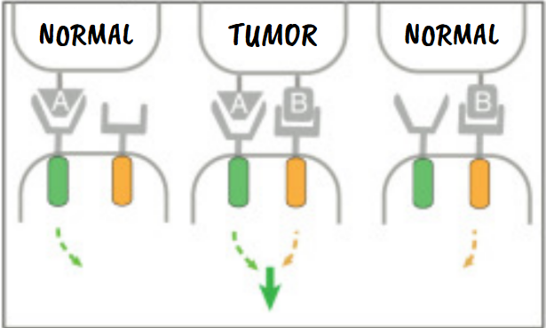






Boolean-Logic Gated Engineered CAR T-Cells for Pancreatic Ductal Adenocarcinoma Therapy
Adhithi Arun, Jerry Ji. Dr. Pavithra Natarajan
Livingston High School, Livingston, NJ, USA
Limitation: CAR T-Cell Therapy → Difficulties in applying to pancreatic ductal adenocarcinoma due to Antigen Escape, Heterogeneity, and Off-Target Effects.
Technique: Engineer AND-Gated CAR T-Cells to Increase Specificity and Reduce Off-Target Effects.
Expected Results: Reduced Tumor Growth + Less off-tumor targets.
Overall more cancer-specific killing.
MSLN EGFR

