Slide 1







Localized Immunosuppression for Lung Transplants
Tanishka Singh, Meileen Trinh, Kirsten Choi, Komal Jasuja. Mary Liu. Peter Horanyi.
Weston High School, Weston, Massachusetts, United States.
Abstract:
Lung transplants are life-saving procedures for patients with severe respiratory diseases, but nearly 90% face rejection due to an aggressive immune response. While current immunosuppressants like calcineurin inhibitors (CNIs) help prevent rejection, their widespread immune suppression increases the risk of infections, cancer, and impaired tissue repair. To address this, we propose a localized immunosuppressive approach using PD-L1 mRNA therapy.
Our project aims to enhance lung transplant acceptance by delivering PD-L1 mRNA directly to lung tissue, promoting local PD-L1 expression. PD-L1 binds to PD-1 receptors on T-cells, inhibiting their activation and reducing transplant rejection. Unlike systemic immunosuppressants, this method targets only the transplanted lung, minimizing harmful side effects. By introducing PD-L1 mRNA into lung cells, we can achieve a temporary, adjustable immunosuppressive effect, allowing for controlled management of immune response over time.
Introduction/Background
Lung Transplant Rejection and Immunosuppressant Drawbacks:
Lung transplants are life-saving procedures for patients, but nearly 90% fail due to acute rejection, where the immune system attacks the transplanted organ due to the body recognizing it as foreign. To prevent this, the current standard of care involves administering oral immunosuppressants, which help protect the transplant but also weaken the immune system throughout the body. This increases the risk of infections, cancer, and impaired tissue repair, making long-term recovery challenging. We aimed to address this issue for our project.
Why Localized Therapy is Better:
Our solution to the problem was creating a localized immunosuppressant. A more targeted approach could reduce transplant rejection while avoiding widespread immune suppression. By locally suppressing immune activity in the transplanted lung, patients could maintain normal immune function in their bodies, lowering the risks of systemic immunosuppressants. Our aim was to find a protein that could inhibit T-cell activity specifically within the transplanted tissue.
Proposed Approach:
We identified the PD-L1 protein as the best candidate, as it naturally suppresses T-cell activation. To deliver it effectively, we plan to use lipid nanoparticles carrying PD-L1 mRNA, ensuring local expression within the lung. Since PD-L1 has a short half-life, we aim to extend its stability to around a week, allowing controlled immunosuppression while minimizing the need for constant drug administration. Our approach could provide a safer, more precise alternative to traditional immunosuppressants, improving transplant success and patient outcomes.
Science Content
Our project aims to use PD-L1 to suppress immune rejection in lung transplants by delivering its mRNA directly to the transplanted tissue. We’ve designed an experiment that involves protein production, mRNA synthesis, in vivo testing, and immune response evaluation.
PD-L1 Protein Production & Purification
We will produce PD-L1 in HEK-293 or CHO cells using a plasmid with a CMV promoter to drive high protein production. After production, we will purify the protein using affinity chromatography and remove tags with specific proteases to ensure the protein is in its natural form. Endotoxin levels will be checked to ensure safety for in vivo testing.
mRNA Generation & Delivery
Instead of using PD-L1 protein directly, we will synthesize mRNA encoding PD-L1 and deliver it in lipid nanoparticles (LNPs) to cells, allowing them to produce PD-L1 in the transplanted tissue.
Rodent Transplant Model & Immune Response Evaluation
We will use a mouse model with a humanized immune system to test our approach. Lungs from genetically identical littermates will be transplanted to eliminate genetic rejection. We hypothesize PD-L1 will suppress immune rejection by inhibiting T-cell activation. Blood tests and immune system tests (such as C-reactive protein (CRP)) will evaluate the effectiveness of the treatment as it will allow us to observe markers of rejection and immune system activity.
Optimization & Troubleshooting
If immune suppression is too strong, or the results do not go as planned, we plan to recalibrate and retry our tests. We will try experimenting by reducing PD-L1 dosage, adjusting the protein structure, or changing the protein or delivery method to improve effectiveness.
Team Content
We are a new BioBuilders team with four members—one senior, two juniors, and one sophomore—united by our passion for biology and research.
Next Steps
Optimizing mRNA Delivery: Improve stability, effectiveness, and duration of PD-L1 expression to enhance lung transplant survival while reducing risks associated with standard immunosuppressants.
Future Research Directions: Explore better protein administration methods to prevent bloodstream integration and identify alternative immunosuppressive proteins with fewer side effects.
References and acknowledgements
“Lung Transplant.” Www.ucsfhealth.org, www.ucsfhealth.org/treatments/lung -transplant.‌
“Tests for Lung Patients.” Ucsfhealth.org, www.ucsfhealth.org/education/tests- fo r -lung-patients.
We would like to thank Ms. Liu and Peter Horanyi for their support, guidance, and patience.

Slide 2
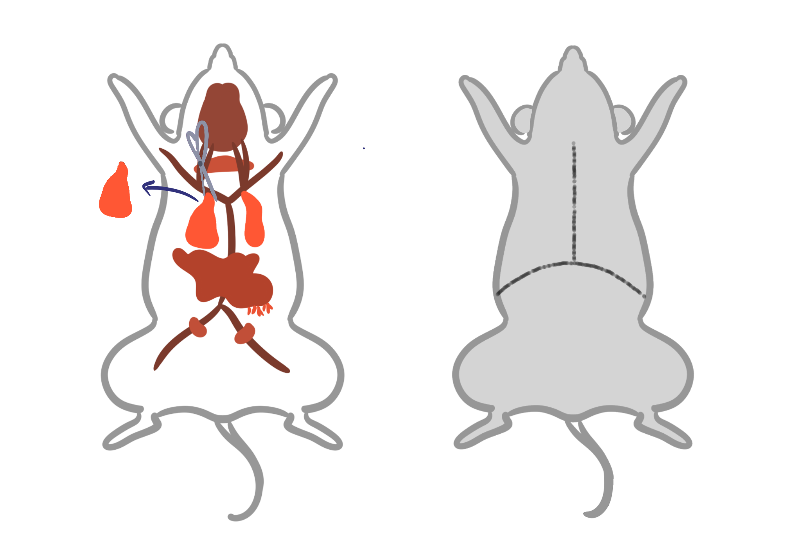
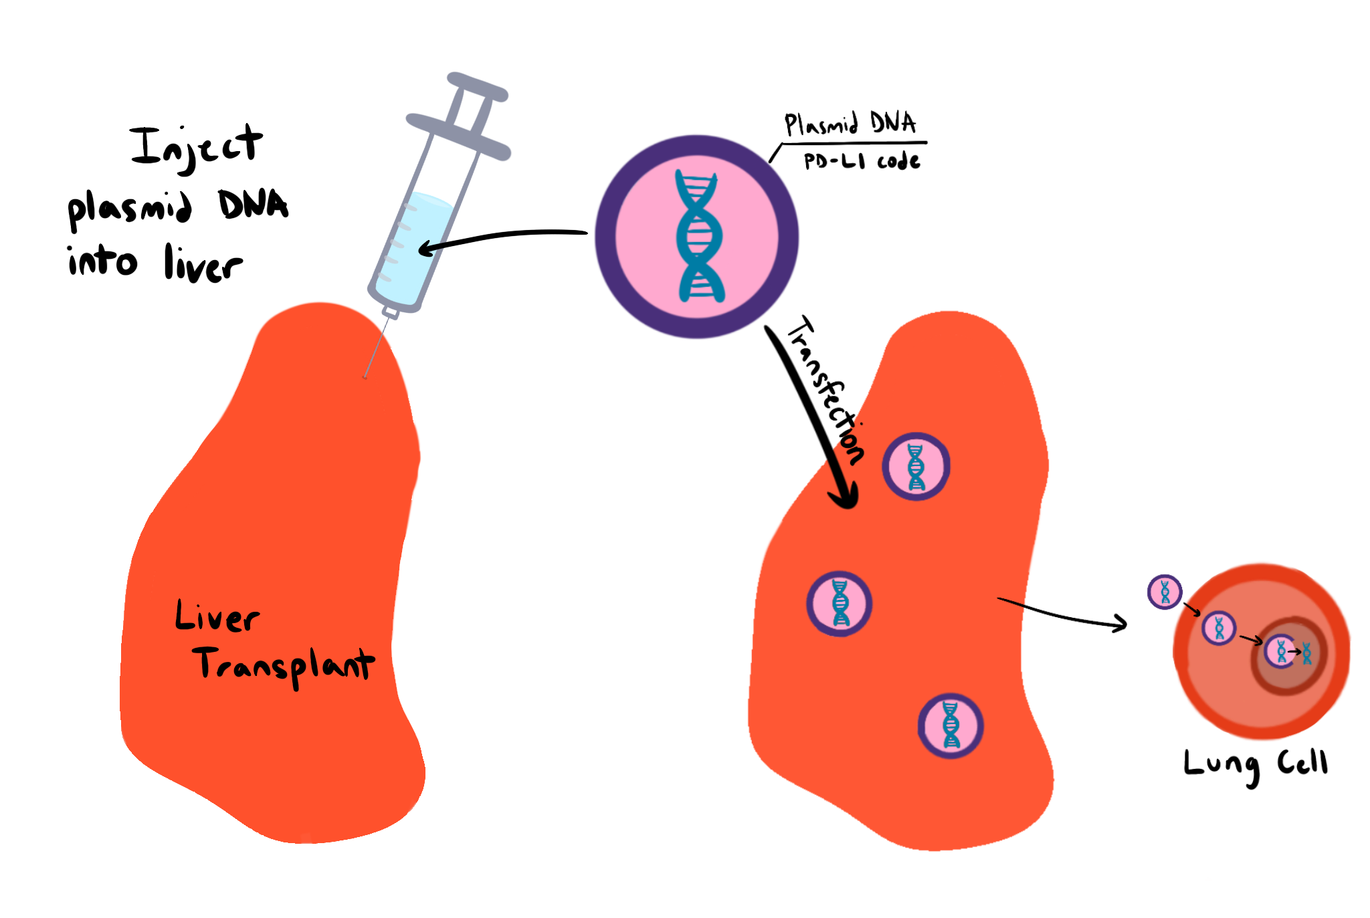
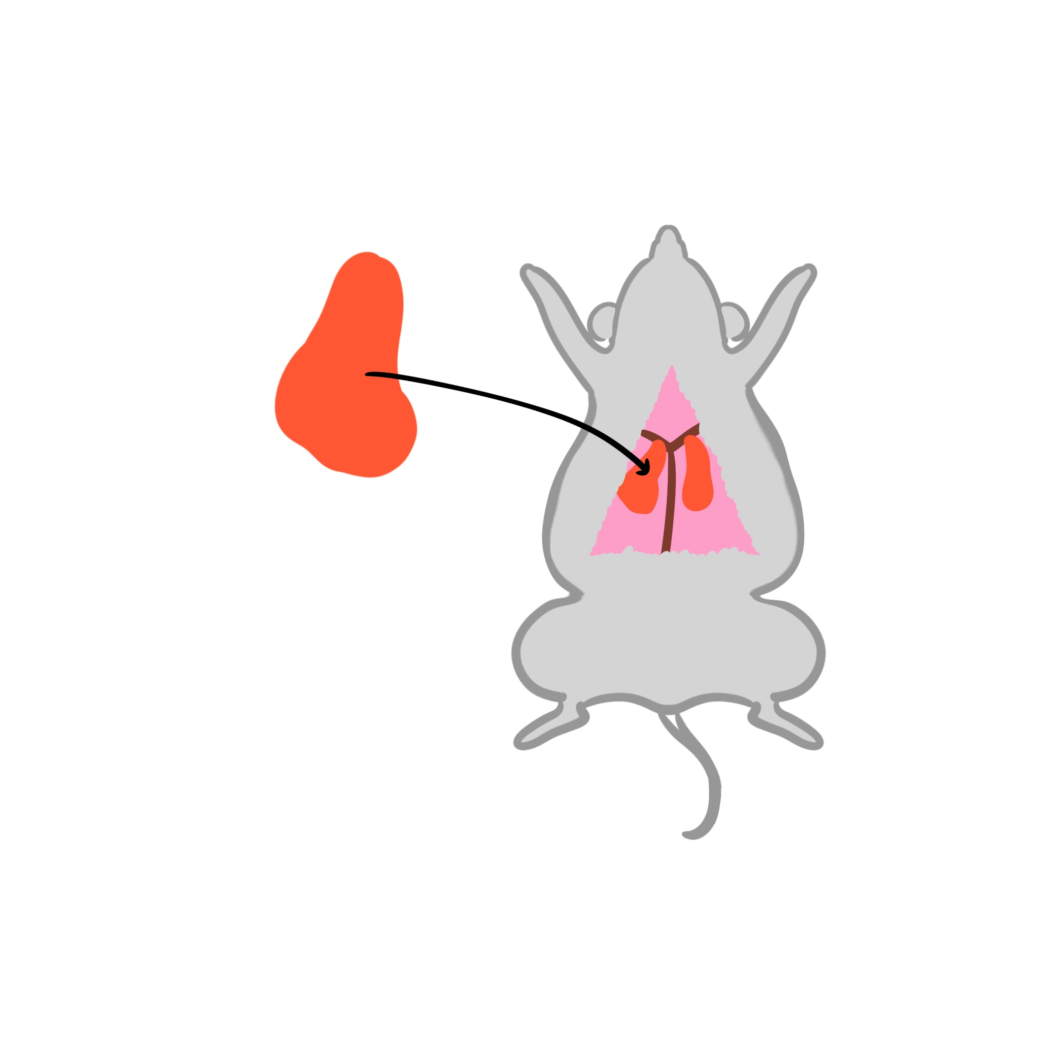
Assumption: Experiment in animals with similar immune systems
Start
Express + Purify Proteins
Extract transplantable organ from donor mouse + prepare mouse to receive organ
Adjust dosage size + check every day
Analyze results over time + Troubleshoot
Treat transplantable organ by injecting the plasmid DNA into it
Measure results, focusing on immune response/rejection
Do Surgery

