Slide 1

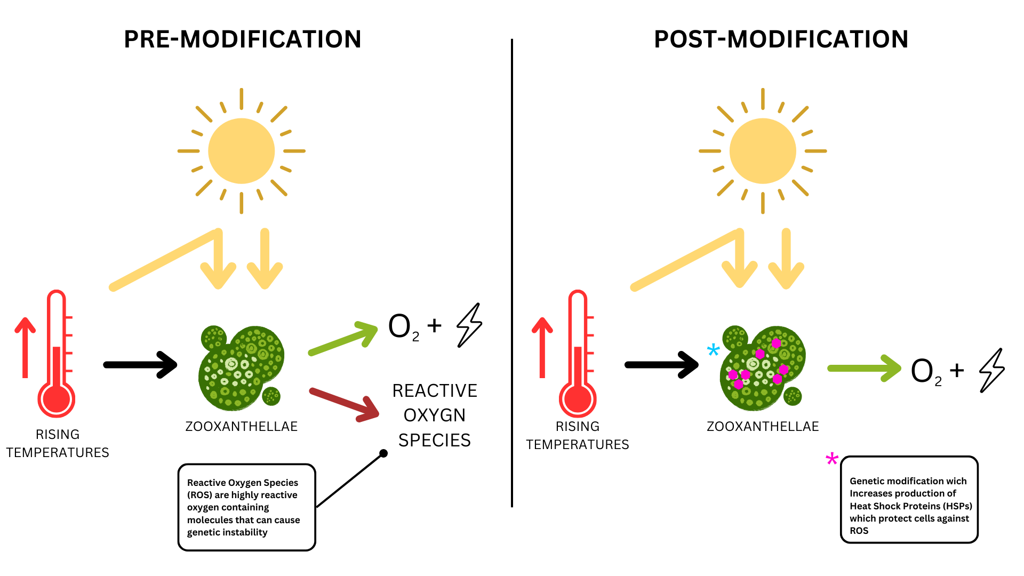
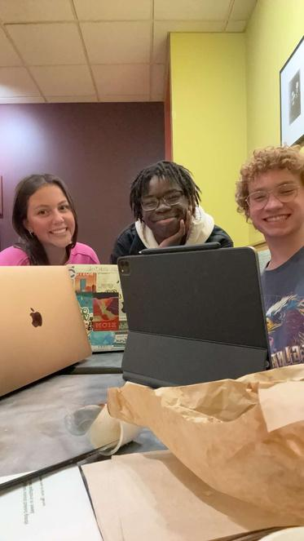
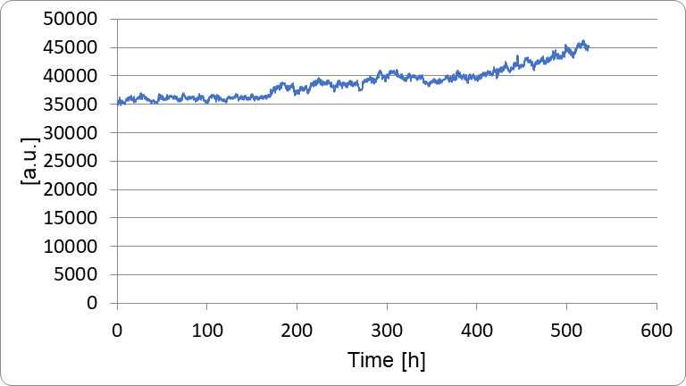
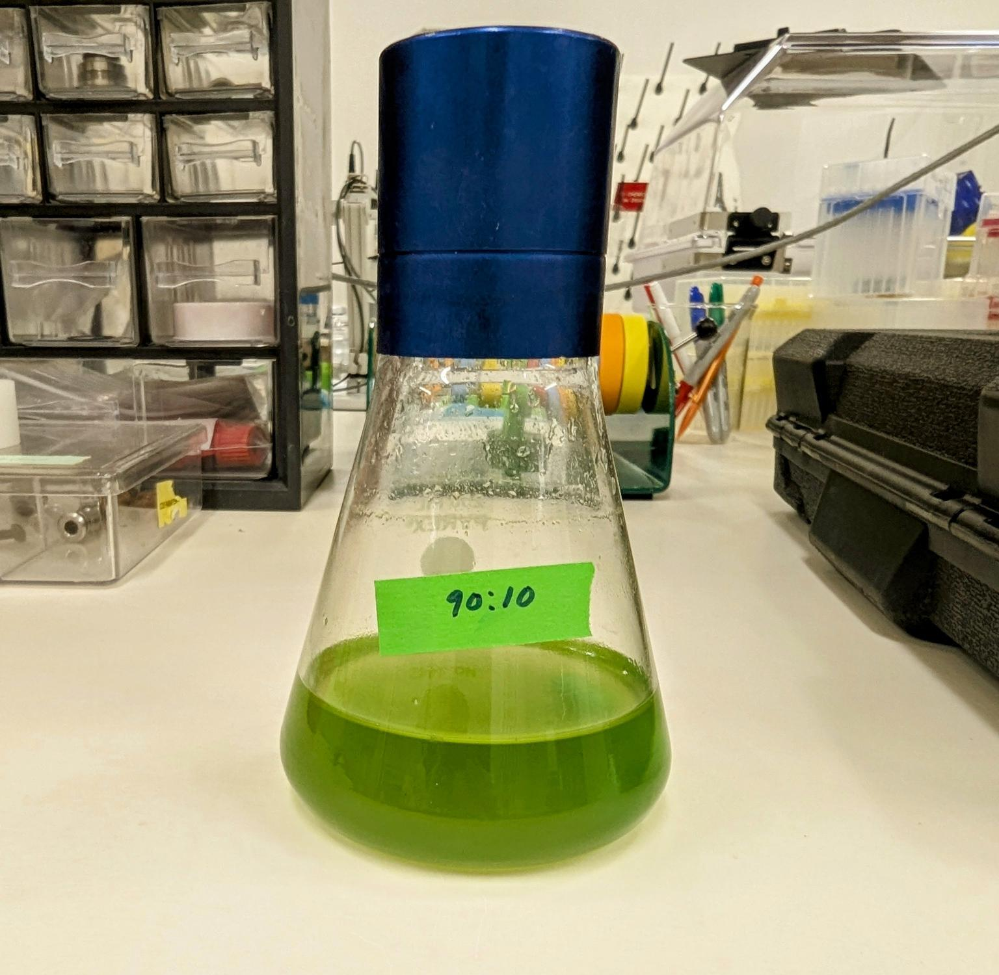







PRJCT SCRaPES
Mia McVey, Liam Klug, Lyle Musesengwa, Ellen Klug, Eric Jorgenson (ETSU Research Corp.)
Dobyns-Bennett, Kingsport, TN, USA
Abstract
Ocean acidification is driven by the proliferation of greenhouse emissions in the atmosphere, referred to as Global Warming. Increased temperatures in the ocean have a direct, adverse impact on ocean ecosystems, including coral. Coral holds a symbiotic relationship with the microalgae, Zooxanthellae. However, as temperatures rise, Zooxanthellae produces reactive oxygen species that harm the host coral. As a result, the Zooxanthellae is expelled from the coral as a protective measure, killing the coral in what is known as coral bleaching. This project aimed to discern a method of isolating Zooxanthellae as the first step in conducting genetic modification to improve heat tolerance through increased production of Heat Shock Proteins (HSPs). Ultimately, Zooxanthellae was successfully isolated and cultivated, and procedural next steps to increase the production of HSPs have been outlined.
Scientific Content
Team Content
We are a newly registered team with three members! We have two seniors, Lyle and Liam, and one junior, Mia.
Our passion for biology sparked from taking Mrs. Lafollette’s Honors Bio class during our freshman year. We met through the band and decided to continue our interest through the BioBuilders program. We are most “productive” at Panera with some bagels and honey walnut cream cheese!
Next Steps
This year, we succeeded in our next steps of conducting related experimentation. However, there is more to be done, and we only touched the surface. Future steps would include finding the most optimal form of genetic modification for the algae, and how we can introduce genes to increase HSP production within the algae itself. This would help to combat the negative effects from rising ocean temperatures.
Heat shock proteins (HSPs) act as molecular chaperones, helping to refold and repair proteins damaged by oxidative stress caused by
ROS. In response to oxidative stress, cells increase production of HSPs to manage the damage caused by ROS accumulation.
Introduction/Background
The bleaching of coral destroys many marine habitats and ecosystems. However, there are not adequate measures being taken to address this issue. Coral bleaches–or loses its color–due to the loss of the microalgae Zooxanthellae. This organism lives harmoniously with coral and provides the required nutrients for coral survival. When water temperatures rise, the microalgae produce reactive oxygen species that overwhelm the coral, ultimately leading to Zooxanthellae expulsion. However, because both organisms rely on each other, both organisms die in this common bleaching scenario. Coral bleaching is being seen on a larger scale than ever before, including on the Great Barrier Reef. While adverse for the environment, larger scales are finally bringing more awareness to the growing issue at hand.
Special thanks to Eric Jorgenson!
References s
This graph illustrates the growth of algae over time in an experimental flask. The flask was supplied with 90 mL of F/2 liquid media and 10 mL of PhycoPure algae Zooxanthellae supplement. The trendline shows the initial slow growth and then steady growth from 200-500 hours. It can be seen that the algae grew very slowly initially.
Notes:
NOTE FOR SELF FOR TOMORROW: CHANGE Zooanth. CAPITALIZATION

