Slide 1

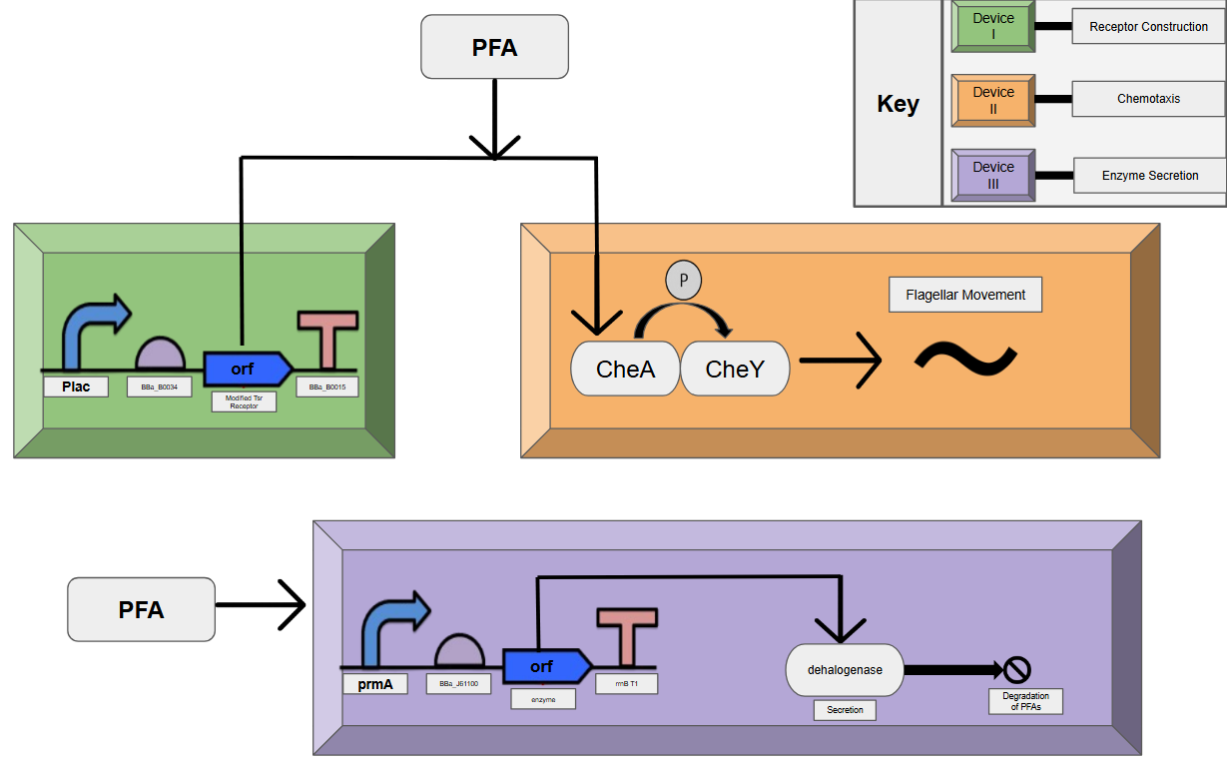






Enzymatic Degradation of PFAS
Anuj Gopal, Abhiruph Seetha Raman, Dylan Hendrixson (Tufts University)
Westborough High School, Westborough, MA, USA
Polyfluoroalkyl substances (PFAS) are commonly found in plastics, clothing, adhesives, and food packaging. They are considered “forever chemicals” due to their robust carbon-fluorine (C-F) bonds, and do not easily degrade in nature. This project addresses the growing issue of PFAS contamination and offers a safe solution to aid the environment and the health of humans and animals. The design involves modifying Pseudomonas putida as the chassis, due to its natural degradation properties. The devices focus on creating chemoreceptors, utilizing chemotaxis, and secreting the 4-fluorobenzoate dehalogenase enzyme to track and degrade the PFAS.
The DNA sequences for our parts came from the Registry of Standard Biological Parts. The design contains 3 devices. Firstly, Device I constructs the modified chemoreceptors that bind with PFAS molecules. Device II takes the outputted receptors from Device I as its input to harness the chemotaxis process. Each protein in the pathway phosphorylates the next one until the signal reaches the flagellum and the chassis moves to the areas of higher concentration. Device III constructs and secretes the enzyme through exocytosis and functions concurrently with Devices I and II. Both Devices I and III are composed of a promoter, RBS, ORF, and terminator.
Future experiments/investigations include: investigating with possible signal peptide solutions, researching other types of PFAS degradation methods including ultrasound and UV radiation, and investigating the CRISPR gene-editing tool to modify protein binding sites. Additionally, adding cofactors would make the enzyme more efficient. Finally, experimenting with different environmental conditions, like pH and temperature, will allow for the best understanding of its limitations and potential.
This is our first year competing in BioBuilderClub as a two-member team. Through brainstorming, designing, and writing up our project, we’ve gained valuable skills in analyzing research papers, building on existing work, and reporting our findings. By exploring topics like chassis, DNA replication, and chemoreceptors, we were able to broaden our understanding of synthetic biology as a whole.
Our project focuses on designing the enzyme, pairing it with a chassis, and fine-tuning the conditions it works in. In the future, this project can be developed by introducing a cofactor to optimize the enzyme’s activity or exploring enzyme immobilization to maintain optimal efficiency in environments with pH and temperature outside the ideal range. Furthermore, testing out different chassis or detection methods would allow for a more efficient method of degradation.
Throughout the process of engineering this enzyme, we were able to work through the complex design process to create an enzyme to perform the desired function. We recommend future efforts focus on the DNA replication and enzyme secretion processes to best solve the persistent problem PFAS pose.
Our mentor, Dylan, played a huge role in helping us refine our project idea and better understand the design process. We’re grateful to have been a part of BioBuilderClub this year, and for all the support and guidance which has helped us grow as scientists. We’re looking forward to learning and exploring the field of science this year and beyond.
Polyfluoroalkyl substances (PFAS) are found in clothing, food packaging, and cookware. These chemicals compound over time and pose serious risks to humans, animals, and the environment, making their degradation vital to protecting the world around us.
Multiple methods, including complex oxidation and carbon filtration, have already been tested to degrade PFAS. However, these methods prove inadequate due to their high costs, energy inefficiency, and limited scope for use. In contrast, biological processes such as enzymatic degradation provide a versatile and efficient alternative that creates long-term sustainability.
Our project utilizes the 4-fluorobenzoate dehalogenase enzyme, which effectively removes the fluorine group from long-chain PFAS. The enzyme is implemented in an aqueous solution, optimized for pH and temperature, with its efficacy measured by comparing the quantities of products, fluoride ions and hydrocarbons, to the initial amount of PFAS.
Although our project is limited to enzyme engineering, it sets the foundation for future improvements, such as refining environmental conditions, introducing cofactors, and enzyme immobilization.
System Level Genetic Circuit/ Wiring Diagram
References and acknowledgements
We wanted to thank the following for helping us a lot in making this project possible!
Dylan Hendrixson (our mentor & PhD Student at Tufts)
Chloe Franklin (Education Program Coordinator at BioBuilder)
Dr. Natalie Kuldell (Founder of BioBuilder)
BioBuilder Textbook and BioRender modeling software
Registry of Standard Biological Parts
Current studies on PFAS

