Slide 1

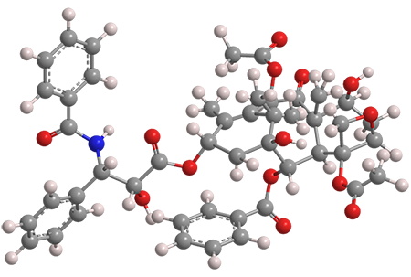
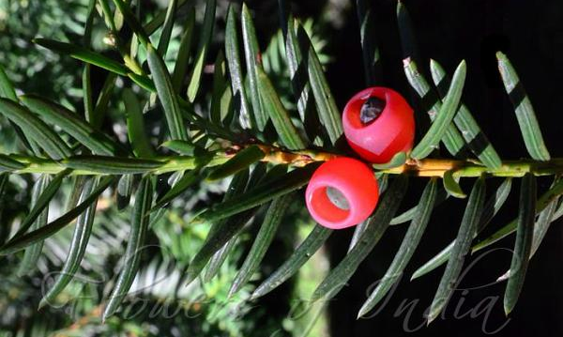

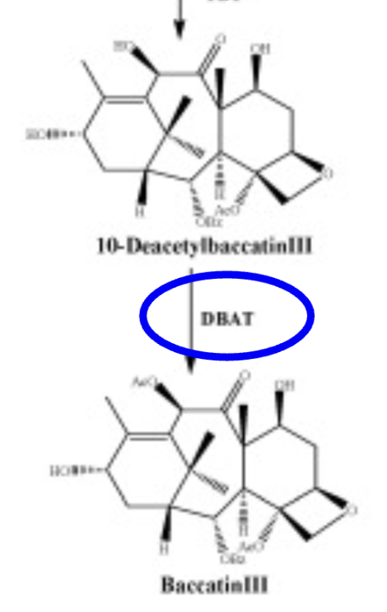
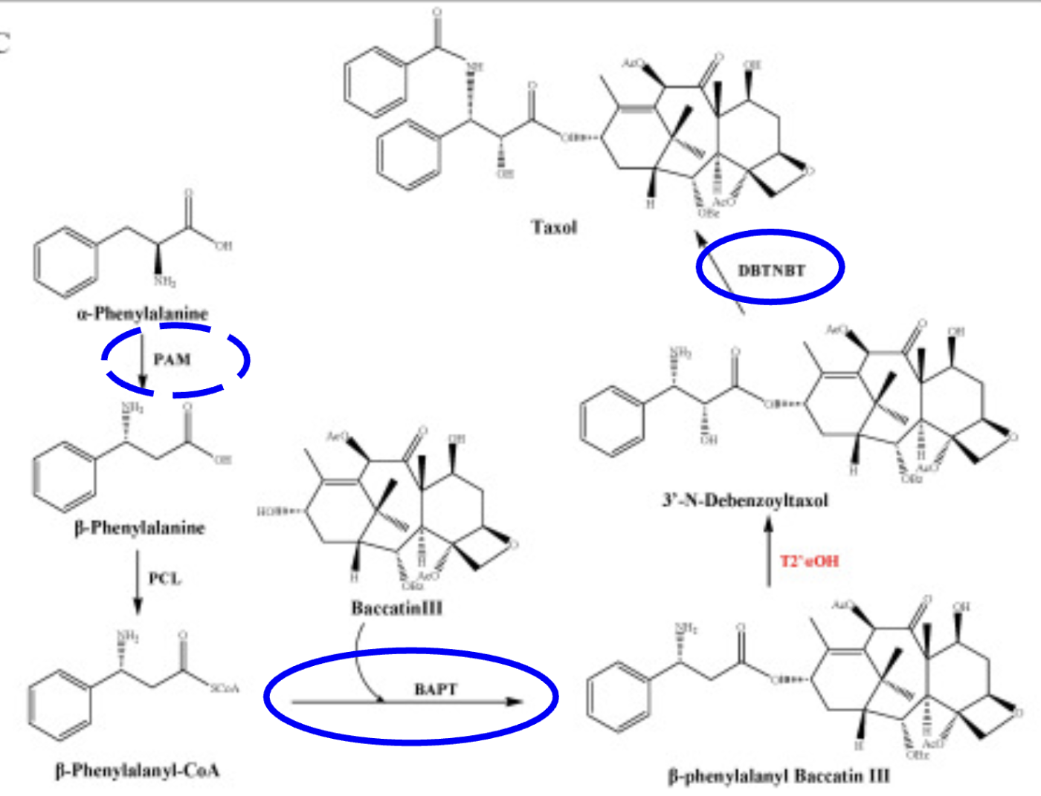






Increasing Paclitaxel Production in Taxus wallichiana via Engineered Plasmids
Rayaan Padaria, Ethan Lee, Jacob Liu, Gabriel Caxoeiro, Duanmu Jiang, Vincent Willits, Anya Jiang, Owen Zhang, Wilson Han, Mr. Mullins, Dr. Patrick Arsenault (Triana Biosciences)
Westwood High School, Westwood, MA, US
Abstract
Science Content
Team Content
Paclitaxel (C47H51NO14), a chemotherapy drug from the Himalayan Yew (Taxus wallichiana), is costly due to destructive harvesting. This project aims to induce paclitaxel biosynthesis in the needles through two parts. A gene gun will introduce an engineered plasmid containing both a CaMV 35S promoter — which drives gene expression in the cytosol to stimulate production of paclitaxel and its precursors such as TASY — and the genes DBAT, BAPT, and DBTNBT, which have been identified as rate determining enzymes. This approach offers a more efficient and cost-effective alternative to traditional extraction while reducing harm done to the tree, promoting its population.
Our experimental plan aimed to increase production of paclitaxel in the needles of the Himalayan Yew is as follows:
A gene gun will be utilized to fire a plasmid containing genetic material and the CaMV 35S promoter through the Yew plant cell wall and into the cytoplasm and nucleus of the cell. The CaMV 35S promoter will activate and control the transcription of the gene, facilitating gene expression. This promoter will ensure high levels of gene expression in the needles of the Yew tree because of its constitutive expression of transgenes in plants, maximizing the production of proteins necessary for the paclitaxel biosynthetic pathway.
Along with the general promoter CaMV 35S, we will also add specific genes to increase expression of rate determining enzymes. These enzymes in the Taxus baccata (the European Yew, which is more commonly studied than the Himalayan Yew) have been identified to be DBAT, BAPT, and DBTNBT. Due to the complex biosynthetic pathway of paclitaxel, with an estimated 20 steps, it is unlikely that full pactlitaxel production within the needle is feasible. Hence, the plasmid would contain the DNA sequences for the rate determining enzymes DBAT, BAPT, and DBTNBT.
We hope that an overexpression of these genes will enhance the flux of the biosynthetic pathway, leading to an increase in paclitaxel production, thus allowing the needles to produce more paclitaxel for less destructive production and harvesting.
Returning team from Westwood High School of 9 with 7 new members, exploring agricultural capabilities of synthetic biology for the third year.
Current Limitations
Using a plasmid to transfer genes has some limitations, as plasmids may not sufficiently be integrated into the plant cell due to a low transfer success rate. The plasmids can also be inaccurate in transferring the genes as it could be inserted into suboptimal locations, leading to unstable gene expression. Plasmids also have physical limitations, as there is a limit on plasmid size (roughly 10 kilo-base pairs). Furthermore, important precursors such as taxadeine will not be included in the process, limiting the true production of paclitaxel in the needles.
In insurgence of key enzymes is likely to cause a metabolic burden on the plant. A solution to this problem could be regulators, such as ligand-inducible promoters, which will enhance the precision for optimal paclitaxel production. These systems will ultimately optimize the production of enzymes while preventing strain on the plant.
Background
Paclitaxel, a chemotherapy drug derived from the Himalayan Yew and its relatives, is difficult to obtain due to slow tree growth and destructive harvesting methods, as the tree must be killed to harvest the compound. To create a more sustainable supply, researchers have explored alternatives such as microbial synthesis, plant cell cultures, and metabolic engineering. Recent efforts focus on enhancing taxane biosynthesis through genetic modifications, allowing for increased production without harming the tree.
References and Acknowledgements
We’d like to thank our advisor Mr. Mullins for guiding our direction through the our research process, and our mentor Dr. Patrick Arsenault for providing us with feedback and answering our questions.
Project Objective
As a group, we wanted to reduce the environmental impact of paclitaxel harvesting through synthetic biology. We hope to build upon and improve existing studies that semi-synthetically produce paclitaxel by transferring engineered plasmids to increase efficiency on an industrial scale.
Previous steps
DBAT = deacetylbaccatin III-10-O-acetyltransferase
BAPT = baccatin III-3-amino 13- phenylpropanoyl-CoA transferase
DBTNBT = debenzoyltaxol N-benzoyl transferase

