Slide 1

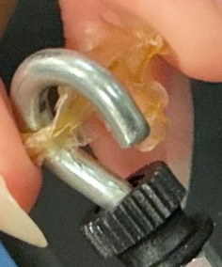
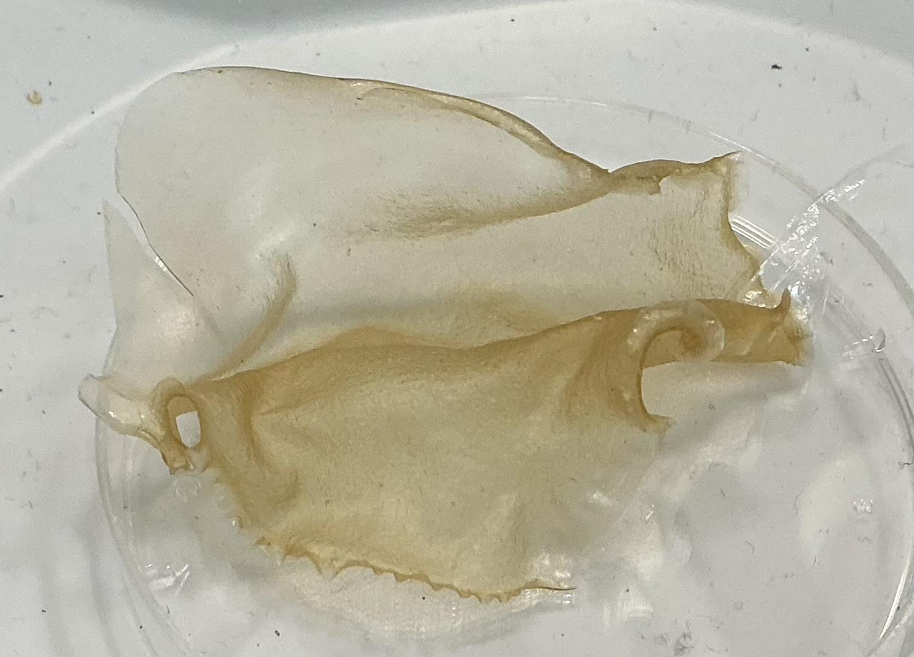
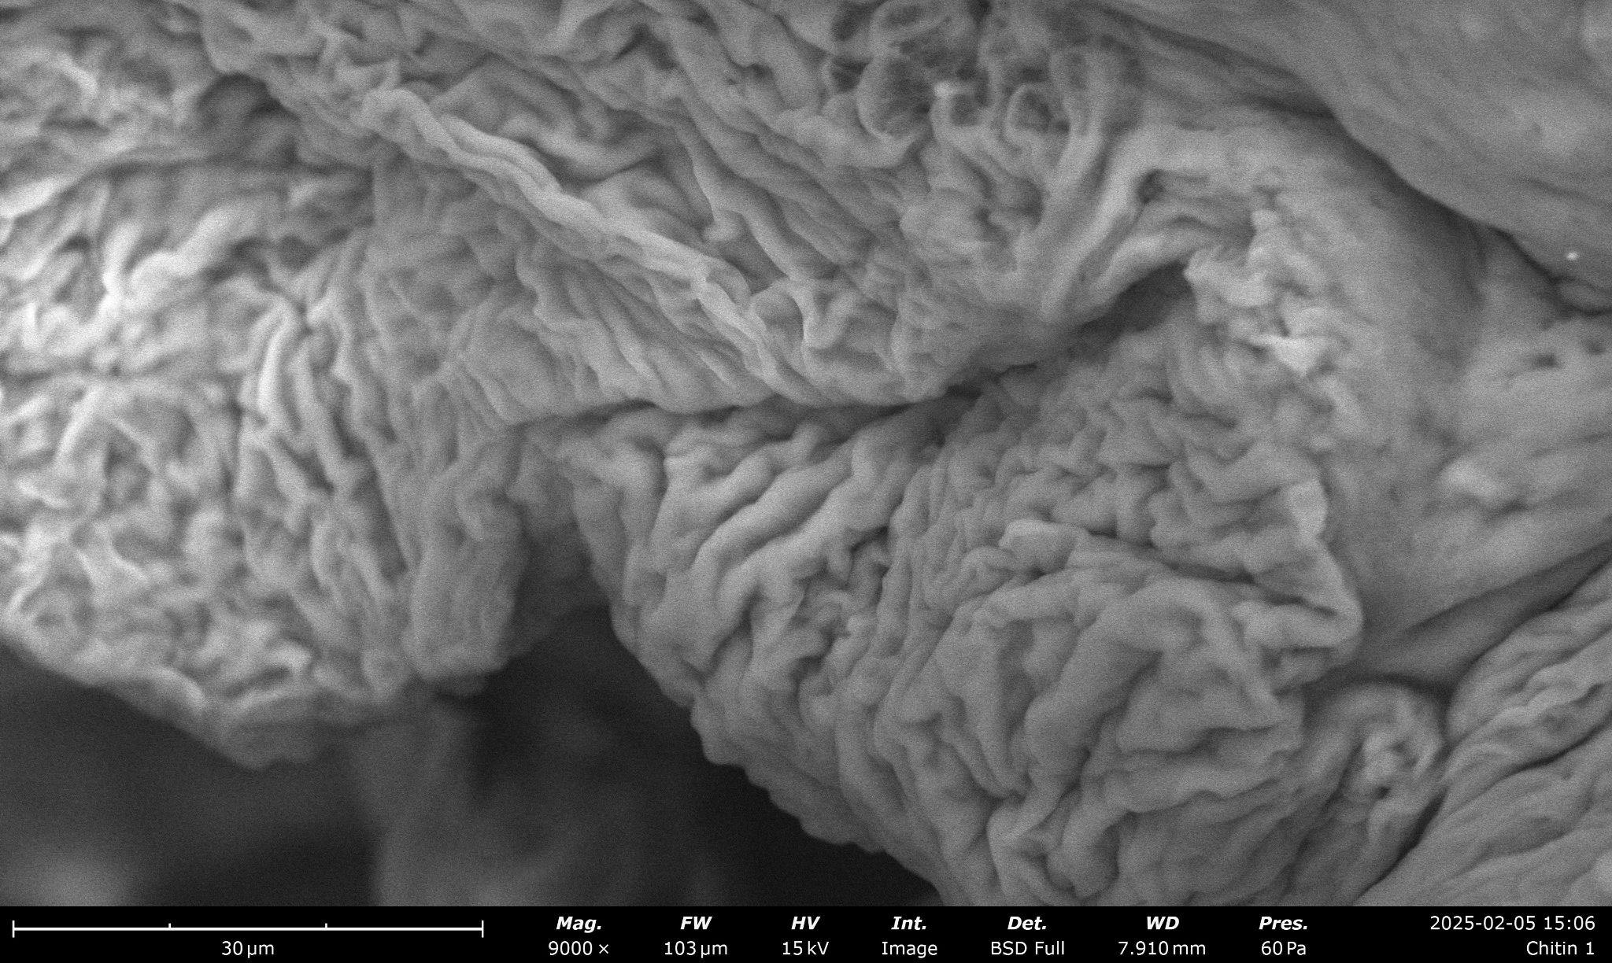
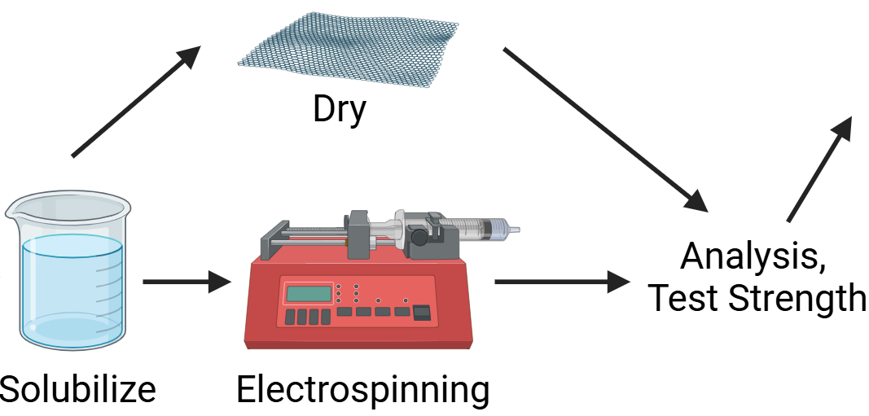
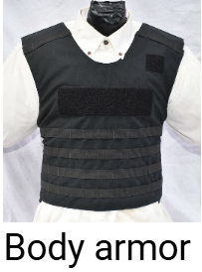
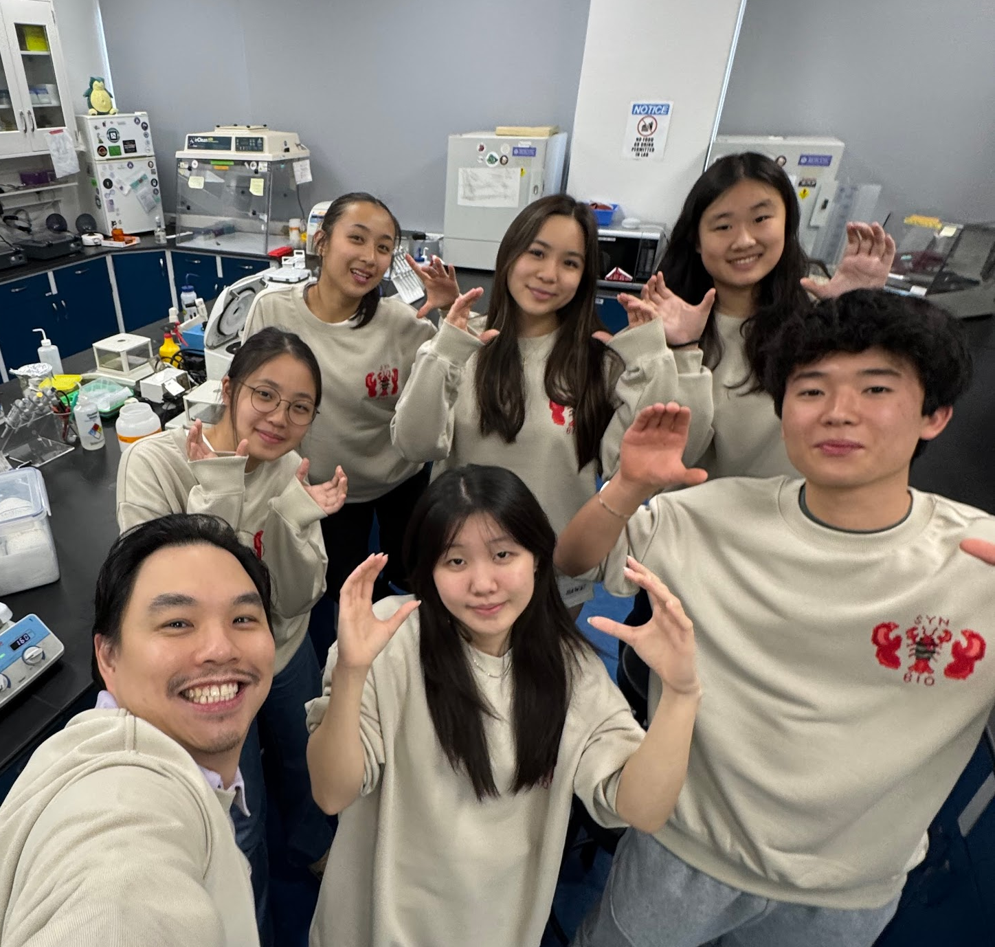

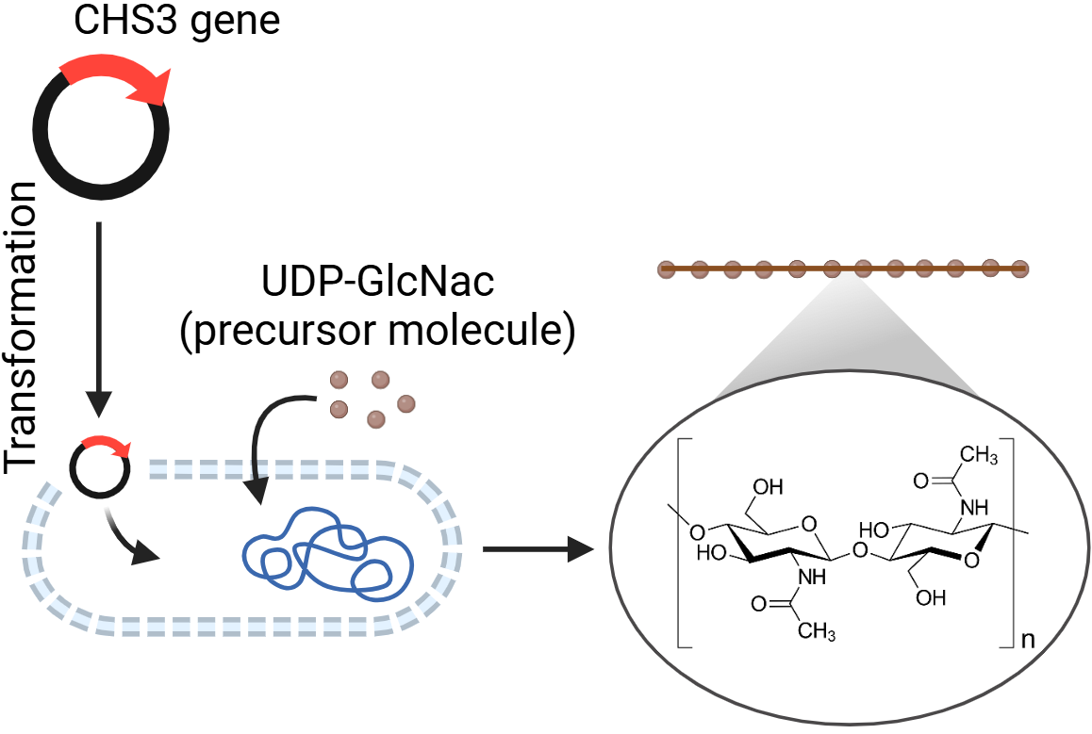
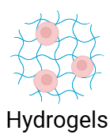
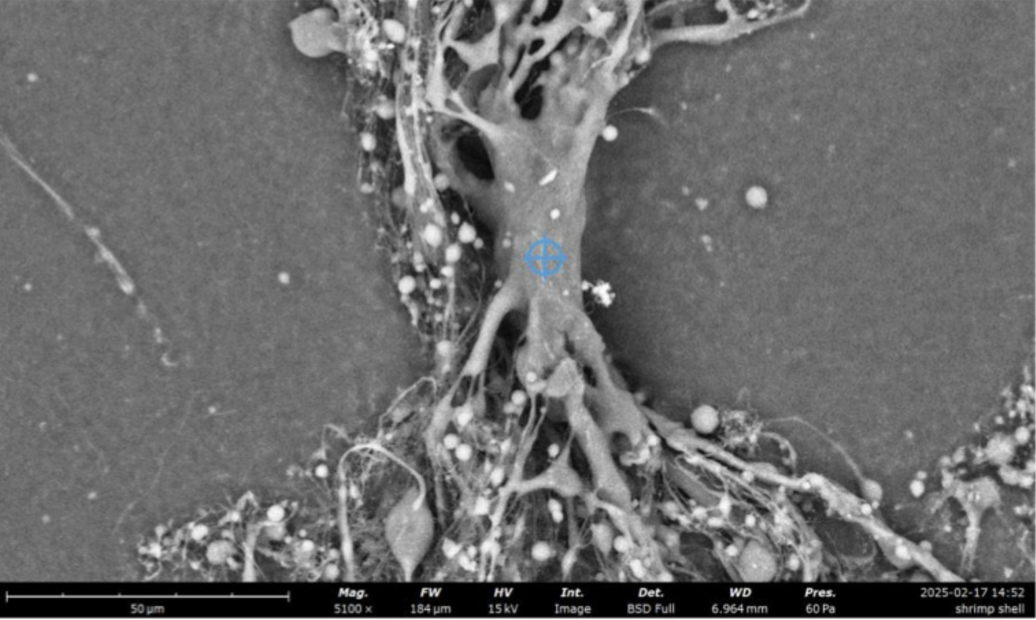








Fightin’ With Chitin
Mia Chen, Isabelle Lee, Audrey Loh, Megan Su, Caden Tan, Florence Wu, Dr. Hsu, Ben French (Toledo)
Taipei American School, Taipei, Taiwan
Trial # | Force (N)
1 | 24.30
2 | 47.16
3 | 57.89
4 | 48.58
5 | 40.68
Abstract
Our research focuses on fabricating chitosan fibers as a sustainable alternative to Kevlar in bulletproof vests. We produce bacterial chitin by cloning the yeast CHS3 gene into E. coli for enzymatic conversion of UDP precursors into chitin. Chitin is then deacetylated to form chitosan, enhancing its strength, stiffness, solubility, and versatility. To create usable fibers, we electrospin chitosan with polyethylene oxide (PEO). We also experimented with direct chitin processing using formic acid for fiber and thin film fabrication via syringe extrusion and spin coating. Scanning electron microscopy (SEM) revealed that our synthetic chitin closely resembles shrimp shell-derived chitin in elemental composition. However, shrimp shell chitin contains additional elements like calcium and phosphorus. Our next step is to conduct stress tests to assess the strength of our chitin fibers quantitatively. We aim to integrate these fibers into bulletproof vests for chitosan-based protective gear. This research advances sustainable, high-performance materials for personal protection.
Figure 3. Tensile strength test data of our chitin strip (~0.5 cm across and 2.0 cm long). Our experimental strip was able to resist a maximum of 57.89 N.
Figure 1. Air-dried Chitin Sheet following Tokura’s protocol [5]
Figure 2. Dried Chitin sheet under SEM. Using elemental analysis, C, O, N were identified to be proportional with shrimp shell elements.
Next Steps:
Experimental Process
[3],[6]
Figure 4. Electrospun chitosan fibers under SEM following Klossner’s protocol [1]
We electrospun at a voltage of 25 mV, a flow Rate of 15 µL/min, and a spinneret-to-collector distance of 10 cm [2],[4]
Chitosan, a derivative of chitin by deacetylation, has higher tensile strength than chitin, thus its usage here in electrospinning
References and
Acknowledgements
We’d like to thank BioBuilder for organizing this event, the wonderful Upper School organization for supporting this project, Mr. Tsao for helping us with ordering materials, and Mr. Frankenberg, our HoS, for supporting this opportunity.

