Slide 1

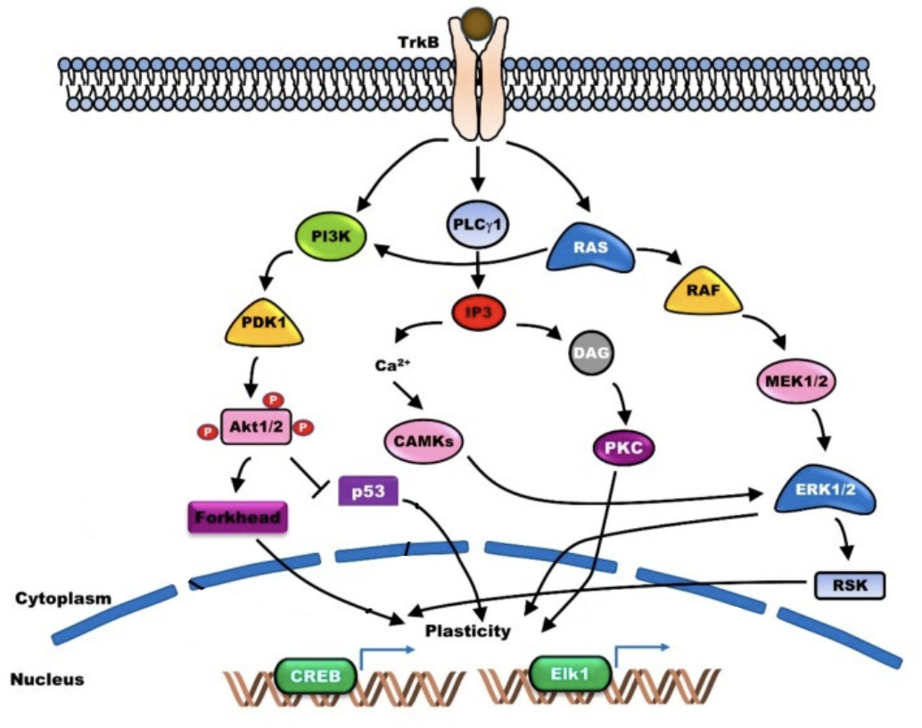
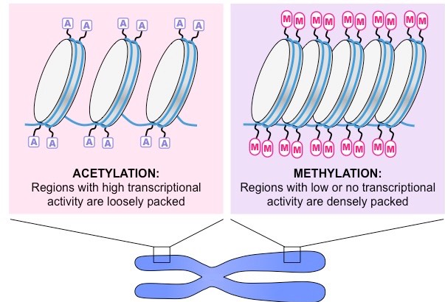
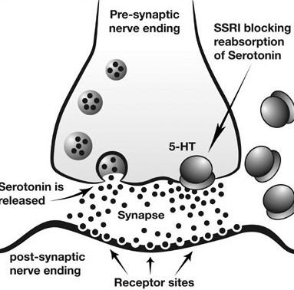







Accelerating Neuroplasticity in Antidepressants
Miley Arora, Serena Ma, Dr. Lindsey L’Ecuyer, Madi Garton (UCB)
Andover High School, Andover, MA, United States
About the Team
We are a new team. Miley is a returning member of BioBuilder Club in her second year of participation, and Serena is a first-year member. Miley and Serena were inspired to start this project based on their passion for both science and mental health. Dr. L’Ecuyer, a biology teacher and BioBuilder Club advisor at Andover High School has guided the team in their research planning and execution. Madi Garton, a structural biologist working for UCB Biopharma has advised the members on the team as a mentor.
Introduction
With one in five adults in the U.S. having been diagnosed with Major Depressive Disorder (MDD), antidepressants, particularly selective serotonin reuptake inhibitors (SSRIs), are widely used. SSRIs stop or delay the body from reabsorbing serotonin, leaving more of it available for the body to use. This regulates mood, but patients don’t see results for an average of two to four weeks. However research found that depression is the failure of neuroplasticity (the brain’s ability to change and adapt), and that SSRIs work partly due to their ability to boost this. Studies found that synaptic density and plasticity were improved with prolonged use of SSRIs. But, this improvement often takes weeks, likely explaining the delay in mood enhancement.
TrkB
Intermediate molecules
Future Steps
We propose the intrastriatal injection of engineered mesenchymal stem cells (MSCs) to accelerate neuroplasticity via BDNF complementing the use of SSRIs. However, we need more research on how to construct the cell vector, and creating experimentation that is feasible at the high school level. If someone picks up the project next year, they could also push the research further by considering if our approach to accelerating neuroplasticity would work for other types of antidepressants such as TCAs, MAOIs, SNRIs, etc.
The Science of Using BDNF
SSRIs enhance brain-derived neurotrophic factor (BDNF) gene expression, which encodes the BDNF protein. BDNF regulates synapse functions through its TrkB receptors. The BDNF-TrkB pathway is key in supporting neuroplasticity. Epigenetic changes are observed in depressed patients; methyl groups attach to BDNF histones, inhibiting the gene expression, and there are not enough acetyl groups on its promoters to counteract this. Activating the transcription factor CREB (cAMP response element binding protein)
induces BDNF expression by increasing acetylation which could decrease the time it takes to relieve depression symptoms. The potential for harmful side effects due to too much BDNF can be suppressed with inhibitors for protein kinase A (PKA).
Acknowledgements
We’d like to thank Dr. L’Ecuyer for overseeing our project from the beginning, and for always pushing us to be better scientists. We’d also like to thank Madi Garton for the expertise that she provided on the science and realistic applications of the project.
References

