Slide 1

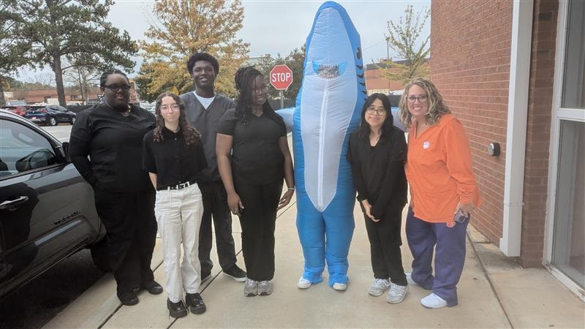
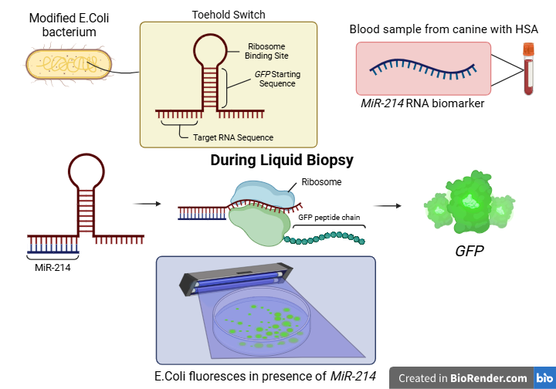







Liquid Biopsy 2.0: E.coli Bacteria Fluorescence-Based Detection of Canine Hemangiosarcoma
Abigail Sanchez-Chavez, Chloe Martin, Zion Jatta, Temitayo Fakunle, Kayony Pierre, Bria Washington, Abigail Ejoga, Andres Gonzalez, Victoria Vazquez, Dr. Tiffany Jones, Dr. Grace Vezeau (CATALOG)
South Cobb High School, Austell, GA, US
Abstract
Science Content
Next steps:
In canines, liquid biopsies can detect the presence of cancer through the released circulating tumor DNA (ctDNA) in the bloodstream. However, liquid biopsies often struggle in detecting certain cancer types and are prone to false-negatives, especially in early-stage canine cancers. To improve these shortcomings, our research examines certain biomarkers to minimize the false-negative results, notably focusing on aggressive and fast-acting canine cancers. Our research aims to genetically engineer E. coli bacteria to fluoresce in the presence of MiR-214, a biomarker associated with hemangiosarcoma (HSA)- an aggressive and rapidly progressing cancer common in canines. Our findings ensure a significantly more reliable and effective alternative liquid biopsy, while maintaining a relatively cost-effective diagnostic.
Biosensor Design
Engineered E. Coli bacteria are designed with a toehold switch mechanism that activates a green fluorescence (GFP) upon detection of miR-214.
This system is packaged as a rapid and cost-effective “Diagnostic Kit”, which includes lyophilized E.coli biosensors, a lateral flow test strip, and a UV light source for fluorescence visualization (GFP).
System Procedure
A blood, urine, or saliva sample is collected from the dog, which may contain miR-214, the biomarker of interest in canine hemangiosarcoma
The sample is added to the diagnostic kit. If miR-214 is present, it binds to the toehold switch in the E.coli bacteria, triggering activation of a reporter gene.
The bacteria then produce a visible fluorescent signal (GFP) , indicating the presence of miR-214.
The fluorescence intensity (GFP) can be directly linked to the concentration of miR-214, indicating the progression of the cancer. For instance, higher intensities correlate to farther cancer progression (Heishima et al., 2015)
Research ways to make the diagnostic kit more safe and effective towards canines, eliminating any possible dangers or risks that could occur.
Further examine the ability for fluorescence intensity to determine specific cancer progression
After conducting research, analyzing the results and comparing them will help identify strengths and weaknesses within the experiment.
:
Team Content
We are a new team of 10 high school students from South Cobb High School! (Some students missing)
Introduction
The leading cause of death in canines is cancer, with six million dogs diagnosed in the U.S. every year and most drugs available being originally intended for human use. Research specifically for canines is improving with advancements such as the liquid biopsy but the new tests lack specificity and precision as it struggles to identify stages and types of cancers. They can also lead to false positives, especially in cases of urothelial carcinoma and histiocytic sarcoma. Current solutions to improve accuracy involve integrating cost-effective cfDNA quantification with targeted next generation sequencing. One of the most malignant, deadly, and undetectable cancers is hemangiosarcoma, which originates in vascular endothelium tissue. Early detection of hemangiosarcoma can lead to prolonging life, as well as developing a variety of methods more targeted towards canine cancer, though they will also likely be applicable to humans with few alterations. Engineering bioluminescent E. coli to react when MiR-214 is detected, could improve sensitivity and the specificity of liquid biopsy tests for canines. The aim of this procedure is to engineer E. coli bacteria to fluoresce in the sample collected from the canine when MIR-214 is detected.
References and Acknowledgements
We would like to thank Dr. Tiffany Jones and Dr. Grace Vezeau for their support and guidance throughout this project. We would also like to thank New England Biolabs, K2 Scientific, CobbTank, and the Georgia Teachers Initiative for funding lab supplies to give the team a hands on experience this BioBuilderClub season.

