Slide 1


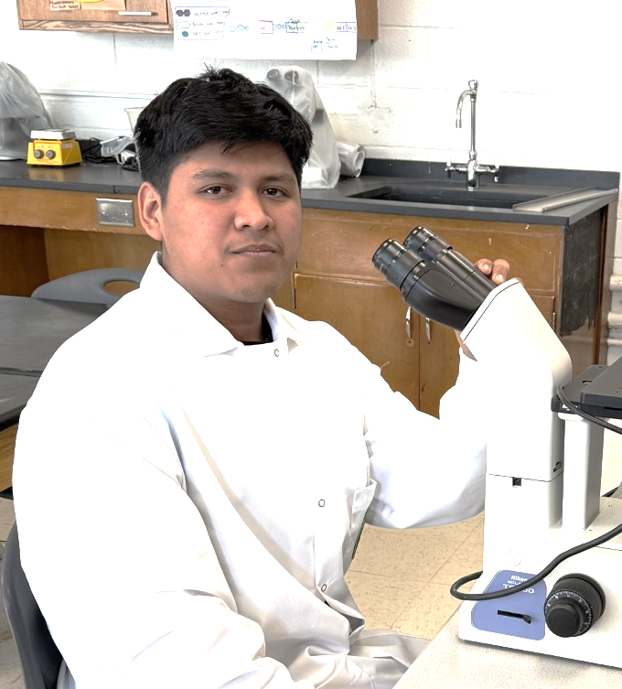







Water Treatment Degradation of PFAS
Juan Mendoza, Ana White Teacher Leader, Dr. Michael Sheets Mentor (Sunflower Therapeutics).
Cross Keys High School, Atlanta, Georgia, United States of America
Abstract
Our research are currently focusing a way to make water safer to drink by removing the harmful PFAS. Our study focuses to find a reasonable method for PFAS degradation. To do this, we are incorporating a prmA promoter known to be activated by PFAS (Young 2021) to the sfGFP-pBAD plasmid from addgene. The plasmid will then be inserted into BL21 Cells to confirm PFAS sensitivity. Then we would insert PFAS-degrading enzymes DeHa 1 and DeHa 2 to confirm we can eliminate PFAS from water (Harris, 2022). Then we would then add a kill switch gene that would induce the bacteria to self-destruct.
Next Steps:
If a different team decided to pick up the project next year, the experiments we would want them do make would be, testing the ability of PFAS-degrading enzymes DeHa 1 and DeHa 2
Also, if the team is able to test the enzyme ability to degrade PFAS, then we would want them to test if the bacterium system can be destroy, by inserting a self-destruct gene rhaS.
Science Content
NAME | Primer 5' (overlap/spacer/ANNEAL) 3' | Len | %GC | 3' %GC | 3' Tm
SfGFP-pBAD_fwd | TACCCGTTTTTTTGGGCTAG | 20 | 45 | 45 | 62.4
SfGFP-pBAD_rev | TCTCTGAATGGCGGGAGTATG | 21 | 52 | 54 | 66.3
prmA Promoter_fwd | atactcccgccattcagagaGAGGGCGTGATGGTCTGC | 38 | 58 | 67 | 69.1
prmA Promoter_rev | ctagcccaaaaaaacgggtaTGTGCGCCTCCTGGATCG | 38 | 55 | 67 | 70.8
Experiment description:
Our plasmid is designed for our proof of concept that contains a prmA Promoter with a Superfolded GFP which will then be inserted into BL21 cells. The results would be the expression of GFP from our system in the presence of ampicillin or PFAS.
Bom
The first image shows the plasmid with the araBAD promoter that would be use as our positive control. The results should show the expression of GFP when arabinose is added to the system.
PBR322
ori
araC
f1 ori
sfGFP-pBAD​
araBAD Promoter
Introduction/Background
  Per-polyfluoroalkyl (PFAS) also known as forever chemicals are a group of microplastics used in various commercials products including fire-fight foam, nonstick, stain-resistant and waterproof products (Schaider 2017). PFAS are highly stable organic compounds containing multiples carbon-fluorine bonds making it difficult to degrade in the environment (Shahsavari 2021).
  PFAS can enter our bodies through contaminated water, food consumption or dust containing PFAS. In addition, exposure to PFAS through products containing PFAS can cause adverse health effects. Furthermore, both long and shorts- chains PFAS influence in males and female's reproductive systems (Boyles, 2021; Šabović, 2019).
AmpR
Superfolded GFP
Table 1: Primers: The table shows primers for Gibson assembly.
Using the NEBuilder assembly tool we design our primers. With this information we would be able to construct the transgenic bacterium for our proof of concept.
AmpR Promoter
Figure 1: Positive control: The plasmid contains an arabinose promoter and GPF.
Bom
PBR322 ori
araC
The first image shows the plasmid with the araBAD promoter that would be use as our positive control. The results should show the expression of GFP when arabinose is added to the system.
f1 ori
sfGFP-pBAD
+prmA Promoter
prmA Promoter
Juan Mendoza
References and acknowledgements
We would like to give thanks to Brookhaven Chick-Fil-A for assisting with fundraising.
We would like to give a thanks to our mentor Dr. Michael Sheets from Sunflower Therapeutic, in assisting and supporting us.
AmpR
Superfolded GFP
AmpR Promoter
Figure 2: Testing promoter: The plasmid contains prmA promoter and GFP.
References

