Slide 1

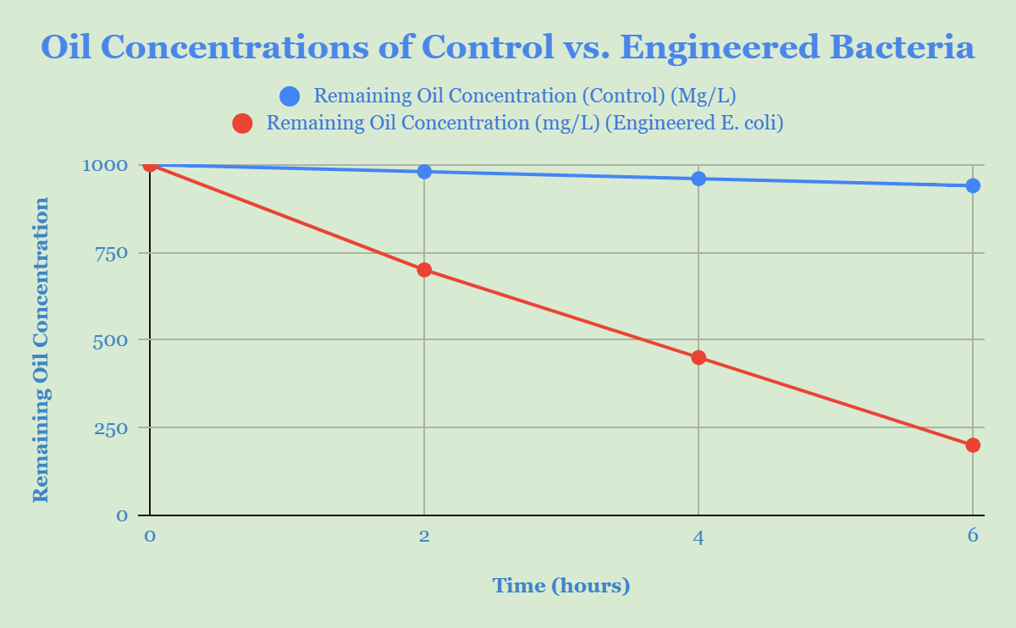

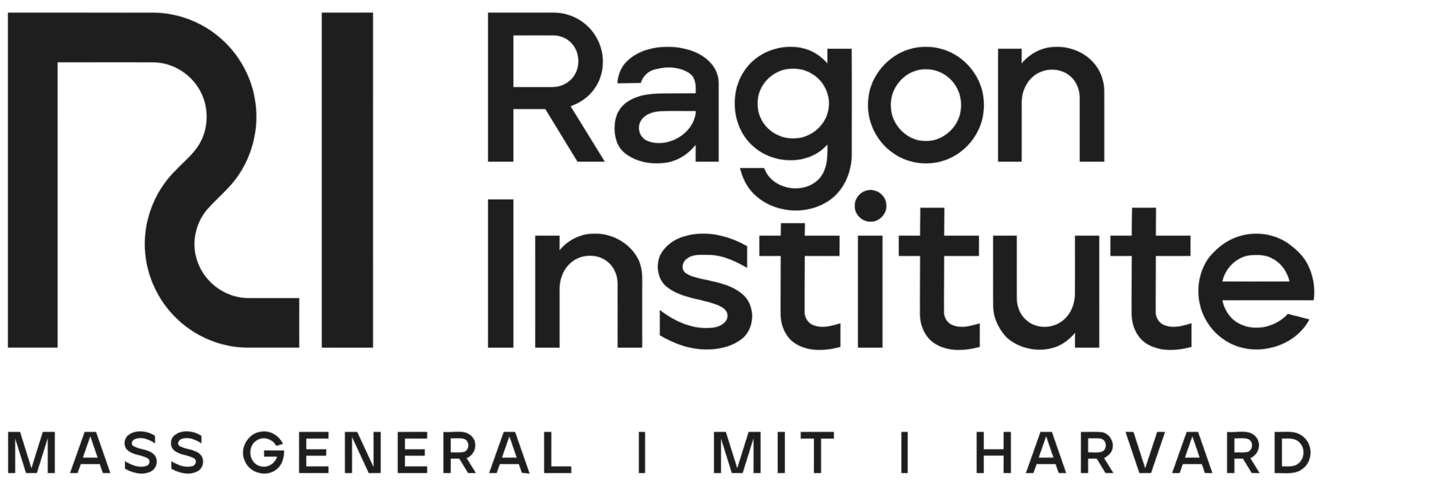


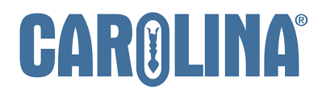
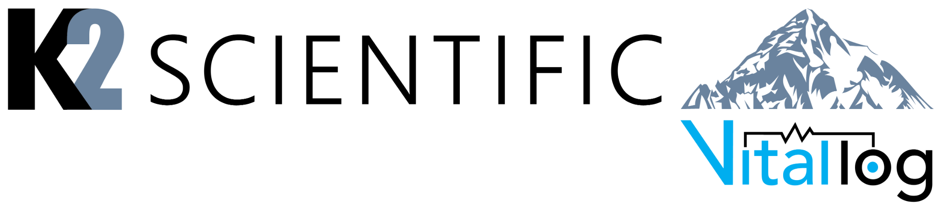

EcoSpill
Neel Bhosale, Vansh Singh, Siya Gupta, Mrs. Ambika Bhosale. Dr. Yuval Dorfan (Holon Institute of Technology), John P. Stevens High School, Edison, NJ
Oil pipeline spills in the Middle East have cost companies millions of dollars and terrorized the surrounding environment, leaking toxic chemicals into the ecosystem. Utilizing synthetic biology, we can engineer a bacteria that breaks down hydrocarbons located in oils and gives visual signals as to where the spill is. This paper aims to investigate methods of hydrocarbon degradation in oils utilizing genes of the Pseudomonas species. Genes such as alkB and xylE can be incorporated to break down the hydrocarbons and RFP to create a visual signal of the leakage. Eventually, we plan on going more in-depth on our study of Pseudomonas genes to identify how effectively they can break down hydrocarbons
Hypothetical Experiment:
In this hypothetical experiment, we would place both a control bacteria and our engineered E.coli bacteria into oil. We expect our engineered bacteria to degrade the oil in only a few hours, with more than 75% of it being degraded by hour 6. The normal bacteria on the other hand wouldn’t degrade the oil very well. This displays how our engineered bacteria would degrade hydrocarbons in the oil.
Another hypothetical experiment we could run would be relating to the RFP and how much is produced. We can identify how much oil is needed to produce enough RFP to be able to be seen by the human eye. This would be another vital experiment we would need to run before we could implement this device in the real world.
The Team!
This is our first year participating in the BioBuilderClub, with all of our members being sophomores in high school. We have enjoyed learning about the implications of synthetic biology in the real world and are eager to find more solutions to solve through it.
Future Steps:
To further enhance this project and try to turn it into a reality, we would require a laboratory with lab equipment so that we can conduct tests. This would allow us to determine what works and what doesn’t and how we could optimize our product. We would also need to not only get approval from the government, but also public approval. Many people may be hesitant to allow us to continue as placing bacteria in oil people use for everyday purposes may seem dangerous. This would be another obstacle we would have to face before we can fully implement our design.
The Problem:
Currently in middle eastern countries, pipes carry millions of barrels of oil from oil fields to refineries. However, unexpectedly, these pipes can form leaks, releasing the toxic oil into the fragile environment. Not only does this pose environmental problems, but it also costs the oil companies huge amounts of money for the lost oil. As a result of this, they must first be notified of the leakage, then they must find the leakage, and then fix it. This issue could be solved in a matter of hours through the use of our EcoSpill device.
The Solution:
Our device lies in an E.Coli bacteria which would be place in the oil beforehand so that it would be readily available if a spill were to occur. If the bacteria detects high amounts of oxygen, that means there would’ve been a leak and the oil had been exposed to air. This would turn on the bacteria and it would begin to degrade the hydrocarbons in the oil and produce RFP which would signal where the leak occurred.
References and acknowledgements
We would like to thank Dr. Yuval Dorfan for helping us brainstorm and create this project.
References

