Slide 1


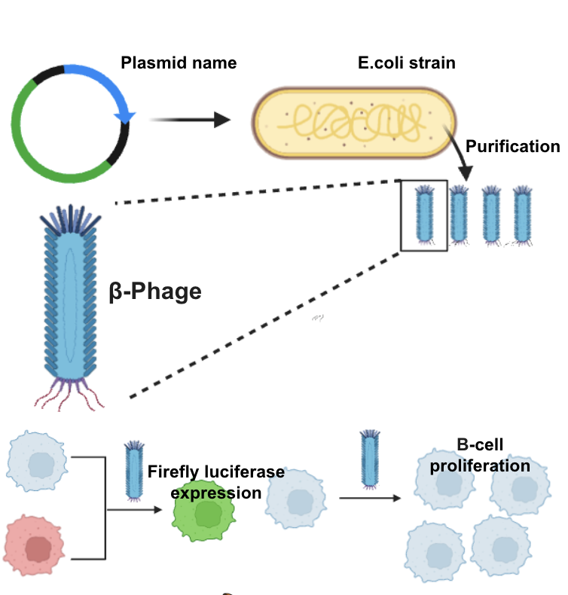






Restoring pancreatic β-cell function with a next-generation chimeric bacteriophage viral vector
R. Rupkumar¹, G. Arora¹, R. Chandrasekaran¹, R. Kummath¹, D. Rajesh¹, S. Salunke¹, A. Rali¹, M.Stark² ¹ Dublin High School, Dublin, CA, USA
²Brigham and Women’s Hospital, Center for Nanomedicine, Harvard Medical School
IMPACT:
This bacteriophage-based therapy for T2D offers a groundbreaking approach by targeting β-cell dysfunction rather than just managing symptoms. Using GLP-1 for precise targeting, it delivers PDXI directly to β-cells, potentially restoring insulin secretion and reducing reliance on lifelong medication. If successful, it could shift T2D treatment from chronic management to a cure, lowering healthcare costs and advancing bacteriophage use in regenerative medicine.
ABSTRACT:
Type 2 Diabetes (T2D) is caused by β-cell loss and impaired insulin production. Current treatments do not restore β-cell function. We propose using the M13 bacteriophage to deliver PDX1 gene therapy, engineered with glucagon-like peptide-1 (GLP-1) to target β cells. This approach ensures selective delivery and promotes β-cell regeneration. In vitro validation will assess its effect on insulin secretion and β-cell proliferation. If successful, this method could provide a cost-effective, targeted treatment for T2D.
REFERENCES:
Paper used for information on bacteriophage production and delivery systems. This paper talks about using bacteriophages to target Glioblastoma in rats and how to track these particles using infrared imaging after delivery.
Tsedev, U., Lin, C.-W., Hess, G. T., Sarkaria, J. N., Lam, F. C., & Belcher, A. M. (2022). Phage Particles of Controlled Length and Genome for In Vivo Targeted Glioblastoma Imaging and Therapeutic Delivery. ACS Nano, 16(8), 11676–11691. https://doi.org/10.1021/acsnano.1c08720
BACKGROUND:
Type 2 diabetes (T2D) occurs when cells become resistant to insulin, causing elevated blood sugar levels and impaired glucose regulation.
Our project aims to use bacteriophages to deliver PDX1 (pancreatic and duodenal homeobox 1), a gene that restores β-cell function, with the help of GLP-1 (glucagon-like peptide 1) to target β cells.
METHODS:
Phage production
Vector-AAV
Cell Type
In vitro beta cell selectivity
Quantification of Firefly luciferase (fluc) in INS-1E β-cells versus Alpha TC1 (αTC1)
3. Beta cell proliferation
EDU staining in EndoC-β cells

