Slide 1

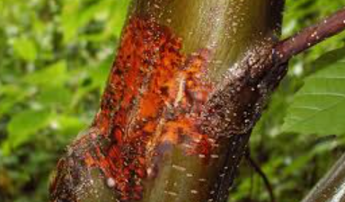
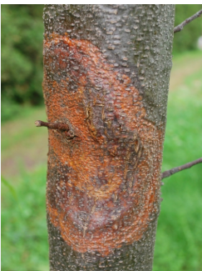
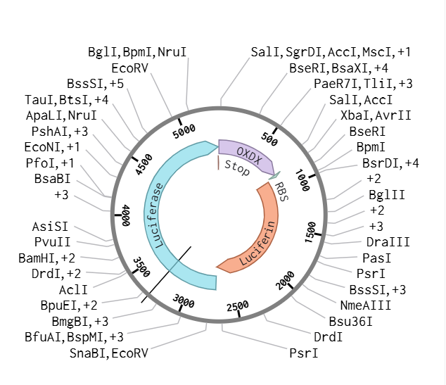

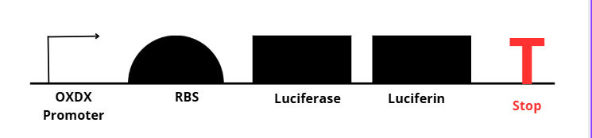






Project BioGlow: Early Detection of Chestnut Blight
Brylee Jones, Jude Athey, Abe Athey, Hallee Kipp, Dylan Klepper, Vincent Klug, Eric Thomas, Natalie Baker, Joey Dodson, and Teacher Amanda Dunham,
Mentors Dr. Kelley Doering and Amanda Ferrante
DB EXCEL, Kingsport, TN, Sullivan
Abstract
Chestnut blight, caused by Cryphonectria parasitica, has devastated American chestnut populations. Early detection of the pathogen before visible symptoms appear is crucial for effective containment and conservation efforts. This synthetic biology project aims to engineer Escherichia coli or Pseudomonas fluorescens to produce bioluminescence in response to oxalic acid, a key virulence factor secreted by C. parasitica. Using a genetic circuit that links an oxalate-responsive promoter to a luciferase gene, the engineered bacteria will serve as an early biosensor, glowing in the presence of oxalic acid. This bioreporter system could be applied to tree surfaces or soil near chestnut trees to provide real-time, visual detection of chestnut blight before physical symptoms manifest. By integrating genetic engineering, biosensor development, and environmental monitoring, this project offers a novel, low-cost, and scalable approach to forest disease management.
Project BioGlow: Early Detection of Chestnut Blight
BioGlow, aims to develop a bioreporter system that produces bioluminescence in response to oxalic acid which can allow for early detection of C. parasitica infections before even visible symptoms appear.
To achieve this we plan to engineer the Pseudomonas fluorescens bacterium by transforming it with a plasmid containing an oxalic acid-sensitive promoter (OXDX) upstream of a luciferase-luciferin gene system. When oxalic acid is present, the bacteria will produce a visible bioluminescent signal, enabling early detection and intervention to prevent the spread of chestnut blight.
Team Content
Our team meets every Monday and Wednesday from 7:15- 7:45 and Fridays and Wednesdays from 2:45- 4pm
Our team has been in existence for three years and consists of new and returning members. Many of our members are interested in pursuing degrees in STEM fields.
And maybe some next steps:
We have recently begun our preliminary research and will continue evaluating the strengths and limitations of our design. This includes exploring alternative promoters and bioreporter proteins to optimize our system.
Our Plasmid
Background
The American chestnut (Castanea dentata) once made up 25% of eastern U.S. forests, with an estimated 4 billion trees stretching from Maine to the Carolinas. These towering giants grew over 100 feet tall and produced nutrient-rich nuts that sustained wildlife and livestock. Their straight-grained, rot-resistant wood was widely used in construction, furniture, and railroad ties, making them a vital economic resource.
However, in the early 20th century, a foreign fungal pathogen, Cryphonectria parasitica (chestnut blight), devastated the species. The fungus produces oxalic acid, a key factor in its virulence, which creates acidic cankers that disrupt the tree’s vascular system. This process ultimately kills the above-ground portion of the tree while leaving the roots alive but unable to regenerate into mature trees.
Within decades, 3.5 billion trees were lost, profoundly altering the ecosystem and economy. Current restoration efforts rely on diagnosing the disease only after visible cankers appear. However, by the time these symptoms develop, the infection is already well established.
References and Acknowledgements
Gene Sequence

