Slide 1

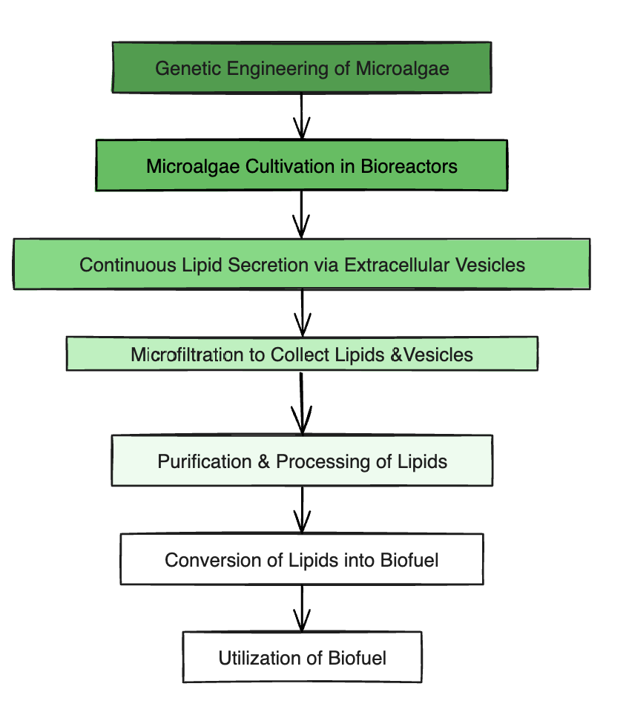






Fueling the Future: Harnessing Reusable Microalgae for Renewable Energy
Harjas Grover, Bridget Ha, Bella Horta, Eliana Kofman, Shaun Ng, Dora Mou, Ida Sanaktekin, Daniel Shaer, Annabelle Xia, Mr. Mato Seth, Mentored by Mr. Gitanshu Bhatia (LanzaTech)
Boston University Academy, Boston, MA, USA
Abstract
The growing demand for sustainable energy calls for efficient biofuel sources. Algae, with rapid growth and high lipid content, are ideal for biodiesel production, but traditional extraction is inefficient and energy-intensive. This project genetically engineers Nannochloropsis algae to secrete lipids continuously without harming viability. Enhanced lipid transport mechanisms direct lipids into engineered vesicles for secretion, allowing simple filtration-based collection. This eliminates costly, destructive extraction while enabling scalable, cost-effective, and sustainable algae-based biofuel production.
About Us
We are a team of nine students who share the goal of developing sustainable biofuel solutions. While we have designed a new approach to continuous lipid secretion in Nannochloropsis, we have not been able to bring our design into the lab yet. We are eager to move forward with experimental validation in the future.
Next Steps
Laboratory Testing – Implement our CRISPR-based modifications in Nannochloropsis to evaluate lipid secretion efficiency.
Optimization – Refine gene expression levels to maximize lipid output while maintaining cell viability.
Filtration & Collection Trials – Test microfiltration methods for efficient lipid recovery.
Biofuel Conversion Analysis – Assess lipid quality for biodiesel production using established transesterification methods.
We look forward to validating our design and advancing the potential of algae-based biofuels as a scalable, sustainable energy source.
Introduction
Fossil fuels accelerate climate change, but current biofuel alternatives are inefficient or harmful. This project genetically engineers Nannochloropsis algae to continuously secrete lipids, allowing for easy collection without harming the cells. Using CRISPR, we enhance vesicle formation and lipid transport. The secreted lipids are then filtered and processed into biofuel, creating a sustainable energy source.
Background
Biofuels reduce CO₂ emissions, but common sources like corn and palm oil require copious resources. Microalgae are an ideal alternative, but traditional lipid extraction is costly and inefficient. This project modifies algae to secrete lipids naturally, allowing for continuous collection via microfiltration, making biofuel production cheaper and more sustainable.
References and Acknowledgements
Grira, S., Abu Khalifeh, H., Alkhedher, M., & Ramadan, M. (2023). The conventional microalgal biofuel production process and the alternative milking pathway: A review. Energy, 277, 127547. https://doi.org/10.1016/j.energy.2023.127547
Fayolle, D., Fiore, M., Stano, P., & Strazewski, P. (2018). Rapid purification of giant lipid vesicles by microfiltration. PLoS ONE, 13(2), e0192975. https://doi.org/10.1371/journal.pone.0192975
We’d like to thank our Mentor, Mr. Bhatia, and our teacher advisor, Mr. Seth, for all their help. Lastly, we would like to thank all our team members for their commitment to creating a project that we love and see a future in.

