Slide 1


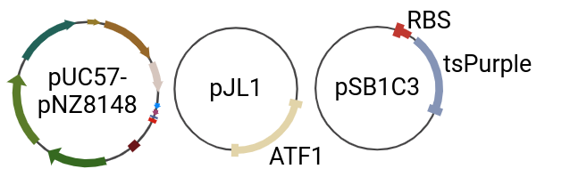

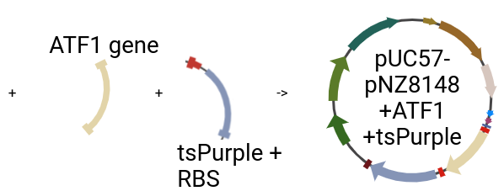
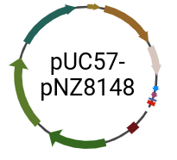
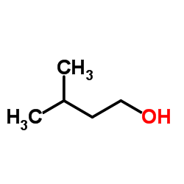
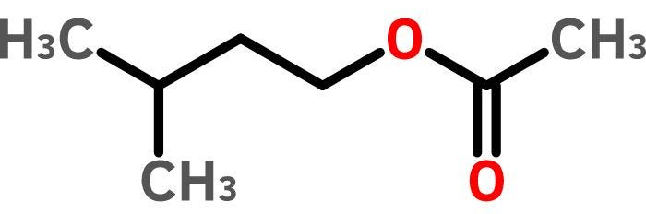






Enriched Flavoured Yogurt
Mahabubul Hasan Sowrav, Yamileth Manzano-Ortiz, Margarita Mendiola-Santoyo, Warren Oliver, Lisbet Ortiz Arreaga,
Ana M White Teacher Leader, Mary Lerner Mentor (UCB), Cross Key High School, Brookhaven, GA, United States
Abstract
Project Design Step 1
Yogurt is extremely rich in nutrients, supports digestive health, increases the immune system, and a plethora of other health benefits [22]. Today’s yogurt is often flavored with fruit. As a result, the yogurt industry must contend with a variety of problems including inconsistency of flavor, quality, and shelf life due to the nature of yogurt and the fermentation process. The aim of our project is to produce yogurt with additional probiotics that are genetically modified into producing their own natural flavors. We designed our system based on a probiotic lactic acid bacterium chassis that produces natural banana flavor and a purple indicator hue.. To accomplish this, we have designed a vector that can be shuttled into both Escherichia coli and Lactobacillus paracasei [15,20,21]. Since E. coli is more amenable to the transformation of recombinant DNA and has a high tolerance of expressing foreign proteins, we will utilize this chassis for vector construction and amplification. Once the vector has been isolated, it will be transformed into the target chassis, L. paracasei, before inoculating into a growing yogurt culture." In conclusion, genetically modifying a Lactobacillus can improve nutritional benefits, regulate consistency of flavor due to considerable problems during the fermentation processing, leading to overall improvement of food products making it more sustainable
Step 1: PCR will be used to amplify ATF1 gene from plasmid pJL1(iGEM-Part:BBa_K1033906). ATF1 encodes an enzyme, that converts isoamyl alcohol to isoamyl acetate, which expresses a strong banana odor and flavor. PCR will also be used to amplify the RBS region with the tspurple gene that encodes a chromoprotein from pSM1C3(addgene). Additionally, PCR will be used to linearize the shuttle vector, pUC57-PNZ8148, which is designed to be transformed into both E. Coli and Lactobicilus paracasei.[ref.1,2] Finally, NEBuilder(Gibson Assembly) assay will assemble the target genes into the shuttle vector, forming pUC57-PNZ8148 + ATF1 + tsPurple.
B
Introduction
z
Yogurt is rich in nutrients, high in protein, and packed with calcium. Yogurt also contains probiotics that facilitate digestive health benefits while also boosting the immune system [22]. The yogurt industry often adds fruit flavored options to their products during the manufacturing process to improve taste and product appeal. However, problems are frequently encountered with the texture, flavor, and consistency of quality because of changes in pH and heating during the fermentation process. Thus, the aim of this project is to produce yogurt with additional probiotics components that are genetically modified to produce their own natural flavors.
Lactobacillus paracasei is a probiotic bacterium known for its health benefits and its potential application in yogurt production [22]. L. paracasei is not traditionally used as a primary starter culture due to its limited ability to ferment lactose efficiently. Instead, a co-culture strategy that combines L. paracasei with traditional yogurt cultures has been developed to create a yogurt-like product that enhances both its probiotic content and functional properties [9]. For this reason, we chose this organism as our “chassis” to engineer into producing a protein that facilitates banana flavor.
Flavor can be an extremely complex trait controlled by many genes. To simplify our design, we focused on one-gene one-flavor that led us to the ATF1 gene used by a 2006 MIT iGEM Team [6,14]. The ATF1 gene, originally found in yeast cells, codes for an enzyme, Alcohol AcetylTransferase (AATase) that converts isoamyl alcohol into isoamyl acetate (Figure A) [24,25]. Isoamyl acetate is an active flavor ester responsible for banana flavor also used in the fermentation of alcoholic beverages [25].
A
RBS
C
Promoter
ATF1 Gene
Isoamyl alcohol
Isoamyl acetate
+
Insert
genes
AATase
Figure B: Three plasmids, the backbone and shuttle vector pUC57-pNZ8148, along with two plasmids containing our target genes, pJL1 containing the ATF1 gene and pSB1C3 containing our tsPurple gene.
Figure C: ATF1 and tsPurple will be isolated and amplified by PCR and inserted into the shuttle vector which will be linearized by PCR. The final construct plasmid pUC57-pNZ8148+ATF1+tsPurple
Figure A: The ATF1 gene encodes alcohol acetyltransferase I (AATase), which is an enzyme that convert isoamyl alcohol into isoamyl acetate creating a strong banana scent [14] and flavor [25].

Slide 2
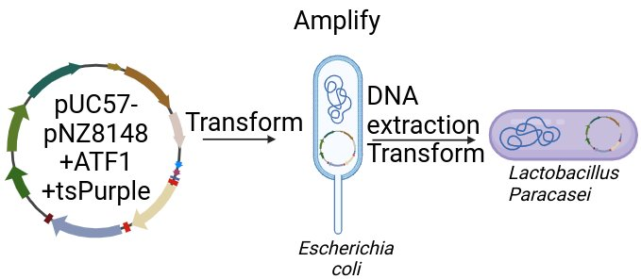
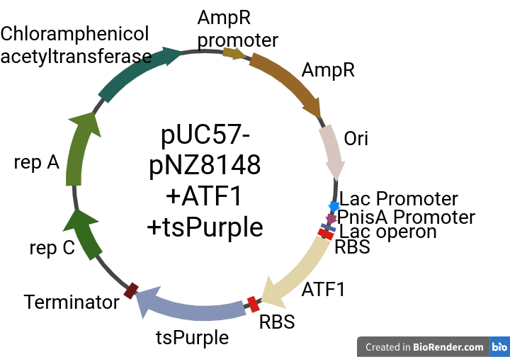
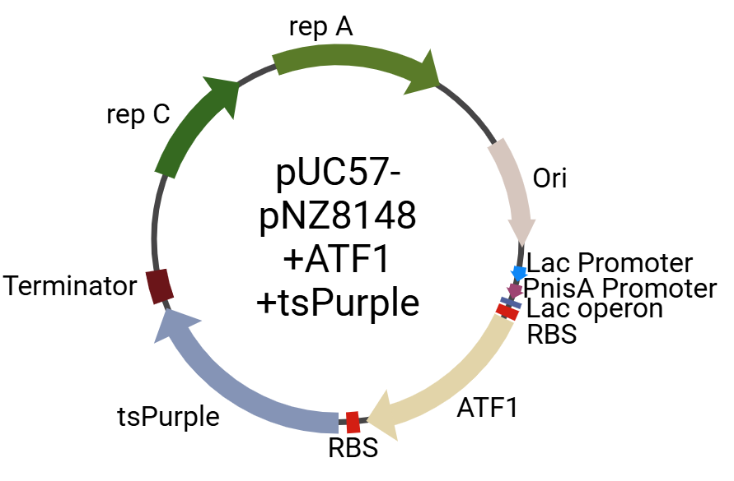
Enriched Flavoured Yogurt
Mahabubul Hasan Sowrav, Yamileth Manzano-Ortiz, Margarita Mendiola-Santoyo, Warren Oliver, Lisbet Ortiz Arreaga,
Ana M White Teacher Leader, Mary Lerner Mentor (UCB), Cross Key High School, Brookhaven, GA, United States
Project Design Step 1 Challenges
Design overview
Lactic acid bacteria(LAB)are bacteria that are used in the fermentation of milk into yogurt. One of the drawbacks of recombinantly expressing foreign proteins via plasmids is low transformation efficiency. For that reason, we will first transform our genetically modified plasmid and amplify it in E. coli, which generally have a higher transformation efficiency and higher tolerance in the expression of foreign proteins. Second, we will isolate the plasmid before transforming them into our host L. paracasei (Figure D ). This method of using a shuttle vector designed to replicate in both E.coli and Lactobaccilus as an expression system is often used more successfully in expression of recombinant proteins in LAB [15,20,21] A tspurple gene also known as tinsel purple will be integrated into our system as a selective marker to assist in identification of our genetically modified L. paracasei. This marker was chosen because it is a safe, alternative selective marker in a food-grade system rather than antibiotic resistance markers used in research [16], while adding an appealing color.
A second challenge is that antibiotic resistant genes are customarily used in E.coli as a selective marker to ensure that the host has successfully acquired the plasmid after transformation. However, the problem is that antibiotic resistance genes are prohibited in food-grade vectors because they pose health concerns. Additionally, the resistance genes could spread to the environment contributing to overall antibiotic-resistant bacteria posing health risks [26]. To overcome this problem, we will use PCR to eliminate the antibiotic-resistant genes and use the tsPurple gene which produces a protein that reflects purple light (Figure E-F). This will act as a visible indicator of successful transformations[10]. This could be further confirmed by the aroma of banana once a culture has induced the expression of AATase . These results will be verified by PCR and sequencing.
D
Figure D: Overview of our system-level design. Utilizing a genetically modified shuttle vector, the plasmid will be tested and amplified in E.coli before transforming it into L. paracasei.
pUC57-pNZ8148 Backbone plasmid from NovoPro Science Inc. (V013967)
pJL1 ATF1 plasmid from iGEM (addgene #106286)
TsPurple chromoprotein plasmid from iGEM (addgene #117848)
Shuttle Vector Design
All constructs were built in BioRender
E
F
8121 nt
6504 nt
Figure E: Plasmid map of the final construct of our shuttle vector that has been genetically engineered with are target genes, ATF1 and tsPurple (reporter gene). Plasmid pUC57-pNZ8148+ATF1+tsPurple. Figure F: Vector after removal of the antibiotic-resistant genes, chloramphenicol and ampicillin one tested and amplified in E.coli.

Slide 3
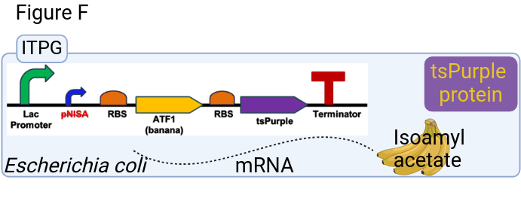
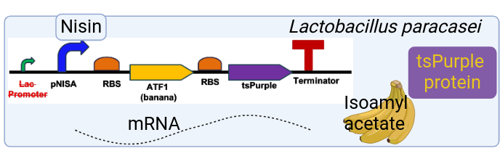
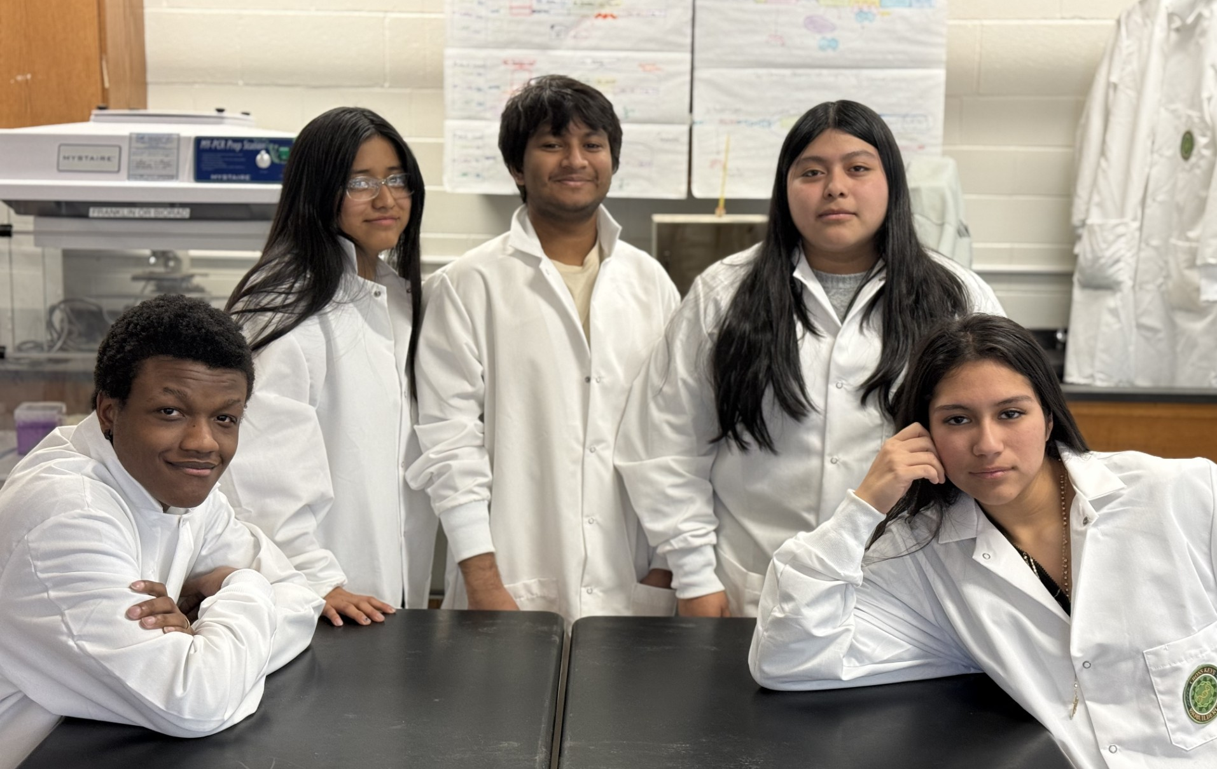


Enriched Flavoured Yogurt
Mahabubul Hasan Sowrav, Yamileth Manzano-Ortiz, Margarita Mendiola-Santoyo, Warren Oliver, Lisbet Ortiz Arreaga,
Ana M White Teacher Leader, Mary Lerner Mentor (UCB), Cross Key High School, Brookhaven, GA, United States
Project Design Step 2
Overall Challenges
Conclusion
Next steps
Step 2: In this step we will induce the expression of our target genes first in E. Coli by adding ITPG which activates the lac promoter. The first gene encodes the acetal transferase enzyme that converts isoamyl alcohol into isoamyl acetate, expressing a strong banana odor and smell. The second gene encodes a purple chromoprotein tsPurple (Tinsel Purple) which acts as a visual marker of successful transformation.
After amplification of our plasmid in E. Coli, the plasmid will be extracted and transformed into Lactobicilus paracasei. Followed by expression of the target genes in a new host, L. paracasei but instead of ITPG, Nisin will be added which will activate the PnisA promoter.
Transgenic organisms are widely used in both research and in the production of food. In food production, one must overcome regulatory obstacles established by the Coordinated Framework for the Regulation of Biotechnology, a Genetically Modified Organism (GMO) [23]. Additional hurdles include biosafety concerns of all GMOs with unintended consequences, and in some cases public perception and misinformation.
The flavored yogurt market in 2024 was valued at USD 50.82 billion and is projected to grow at a compound annual growth rate of 8.7% from 2025 to 2030 [19] providing potential feasibility for the project. Consumer preferences for yogurt with diverse flavors and natural ingredients as well as offering lactose intolerant individuals an alternative to traditional yogurt provide additional support for this system [16]. In conclusion, using genetically modified Lactobacillus to enhance flavor in yogurt production reduces the vast problems associated with growing and processing of fresh fruits, including climate change and economic issues that can cause less desirable taste, consistency, and quality, reducing the need for agro-food products making it more sustainable [5].
G
After successful transformation and expression of the plasmid's genes are confirmed in the Lactobicillius Paracasei, the bacteria will be grown in a culture by itself. And then the culture will be put into milk to allow for the fermentation of our banana flavored yogurt.
H
Team Elemental Alliance
Acknowlegements & References
Front row: Warren Oliver, Margarita Mendiola-Santoyo
Back row: Lisbet Ortiz Arreaga, Mahabubul Hasan Sowrav,Yamileth Manzano-Ortiz
Frugal Science Academy and Janet Standeven at GT, in assisting and supported our process
Dr. James Paredes, CKHS for proofreading and supporting our Team
We would like to give thanks to Brookhaven Chick-Fil-A for assisting with funding raising.
Figure G: Proposed gene expression of the shuttle vector in E. coli. ITPG will be used to induce the lac promoter leading to the transcription of the ATF1, an enzyme essential in the catalysis of the reaction converting it so isoamyl alcohol creating a strong banana small and tsPurple reporter gene a as natural occurring chromoprotein found in sea anemone [10]. Figure H: Proposed gene expression of the shuttle vector in Lactobacillus paracasei. Nisin will be used to induced the PnisA promoter leading to the transcription of the enzyme AAtase and tsPurple chromoprotein [10].
References
Lightning Talk
This is our teams first-year. Several team members are returned next year to turn our research design into research method.

