Slide 1


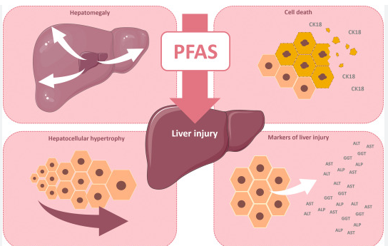

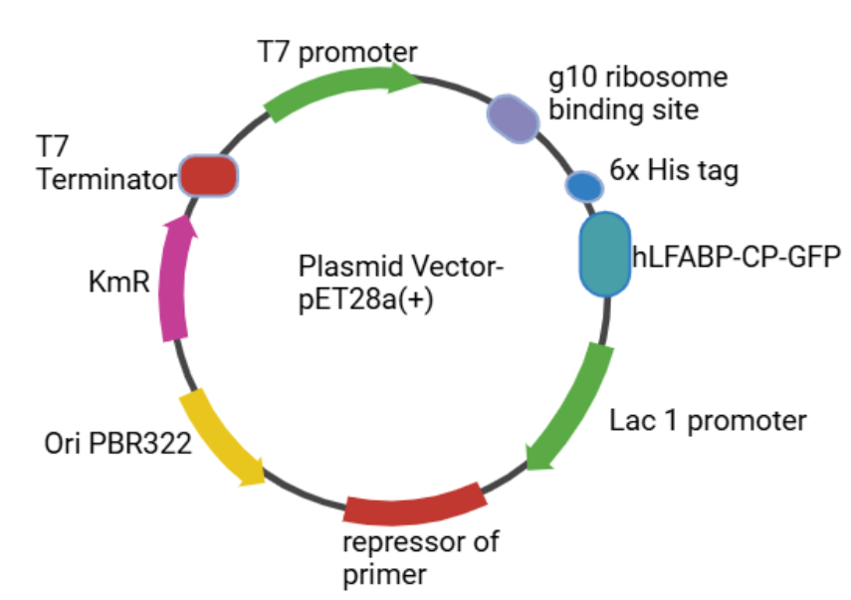

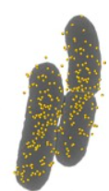
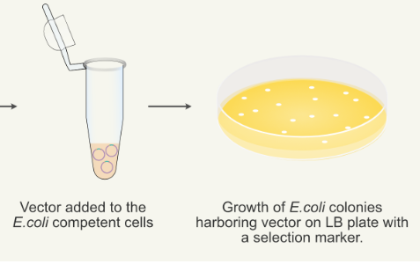
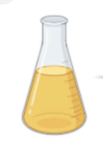


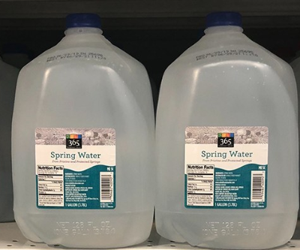






PFAS Detectives: Safeguarding Our Health and Environment
Rachael Barman, Riley Bradish, Sophia Ciccariello, Andrew Pruett, Jake Staples, Tiah Tarabay.
Team Leader: Mary Johnston. Mentor: Jackie Thompson (Research Associate, Asimov).
Haverhill High School, Haverhill, Massachusetts, United States of America
Abstract
Our research seeks to design a low-cost reliable whole cell biosensor for the detection of PFAS chemicals in water. We have applied and improved upon work first proposed by scientists at the University of Virginia in 2023, who suggested that PFAS accumulates in the liver and binds to liver fatty acid proteins. This led to the creation of a plasmid to be integrated into E. coli Strain BL-21 that will express a novel split human liver fatty acid binding protein fused to a circularly permuted green fluorescent protein marker. The fluorinated alkyl chains of the PFAS chemicals contain similar hydrophobic properties to liver fatty acid tails. This will allow the hLFABP-GFP fusion protein to attach to any PFAS in the water and emit fluorescence. Our sensor will be enhanced by a coating of gold nanoparticles that will increase its limit of detection in order to meet the newly established EPA standard of 4 ppt for PFAS in water.
Introduction/Background
In 2019, Spring Hill Water, a bottled water company in Haverhill, Massachusetts, shut down after perfluoroalkyl and polyfluoroalkyl substances( PFAS) chemicals were found in its spring water. PFAS are human-manufactured substances that were originally designed to resist fire, water, petroleum and stains. Due to their strong Carbon-Fluorine bonds, they have been nicknamed “forever chemicals” because they are difficult to break down. Unfortunately, research has linked them to a number of damaging health effects, including cancer,endocrine disruption, liver disease, developmental effects, and more. On April 10, 2024, the U.S. EPA announced that the Maximum Contaminant Level (MCL) of PFAS in drinking water should be set at 4 parts per trillion (ppt). In Haverhill, the municipal cost to screen at this level is estimated to be more than $5.5 million dollars, which is not economically feasible.
Science Content/ Project Design
Step 1: Create the Plasmid with the Human Liver Fatty Acid Binding - GFP Insert :
Experiment Description: Using PCR, amplify both the hLFABP and circularly permuted GFP genes with primers that add the restriction sites for BamHI and XHol and digest the plasmid pet28a+ with the same restriction sites.Then simultaneously digest and ligate the hLFABP and CPGFP using Golden Gate Assembly. (This molecular cloning technique from New England Biolabs allows the PaqCl restriction enzyme to cut outside of its overhangs allowing for DNA to be inserted very precisely).
Figure 3: Human Liver Proteins bind PFAS well leading to liver injury, but also making them good PFAS detectors
Figure 2: Split Human Liver Fatty Acid Binding Protein- Circularly Permuted GFP Fusion Protein construct with stabilizing linkers
Step 2: Transform E.coli BL21 using hLFABP-pET28a(+) under the T7 promoter with the AGGAGG ribosome binding site ( Shine-Delgarno sequence) and kanamycin resistance using traditional heat shock protocol.
Experiment Description: Add pET28a+ plasmid DNA to the tube containing competent E. coli BL-21 cells and incubate on ice for 30 minutes to help DNA adhere to the cell membrane. Heat shock at a temperature of 42°C for 30 seconds. Then place back on ice. Luria broth is added and the transformed cells are incubated at 37°C for 30 min on a shaker.
Step 3 : Identification of Transformed Cells
Experiment Decsription: Growth of E. coli colonies on the LB plate with selectable marker kanamycin. Confirm correct plasmid uptake with gel electrophoresis.
Figure 4: Plasmid with hLFABP-CPGFP under the T7 promoter with Kanamycin resistance. The plasmid is inducible by IPTG. By including the LACI promoter and the repressor of primer, there is tight control over the T7 promoter. There will be no expression of the hLFABP-GFP fusion protein without IPTG. This will be less stressful for the E. coli bacteria.
Figure 5: Selection of Kanamycin resistant cells
Figure 6: Incubation of E. coli with gold nanoparticles
Step 4: Incubate E.coli with gold nanoparticles to increase fluorescence
Experiment Description: Incubate E. coli cells with gold nanoparticles for 60 minutes at 37℃. Centrifuge and wash the pellet to remove any unbound gold nanoparticles.
Figure 1: WGBH Headline August 3, 2019
Notes:
Labels 32 B- writing 26-28
References ~15

Slide 2
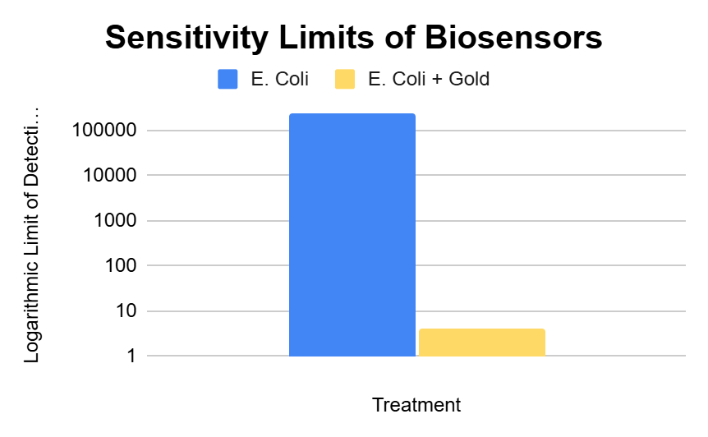



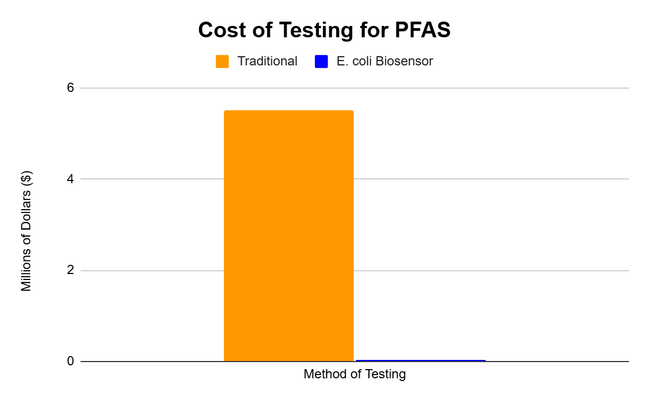



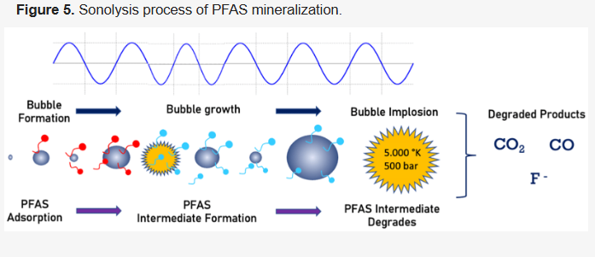
PFAS Detectives: Safeguarding Our Health and Environment
Rachael Barman, Riley Bradish, Sophia Ciccariello, Andrew Pruett, Jake Staples, Tiah Tarabay.
Team Leader: Mary Johnston. Mentor Jackie Thompson (Research Associate, Asimov).
Haverhill High School, Haverhill, Massachusetts, United States of America
Science Content/ Project Design
Next Steps
Figure 11: GFP attached to Gold nanoparticles
What We Learned: We researched in great detail how to design your own biological machine to complete a necessary task. It was cool to think about how our own design could actually be put into practice and be useful in the world. We learned more in depth about plasmid creation, transformation and the many factors that play a role in gene expression. We also learned how time-consuming and overwhelming research can be, but also how rewarding hard work can be when you put the time and effort in.
Step 5: Induce protein expression.
Experimental Procedure: Use IPTG and grow E. coli in a shaking incubator for 2 hours at 37 degrees Celsius.
Step 6: Add biosensor to water samples and check for fluorescence using a fluorometer.
Experiment Description: To test the efficiency of our system, our transgenic bacteria will be exposed to various concentrations of PFAS. Our hope is that our system will effectively express the necessary protein to detect PFAS.
Expected Results
Proof of Concept:
We need to test the efficacy of our gold-coated E.coli biosensor by testing its Limit of Detection (LOD) at different concentrations of PFAS. The sensitivity of the original test was 236 parts per billion and we are hoping that the gold coating will increase the sensitivity to the EPA required LOD of 4 parts per trillion.
Figure 9: Enhanced PFAS Sensitivity with Gold Coating
Resources:
Figure 7: GFP detection in PFAS water sample (left) vs. negative control (right)
Acknowledgements:
Special thanks to our Team Leader Mary Johnston and our mentor Jackie Thompson for their support and dedication to our project.
Haverhill Biobuilder Team members:(from left)
Sophia Ciccariello, Riley Bradish, Rachel Barman, Tiah Tarabay, Andrew Pruett, Jake Staples
Haverhill High BiobuildBer Club Team# 1
Step 7: Use sonolysis to degrade PFAS detected.
Figure 10: Estimated Cost Comparison of Traditional PFAS testing vs E.coli Biosensor based on current market costs as of March 2025
Figure 8: Sound waves can break apart PFAS
Notes:
Labels 32 B- writing 26-28
References ~15

