Slide 1

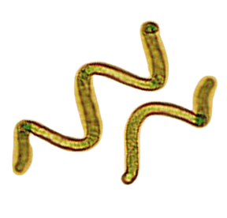
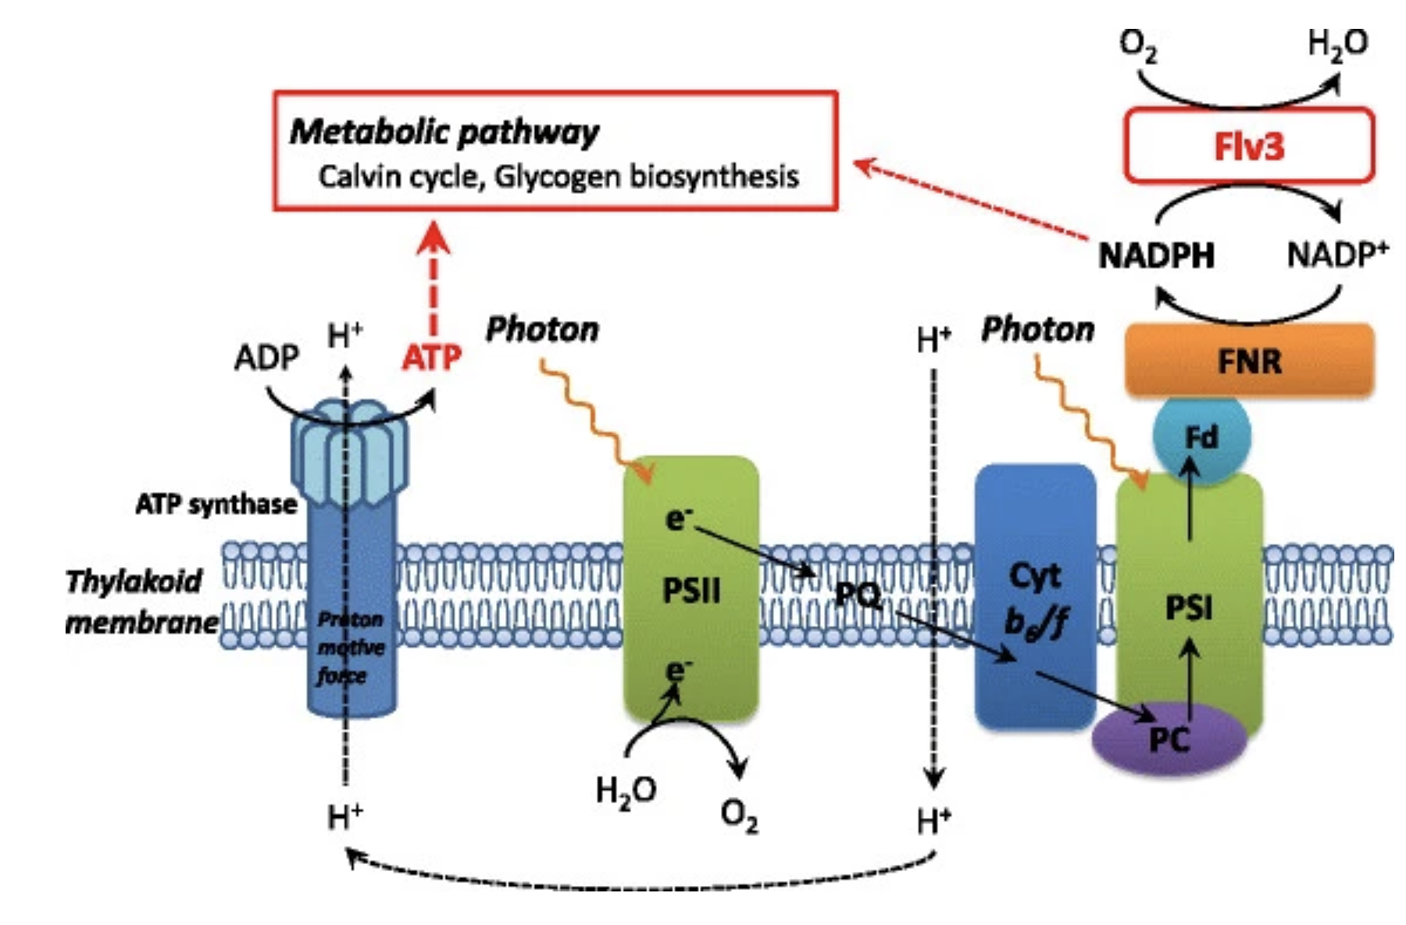
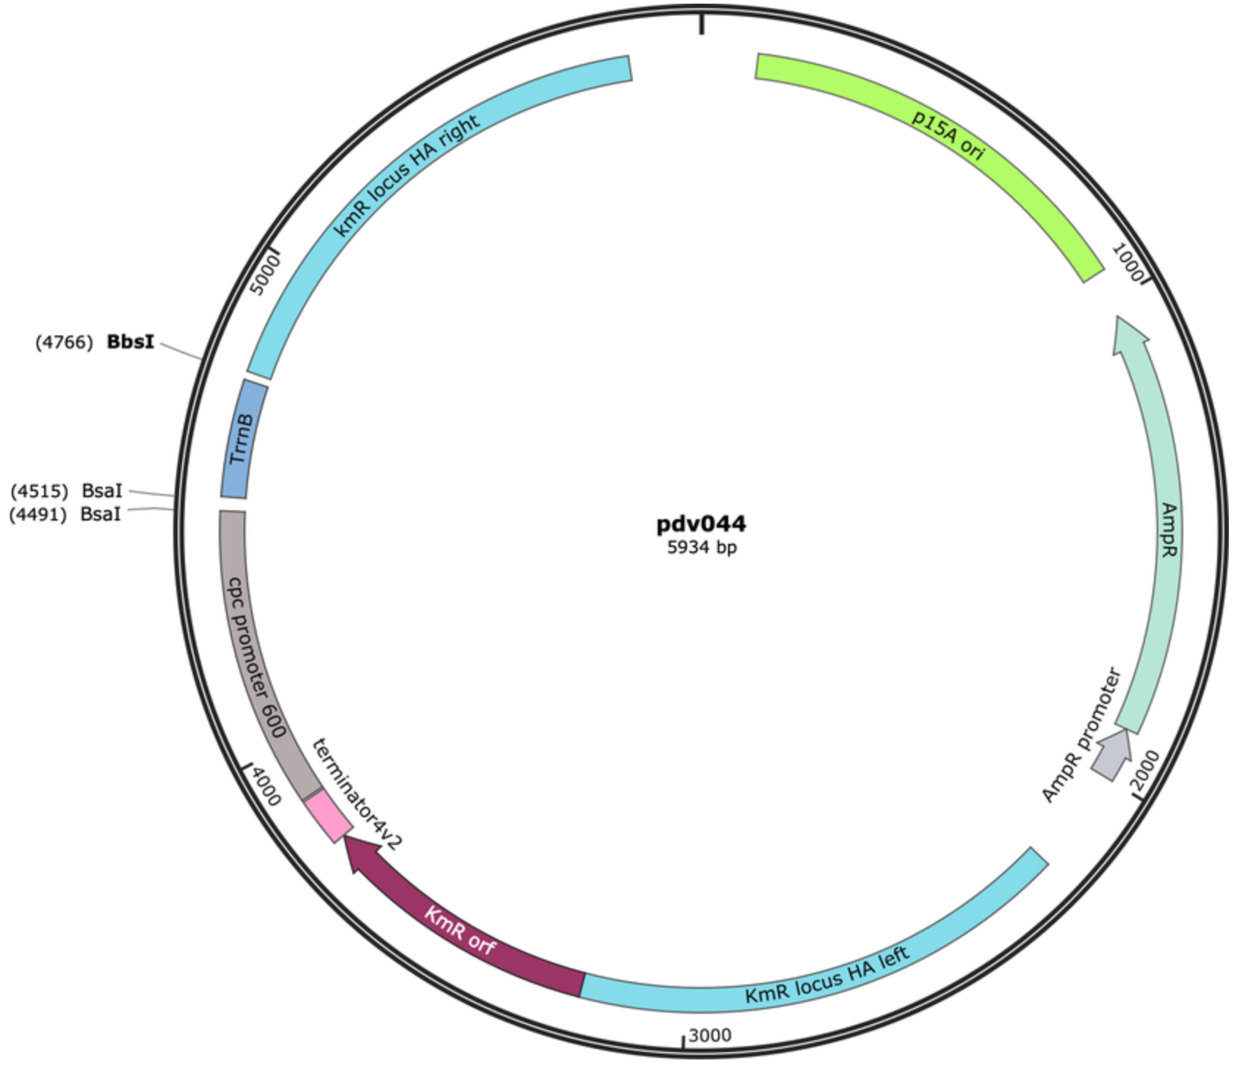


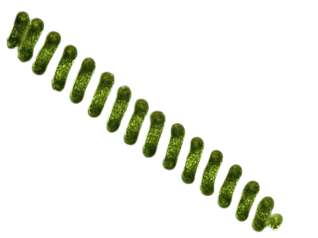






Genetic Transformation of Arthrospira Platensis to Enhance Photosynthetic Pathways
Panagiotis (Peter) Matheos, Zach Skutt, Jonathan Fanikos, Jack O’Neil, Nolan Miley, Alex Hall, Evan Campbell, Maddox Lund, Anoop Rampure, Heather Osborne, Hiroko Kaczmarek (BioBuilder)
Xaverian Brothers High School, Westwood, MA, USA
Abstract
The increasing concentration of carbon dioxide (CO₂) in the atmosphere is a major contributor to climate change, necessitating innovative solutions such as carbon sequestration. Our project explores the potential of flavodiiron protein 3 (FLV3), known for regulating oxidative stress and oxygen levels during photosynthesis, by enhancing CO₂ fixation in Arthrospira platensis (Spirulina). Previous research has demonstrated FLV3’s role in facilitating photosynthetic pathways in other bacterial species, but its impact in Spirulina remains unexplored. We hypothesize that FLV3 expression in Spirulina will accelerate photosynthesis by maintaining oxygen balance, potentially increasing carbon capture efficiency. Our designed organism will express the FLV3 gene from Synechocystis sp. PCC6803 into Spirulina, utilizing both a basic expression system and an overexpression model with a stronger promoter. This ensures that FLV3 elevates light reaction output to enhance the Calvin cycle. Through biochemical and molecular analyses, we will assess the impact of FLV3 on oxygen regulation, oxidative stress response, and overall efficiency of CO₂ capture during photosynthesis. Spirulina was selected because it had a significant potential for genetic manipulation within the FLV3 gene, while being highly accessible. Our study provides insights into the mechanisms of FLV3 in Spirulina and its potential application in bioengineering efforts aimed towards reducing CO₂ in the atmosphere. By fully optimizing photosynthetic carbon fixation, this novel approach could contribute to scalable solutions for mitigating climate change. Future efforts include refining the plasmid design, selecting better promoters, and further investigating oxidative stress in Spirulina
Using what we learned about FLV3 in other cyanobacteria, we hypothesized that by infusing the FLV3 gene into spirulina through a plasmid, we can enhance the photosynthesis pathways which will lead to more CO₂ consumption, ultimately reducing the amount trapped into the atmosphere.
Science Content
Transformation of Spirulina with the FLV3 gene has not occurred yet to our knowledge. However through our research we have developed a plausible method to undertake such a feat. Using the FLV3 gene sequence, also called sll0550, we would insert this into the pDV044 plasmid backbone at sites BsaI 4491 and 4515 found between the cpc promoter 600 and the ampicillin TrrnB terminator. Although multiple methods of doing this were found, the two most plausible methods involves synthesizing FLV3 gene as a gene block or through PCR amplification with Synechocystis species PCC6803. The second method would involve the addition of modifications at 5’ end of PCR primers to
enable Golden Gate Cloning into pDV044. This would successfully integrate the 1722 nucleotide long gene sequence (sll0550) into the plasmid. We chose pDV044 over other possibilities because of the promoter and terminator already present along with the presence of kanamycin selection along with ampicillin resistance to use as selection markers during experimentation. We would then, through a genetic transformation, insert the plasmid into the Arthrospira Platensis and after a 35 day incubation period under constant lighting, we would have a genetically transformed Arthrospira Platensis that should, in theory, have an increased rate of photosynthesis and in turn, an increase in carbon dioxide removal .
Team Content
We are a first-year team from Westwood, Massachusetts representing Xaverian Brothers High School. The team consists of nine members who have contributed to the project with research and planning. We are composed of Sophomores, Juniors, and Seniors. We are looking to deepen our research on this topic later this year and hopefully be developed and continued into next year.
Next Steps
To advance this project, optimizing FLV3 expression in Spirulina requires tweaking the promoters, improving analysis on oxygen regulation, and researching oxidative stress further to find out its role in photosynthesis. Working on stable transformation methods would also strengthen the real world application side to this. If another team continues this research, the next potential step would be to compare FLV3 over-expression to total FLV3 deletion. To clarify its function, we would also be testing oxidative stress levels, photosynthetic efficiency, and the evolution of oxygen. Doing this would help us learn more about carbon fixation within FLV3.
Figure 1
Introduction
Due to the increasing concerns of global warming, ocean acidification, and respiratory issues, our team decided to research and test ways in which we can reduce CO₂ pollution. To offer a potential tool to address this issue, we concluded that designing a plasmid containing the FLV3 gene, a gene that has been shown to enhance photosynthetic pathways in other cyanobacteria, may further offer a potential tool to reduce carbon pollution (Fgure 1). While researching, we came across an experiment where the FLV3 gene was overexpressed in Synechocystis, which led to an increase in photosynthetic efficiency. Cyanobacteria are a type of bacteria that are photosynthetic, and will intake carbon during the Calvin cycle, eventually turning it into glucose (C₆H₁₂O₆). This process removes the excess carbon from the atmosphere, and converts it into food for the organism. Spirulina, in particular, is a cyanobacteria that is relatively easy to manipulate genetically.
Sources
References and acknowledgements
We’d like to thank Heather Osborne, Hiroko Kaczmarek, Chloe Franklin from BioBuilder, and all the Xaverian Brothers High School Students who attend our club as well as anyone else who may have contributed to our project.
Sll0550 Sequence

