Slide 1

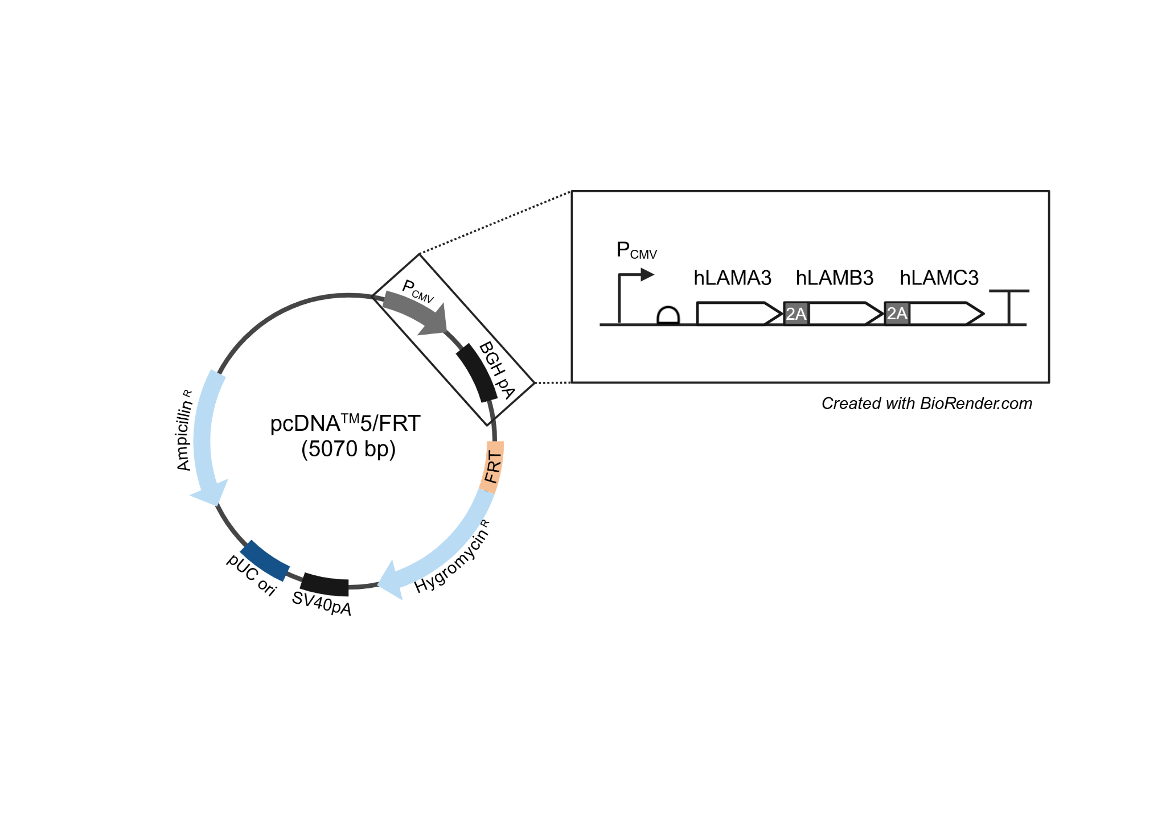

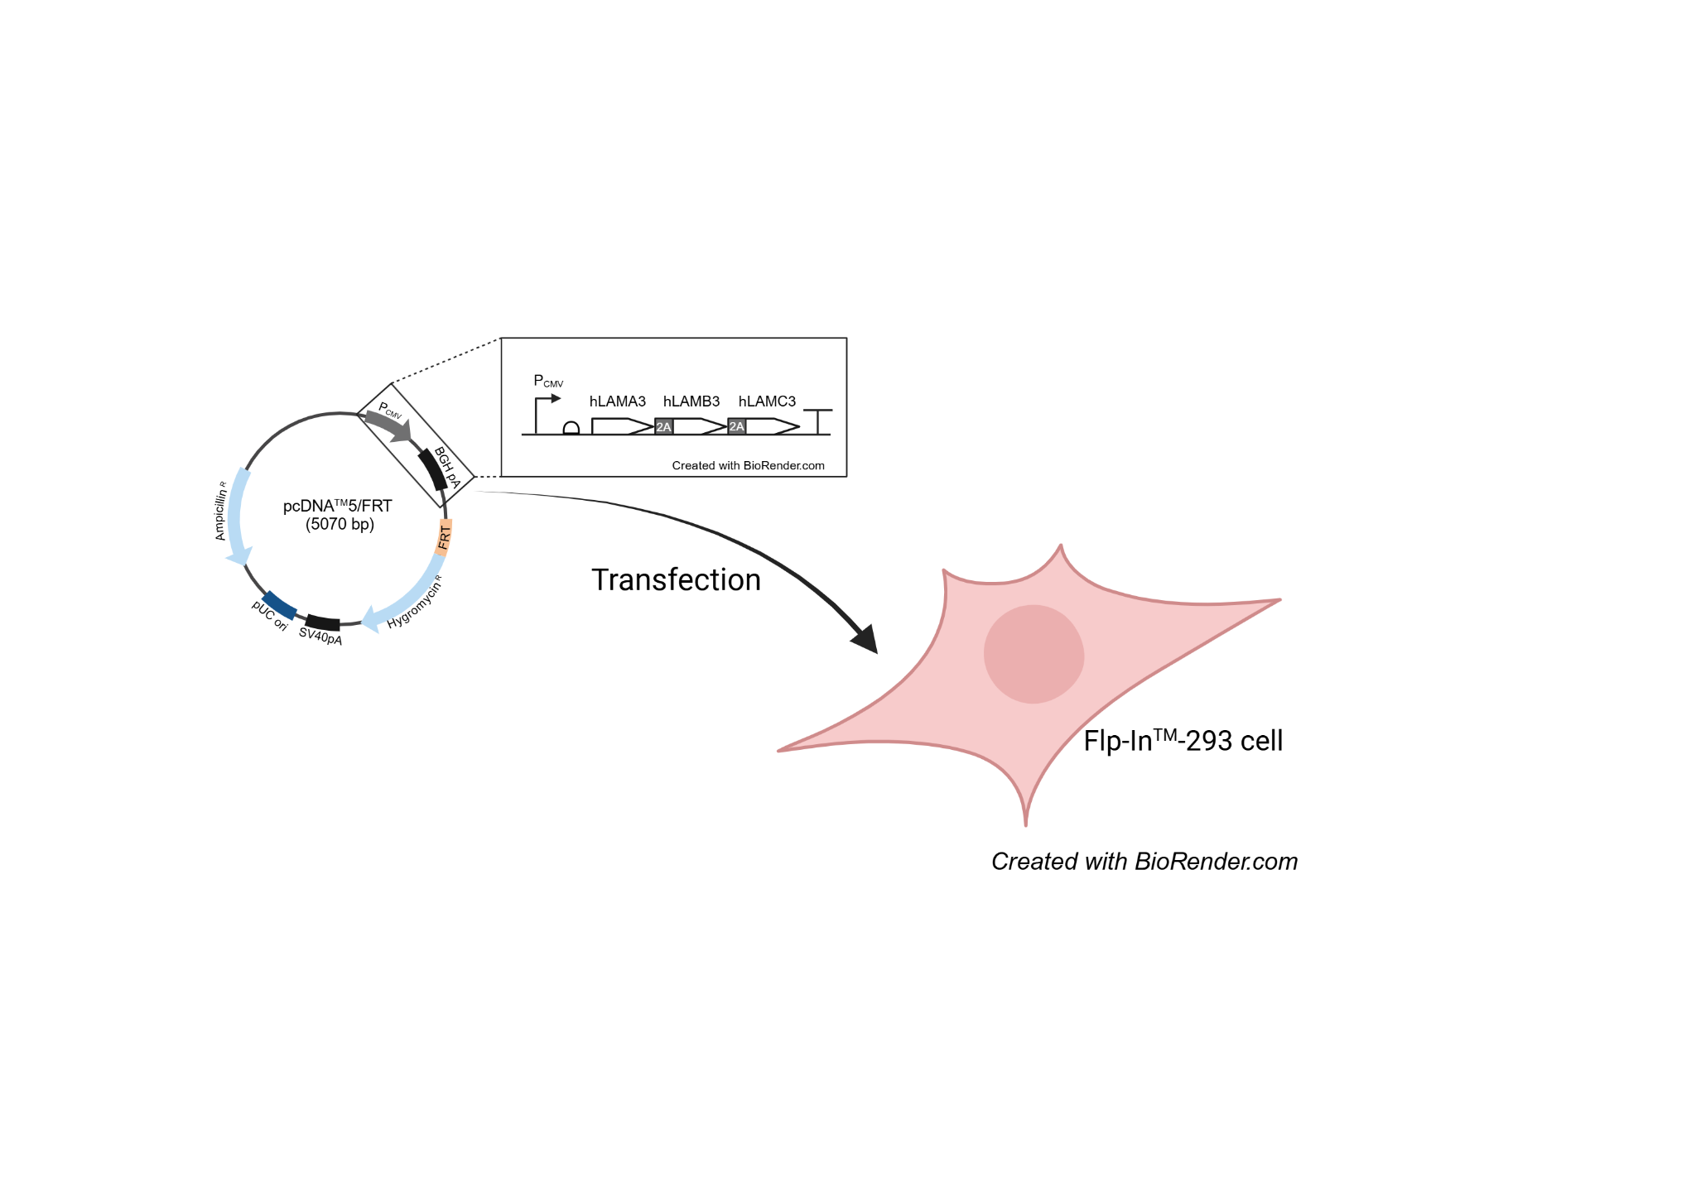
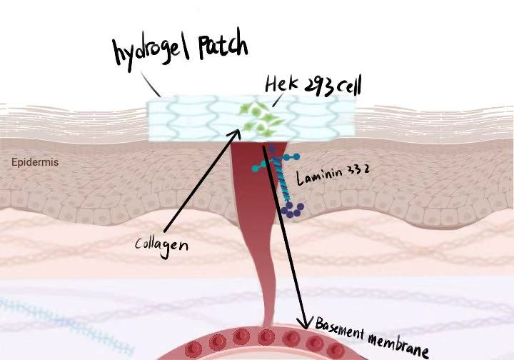






Synthetic Hemostatic Hydrogel
Anni Chen, Xixi Arya Chen, Kelly Du, Shengbo Micheal Jiang, Sally Li, Haoxiang Becky Liu, Jiache Liu, Jiayan (Lan) Liu, Yifan Xiang, Ruoxi Amy Zhou Daniel Kemp, Hiroko Kaczmarek (BioBuilder)
Hamden Hall Country Day School, Hamden, CT, United States of America.
Project Objective
Schematic of our DNA build strategy
Audio file:
Our project develops a bioengineered material for rapid hemostasis and wound healing. Engineered cells detect collagen at injury sites and release laminin-332 to enhance recovery. Encapsulated in a hydrogel “band-aid,” they provide controlled treatment without entering the bloodstream. This design improves safety, speeds healing, and supports sustainable medical care.
Proposed Application of Engineered Cells to Wound Site
Transfection of designed DNA
Notes:
Figure X. Our designed DNA will be transfected into Flp-InTM293 cells (Invitrogen), a HEK293 cell line that contains a stably integrated genomic FRT site. Upon successful recombination event, the genes coding for hLAMA3, hLAMB3, and hLAMC2 will be stably expressed.
Figure XX. Schematic of our DNA build strategy. The genes for three subunits that comprise laminin 332 (hLAMA3, hLAMB3, and hLAMC2) will be cloned into pcDNATM5/FRT vector from Invitrogen. The three ORFs will be co-expressed from one promoter by the inclusion of 2A peptide linkers.

