Slide 1



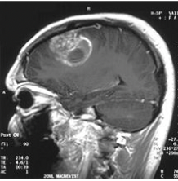






Targeted Delivery of Hydroxychloroquine to Glioblastoma Cells Using Transporter Proteins
Saanvi Bharadwaj, Amanda Lee Shen, Sophie Ohliger Yang
Castilleja School, Palo Alto, California, United States of America
We aim to test various transporter proteins in both vitro and vivo type experiments, with an emphasis on preventing hydroxychloroquine leakage to non-target areas and minimizing damage to normal cells.
A glioblastoma tumor is a very aggressive brain tumor which is resistant to traditional methods of removal.
Our proposed solution entails using a transporter protein which can carry HCQ to the tumor and induce cancerous cell death
Anticipated Experiment Details
Conduct in vitro experiments - such as experiments in petri dishes to assess how well the different transporter proteins can enter cancer cells, release HCQ, and modulate autophagy.
We will use mice models with glioblastoma tumors to evaluate the in vivo effectiveness of different transporter proteins in delivering HCQ and inducing cell death.
MRI of glioblastoma in 15 year old boy

