Slide 1

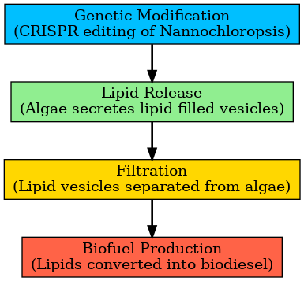
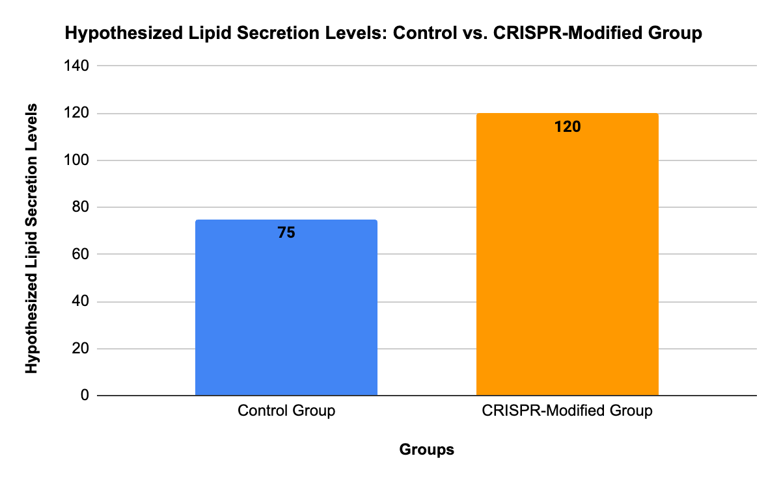






Fueling the Future: Harnessing Reusable Microalgae for Renewable Energy
Harjas Grover, Bridget Ha, Bella Horta, Eliana Kofman, Shaun Ng, Dora Mou, Ida Sanaktekin, Daniel Shaer, Annabelle Xia, Mr. Mato Seth, Mentored by Mr. Gitanshu Bhatia (LanzaTech)
Boston University Academy, Boston, MA, USA
Objective
This project’s objective is to enhance the efficiency and sustainability of biofuel production by genetically modifying algae, specifically Nannochloropsis, to continuously release lipids. Obtaining high concentrations of lipids is important, as they are essential in biofuel production. We plan to target genes involved in lipid storage to encourage the natural secretion of lipid-filled vesicles. This innovation eliminates the need for traditional methods of biofuel production, which proved to be cost-intensive and inefficient.
Overview of genetic system
The genetic system of this project will utilize CRISPR to edit the genome of the microalgae. We plan to target the genes responsible for the following:
Lipid production overexpressed, increasing overall production
Extracellular vesicle (Microvesicle) production increased, enabling lipid secretion without cell lysis and permitting continuous sustainable algal growth
Lipid storage systems modified so as to destabilize the lipid microdroplets and encourage secretion
Our project was mainly design-based and we didn’t collect experimental data. However, as part of our methodology, we aimed to test whether modified algae would result in greater lipid secretion compared to unmodified group. This experiment would be crucial for validating our design by providing empirical evidence of the effectiveness of our genetic modifications.

