Slide 1

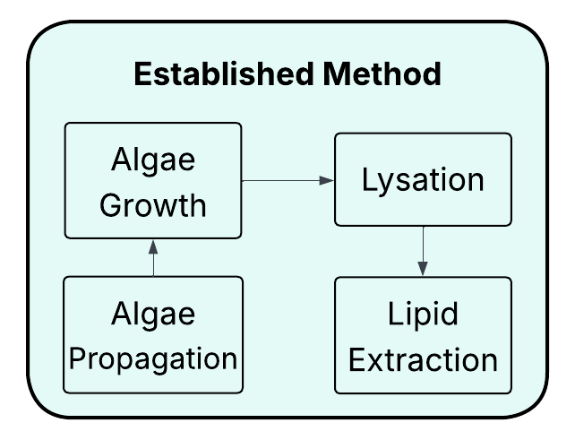
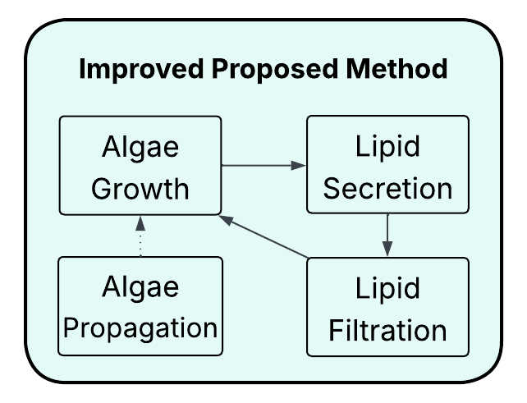
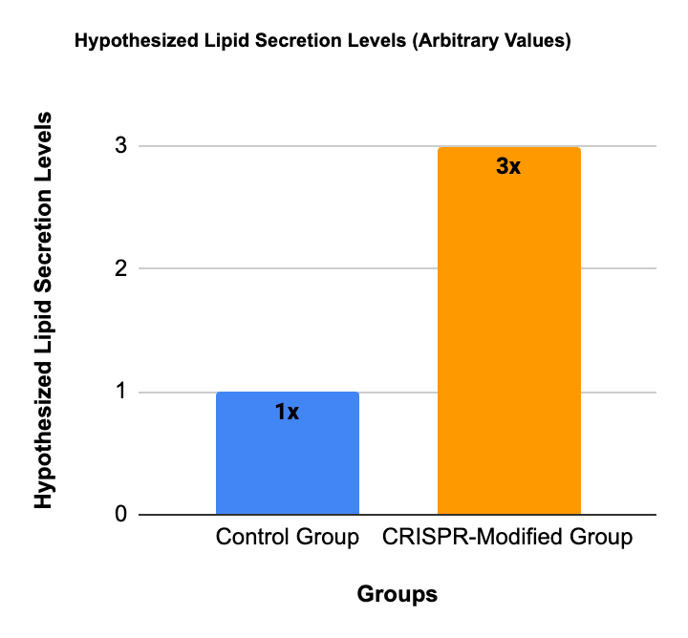








Fueling the Future: Harnessing Reusable Microalgae for Renewable Energy
Harjas Grover, Bridget Ha, Bella Horta, Eliana Kofman, Shaun Ng, Dora Mou, Ida Sanaktekin, Daniel Shaer, Annabelle Xia
Boston University Academy
The Problem: Why Do We Need a Better Biofuel?
Fossil fuels emit large amounts of CO₂ and remain the leading driver of global climate change.
Corn- and palm-based biofuels require significant land, water, and fertilizer, and compete with food production.
Microalgae grow rapidly, don’t need arable land, and are rich in energy-dense oils—making them a promising alternative.
But traditional oil extraction methods destroy the algae cells, making production costly, inefficient, and hard to scale sustainably.
Engineering Our Algae: How and Why
We plan to genetically engineer algae (Nannochloropsis oceanica) to produce and secrete oils sustainably for biofuels. Our approach has four goals:
1. Boost Oil Production
Introduce enzymes to increase fatty acid and oil synthesis.
2. Prevent Oil Breakdown
Remove enzymes that recycle oils, preserving high lipid content.
3. Enable Oil Secretion
Add transport proteins to export oil droplets continuously.
4. Maintain Cell Health
Include enzymes supporting photosynthesis and cell energy.
Why It Matters:
Our algae sustainably produce biofuel oils without destructive harvesting, reducing environmental impact and costs.
Next Steps: Lab Implementation
1. Cultivation and Testing
Grow algae strains and verify genetic edits.
2. Lipid Collection & Fuel Testing
Test filtration to harvest algae-produced oils.
Convert lipids into biodiesel and evaluate quality.
3. Optimization
Refine gene expression for maximum oil output and healthy algae growth.
Monitor lipid yields, growth rates, and photosynthetic health.
Our Solution
We plan to genetically engineer Nannochloropsis oceanica — a fast-growing species of microalgae — to continuously secrete lipids (oils) without needing to be harvested or destroyed.
Using CRISPR gene editing, we aim to:
Transform algae into efficient, self-renewing biofuel producers.
Create a system that eliminates the need for cell harvesting or chemical extraction.
Enable continuous oil release directly into the growth medium.
This means:
A clean, renewable energy source that runs without disrupting the organism.
A simpler, more energy-efficient way to collect biofuel.
A scalable, sustainable alternative to fossil fuels and traditional biofuels.
References
Ma, Y., Wang, Z., Yu, C., Yin, Y., & Zhou, G. (2016). Evaluation of the potential of 9 microalgal strains for biodiesel production. Bioresource Technology, 167, 503–509. https://doi.org/10.1016/j.biortech.2014.06.035
Grira, S., Abu Khalifeh, H., Alkhedher, M., & Ramadan, M. (2023). The conventional microalgal biofuel production process and the alternative milking pathway: A review. Energy, 277, 127547. https://doi.org/10.1016/j.energy.2023.127547
Molino, A., et al. (2018). Microalgae characterization for combined lipid and carbohydrate production. Energies, 11(10), 2713. https://doi.org/10.3390/en11102713

