Slide 1

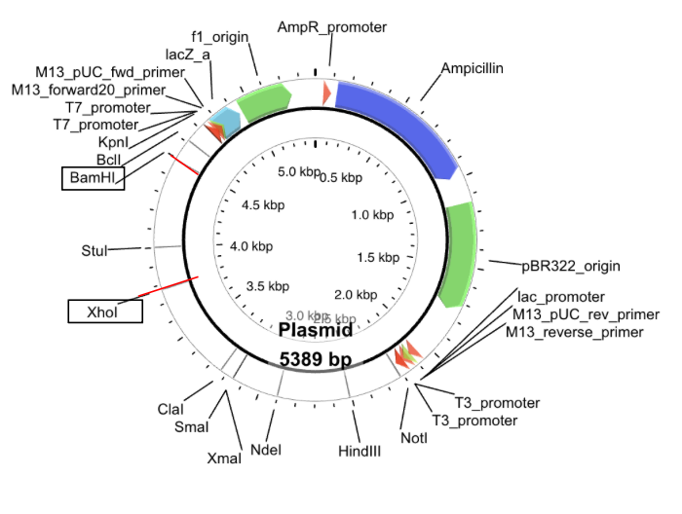
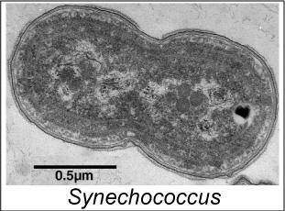
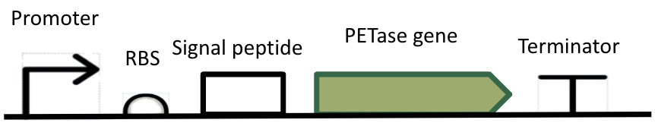






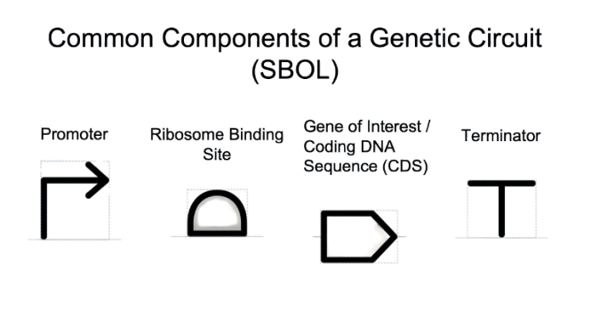
Echoing PETase!
Charlotte Eggimann, Nyla Tait, Roma Hatton Rueda, Nina Minsky, Jasmine Rancourt, Karin Schinkmann, Carine Robichon-Iyer, NEB, Mark Cherepashensky, BU
International School of Boston, Cambridge, MA, USA
Engineer a cyanobacteria: Synechococcus: to digest PET plastic
Proof of concept: PETase plasmid growth in E Coli, verify functionality
Final: PCR amplification of PETase gene, insertion into compatible plasmid for Synechococcus, transformation, expression, and verification of functionality
Promoter
Promoter
PETase gene
PETase gene
Terminator
Signal peptide
Terminator
Signal peptide
RBS
RBS

