Slide 1


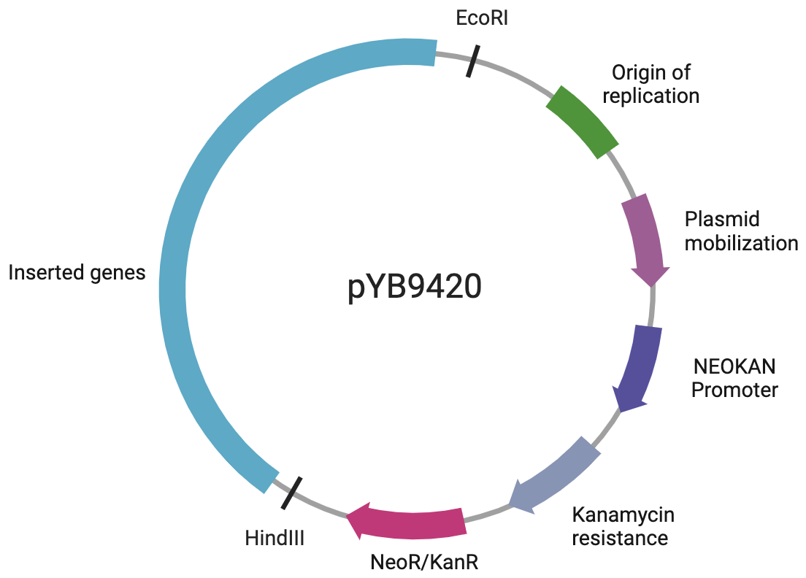
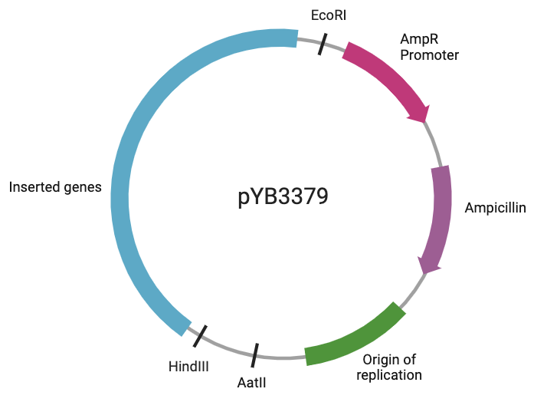
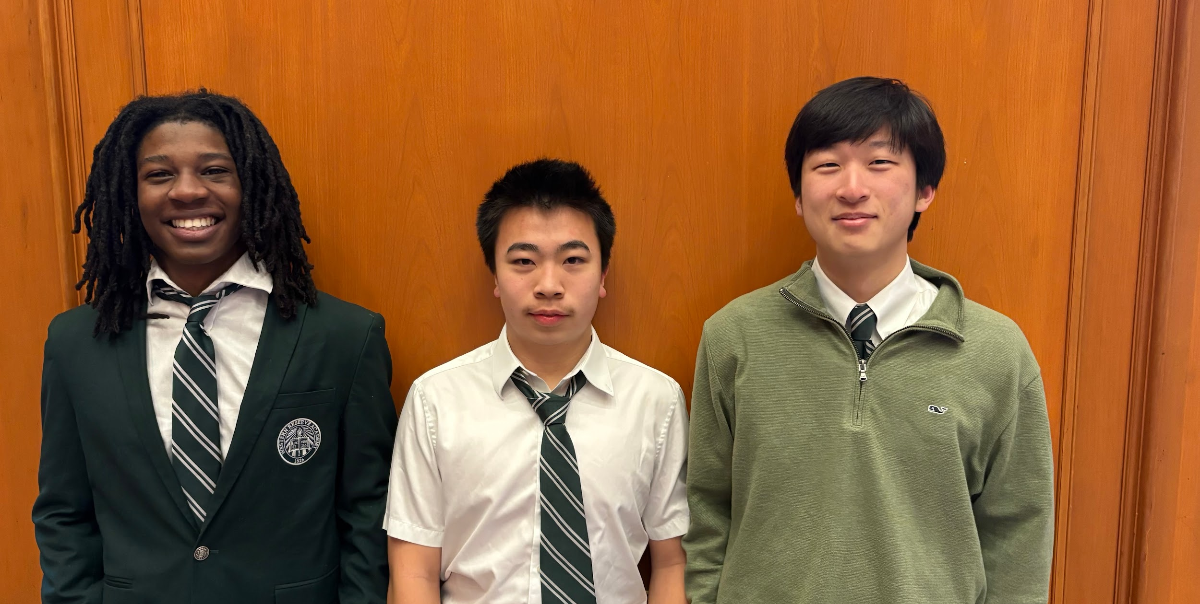
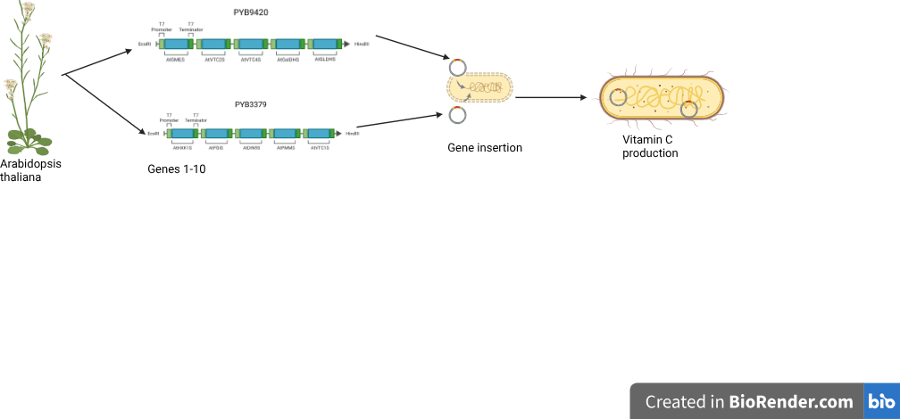







Biosynthetic Production of Vitamin C in Space
Blake Collier, Bob Fan, Haram Yoo, Dr. Pethel, Ming Hia (Boston University)
Western Reserve Academy, Hudson, Ohio, United States
Abstract
Maintaining sufficient vitamin C intake is crucial for astronauts’ health and mission success. As astronauts embark on multi-year expeditions, vitamin C content in processed foods aboard spacecraft degrades over time. Without sufficient vitamin C, tissue growth and repair, wound healing, and immune functions are significantly debilitated. We identified two plasmids containing the vitamin C production pathway from Arabidopsis thaliana to transform into Escherichia coli. By engineering a cosmic radiation resistant variant of E. coli isolated by a group of researchers with the vitamin C pathway genes, our project will create a sustainable source of vitamin C for astronauts. To improve protein expression, we will use CRISPR to knock out the OmpT and Lon proteases in the radiation resistant E. coli chassis. E. coli exposed to microgravity environments displays increased growth and production of recombinant DNA. Moreover, the adaptability of this method could be extended to the production of other essential vitamins such as vitamin A and vitamin D. We hope to provide astronauts with the necessary nutrients for deeper space exploration.
Science Content
Utilize two existing vectors to insert the 10-step vitamin C pathway from A. thaliana into the chassis.
Knock out the OmpT and Lon protease genes of radioresistant chassis (IR9-100-2) with CRISPR to enhance protein production.
Cultivate the E. coli in a bioreactor to maintain the pH levels, temperature, and proper nutrient growth.
Separate vitamin C from E. coli.
Use ion-exchange chromatography to ensure vitamin C is purified.
Convert the vitamin C liquid into a powder which will be ready for a capsule.
Orbital Pioneers
Bob Fan- New to the science world, fueled by passion for the stars.
Blake Collier- Has taken two years of Cancer Immunology.
Haram Yoo- New to the science world.
The team is filled with laughter and hard work.
Introduction
As space exploration extends beyond the Moon and Mars, maintaining astronaut health is crucial. Vitamin C (L-ascorbic acid) degrades over time, making long-term storage impractical. A sustainable solution is in-space vitamin C production using E. coli, a well-established chassis in synthetic biology.
Next Steps
Test the production of vitamin C of either inserting radioresistant genes into BL21 or enhancing recombinant protein production for the radioresistant strain of E. coli .
Test the feasibility and efficiency simulating space conditions
E. coli can be engineered to convert GDP-mannose into vitamin C through a
five-step pathway. However, naturally produced GDP-mannose in E. coli is not enough to be directed to vitamin C conversion. Therefore we identified a 5-step pathway to produce GDP-mannose. To address the conditions in space, we will be working with a strain of radioresistant E. coli which will be enhanced using CRISPR. By producing E. coli in space, astronauts can produce vitamin C on demand,reducing reliance on costly resupply missions. This approach ensures a stable nutrient supply, supporting long-duration missions beyond Earth’s orbit.
References and acknowledgements‌
Scan the QR code for detailed references.
We would like to thank Dr. Pethel and Mr. Hia for their guidance

