Slide 1


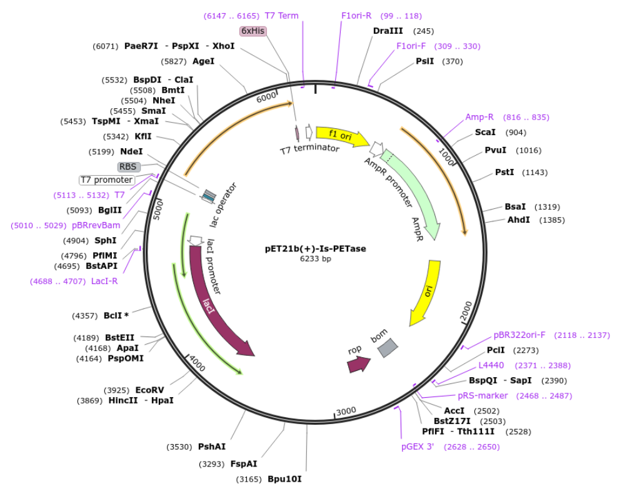
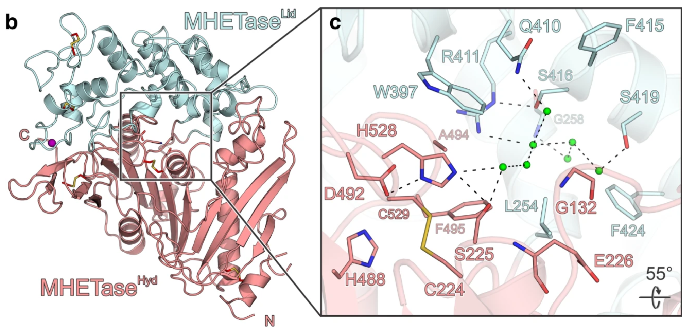
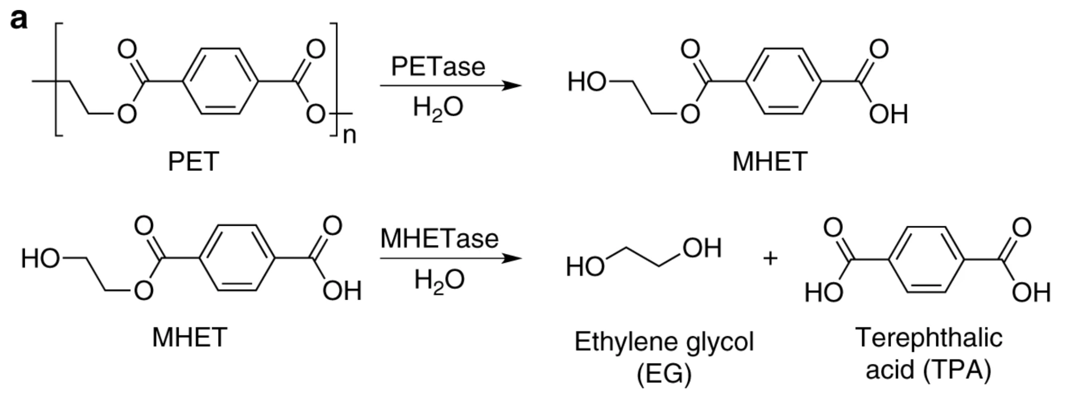
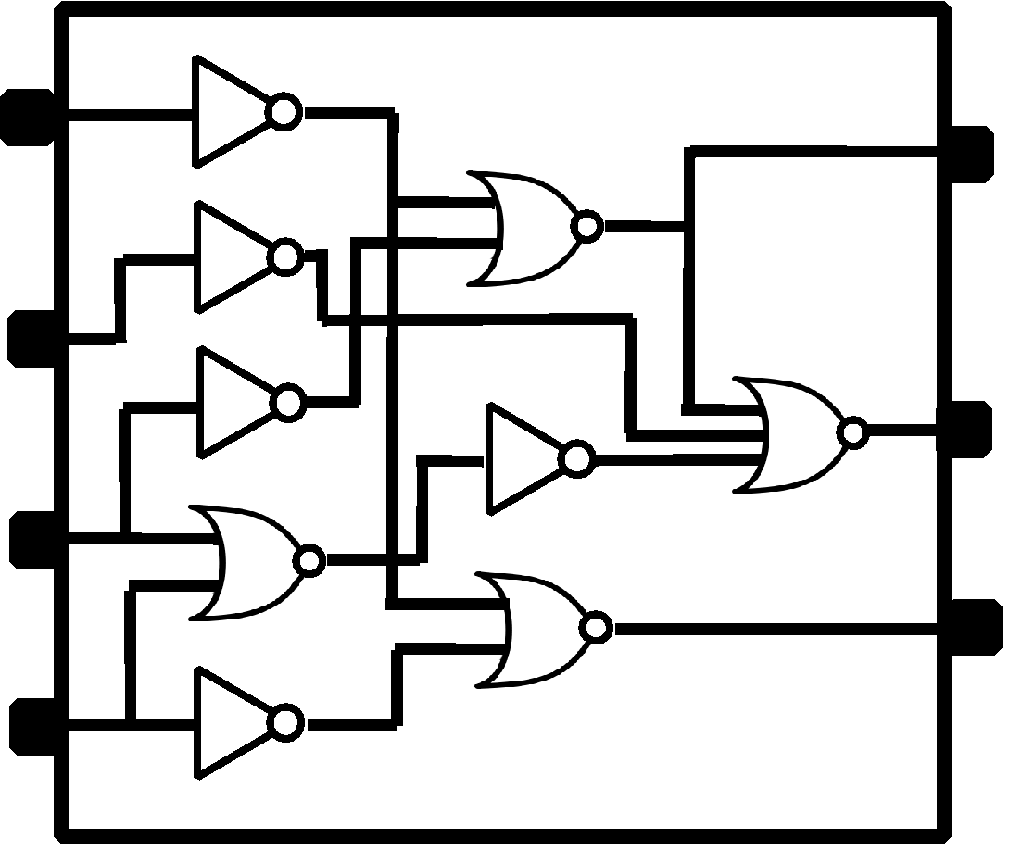
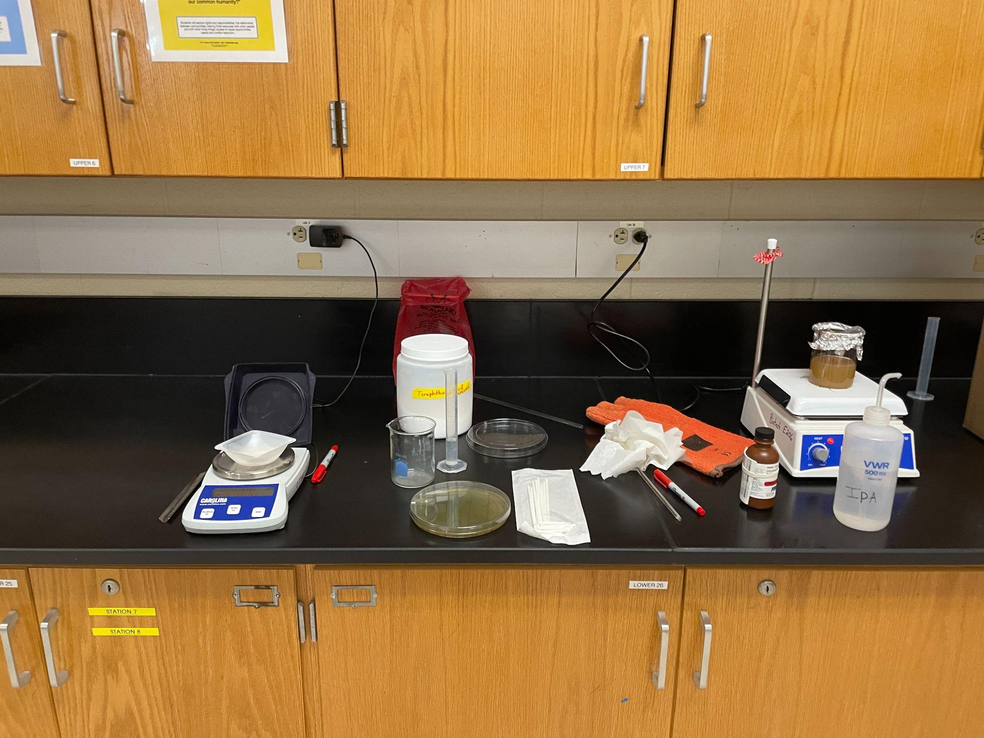
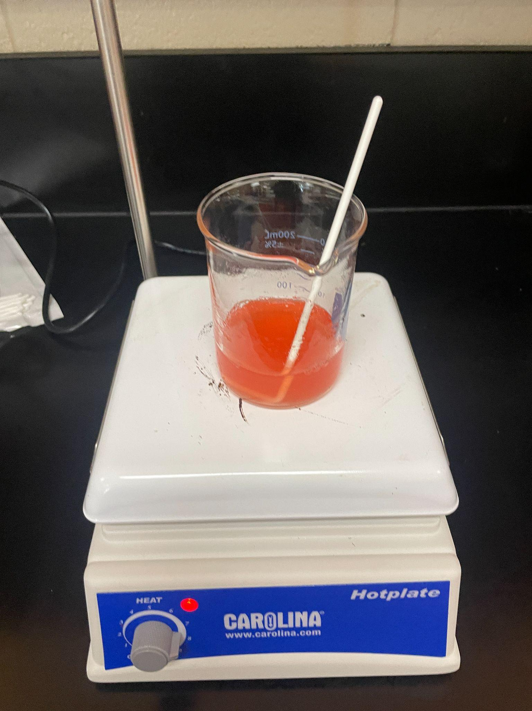
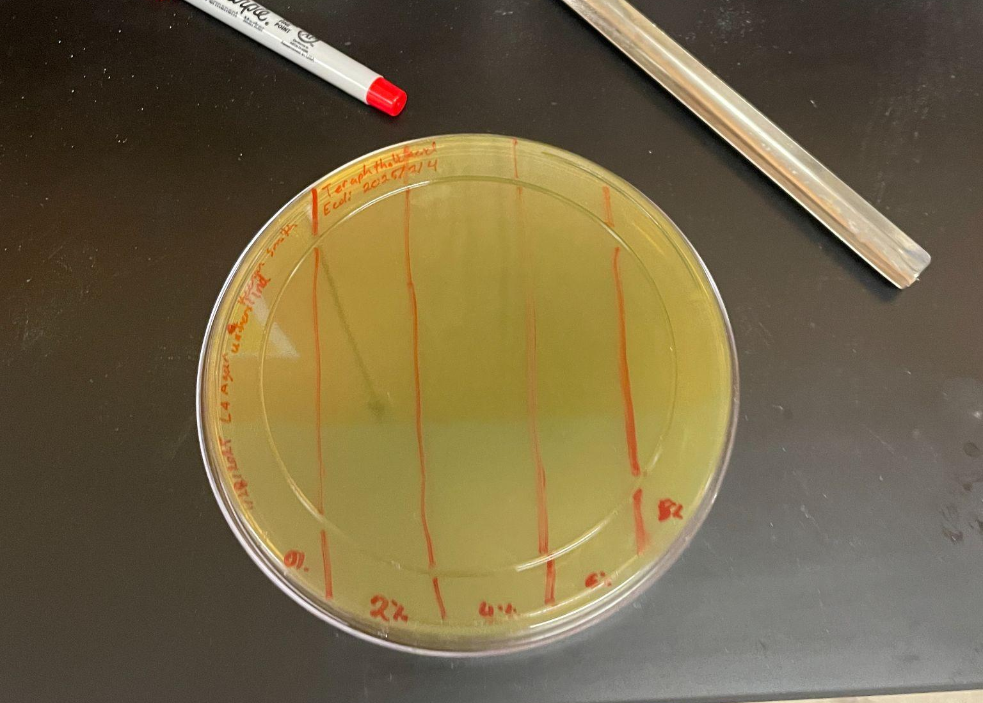






PROBLEM SOLVING POLLUTION with PETase
Keenan Smith, Amanda Barrett, Irene M.B. Reizman, Ph.D. (Rose-Hulman Institute of Technology) Marietta High School, Marietta, Georgia, United States
The objective of the PETase project is to develop and use the enzymes produced by the bacteria ideonella sakaiensis that allow PET plastics to be broken down into much smaller monomers using E coli.
There are two major hurdles to overcome, first is to make E coli resistant to an acid byproduct and the second is to insert the plasmid containing the PETase and MHETase genes.
A limitation of this project is the possibility of E coli rejecting the plasmids due to a less than ideal environment.
Predicted results is that it will take some time to develop acid resistance in E coli that will retain plasmids in a stressful environment.
Schematic/ Graphic Depiction of your project

