Slide 1

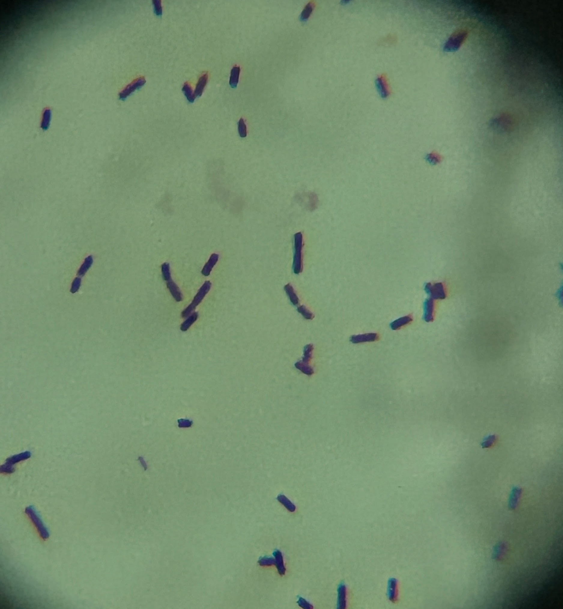
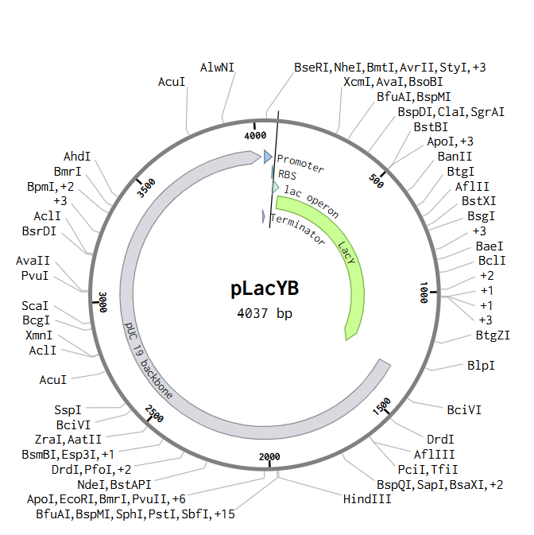







Optimizing Co-Culture Growth of E. coli and L. acidophilus: Enhancing E. coli for Improved Lactose Utilization
Makayla Dunn, Suleman Bahar, Amanda Barrett, Hia Ming (Boston University)
Marietta High School, Marietta, Georgia, USA
Abstract
This project was two-fold - first, to further elucidate the co-culture growth of E.coli and L. acidophilus, and second, to utilize E. coli as a model to demonstrate genetic enhancement for greater permeability of lactose. Enhanced lactose uptake will lead to increased metabolism of lactose and thus lead to the alleviation of lactose intolerance symptoms.
Science Content
Notable Materials
Beta glucan
MRS media
Dehydrated L. acidophilus
E. Coli K-12
Design Outline
First MRS agar with varying concentrations of beta glucan ( 5%, 10%, 15%) would be plated. Which would then be inoculated with Lactobacillus and E. Coli and with solely Lactobacillus. This would be left for 72 hours. This would then be repeated for three trials at each concentration of beta glucan. Then the results will be observed and measured based off of CPUs.
Expected Outcomes
We predict that higher concentrations of beta glucan would stimulate Lactobacillus growth as seen with Dai et al. (2022). Additionally, in cocultures it is expected that the number of E. coli CFU’s will decrease as beta glucan concentrations increase. This would be applicable to Lactobacillus’ use as a probiotic in conjunction with prebiotics like beta glucan as a method of inhibiting pathogenic bacterial growth.
Team Content
We are a returning team with one new member, one returning member.
And maybe some next steps:
Hopefully, the next step of our research would be actually performing our planned experiment. Further funding is needed to be able to get the plasmid model created so that it can be tested for functionality.
We would want a different team to insert the plasmid into E. coli through transformation. Then have them culture it in nutrient agar with a different set of nutrient agar culturing untransformed E. coli. Last to test the efficiency of the engineered E. coli spread hydrated lactose into every dish and use a pH indicator to measure how much lactose was metabolized.
Gram-stained rehydrated L.acidophilus in oil, 1000x magnification
Introduction/Background
Escherichia coli is a common bacteria found in food, water and intestines. It aids in the breakdown of nutrients and protects the body from harmful bacteria (Ingerson-Mahar & Reid, 2011). E. coli breaks down lactose, a sugar found in dairy products. Due to the complexities of engineering on Lactobacillus, an E. coli chassis is used as a model to provide proof of concept. The Lac operon in E. coli consists of three genes: LacA, LacY, and LacZ (1). It is responsible for intake and metabolism of Lactose in the absence of glucose. The experiment is focused on the LacY gene, which encodes for the production of lactose permease. Its function is to allow lactose into E.coli to then be metabolized into galactose and glucose. The goal is to increase the expression of the LacY gene and raise the overall production of lactose permease to enhance the uptake of lactose.
References
We would like to thank Hia Ming for his amazing assistance, mentoring, and encouragement.

