Slide 1

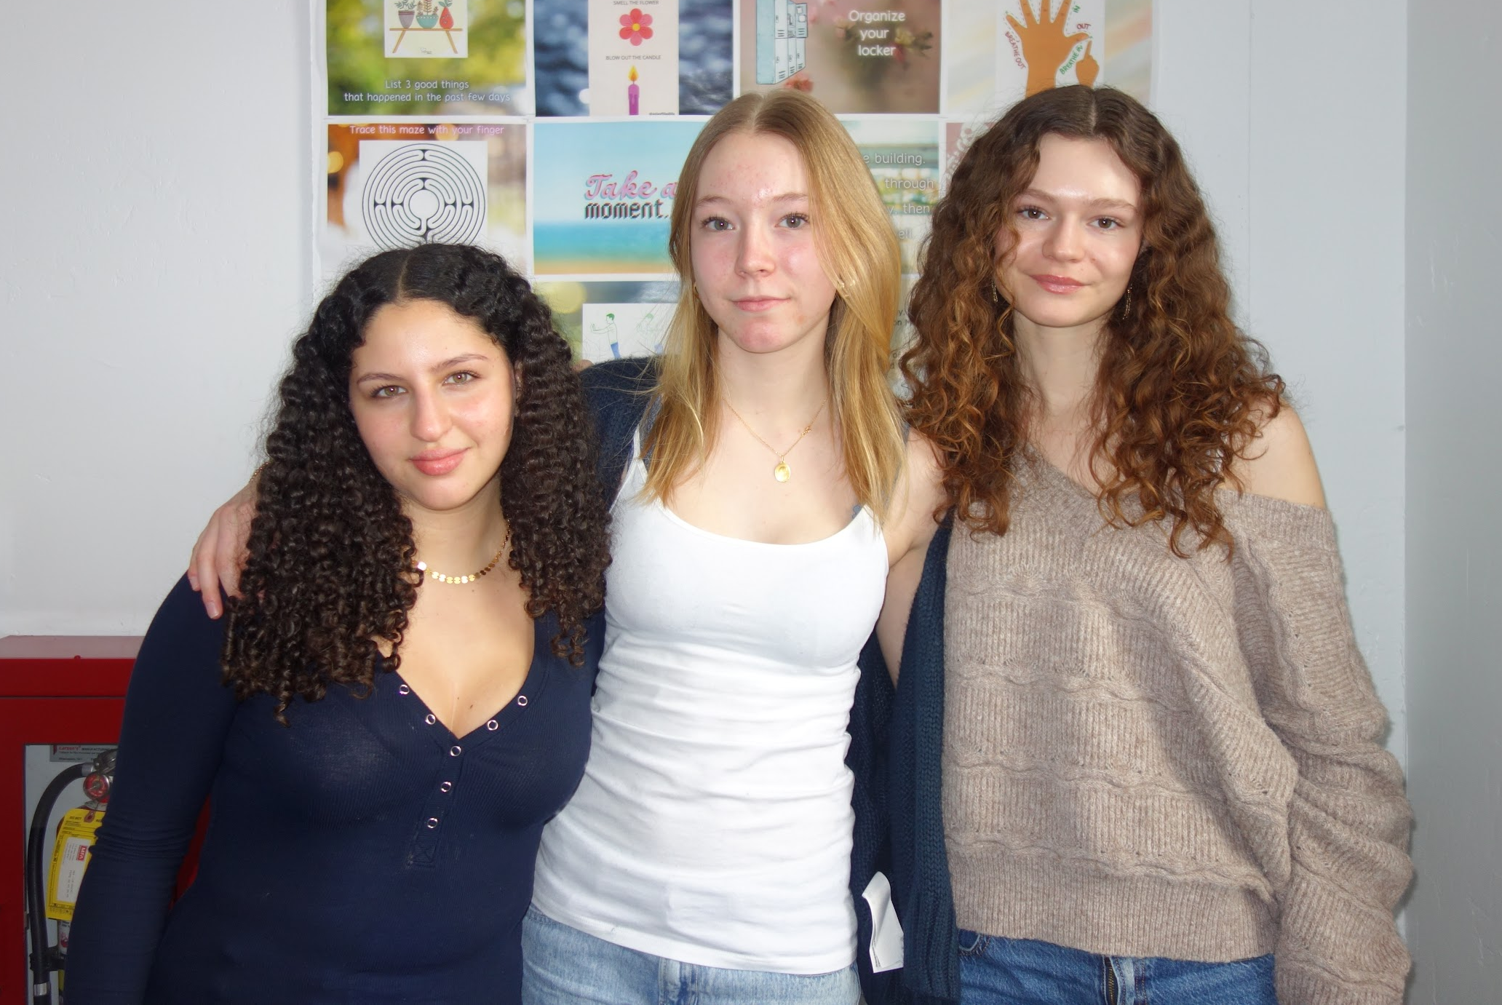
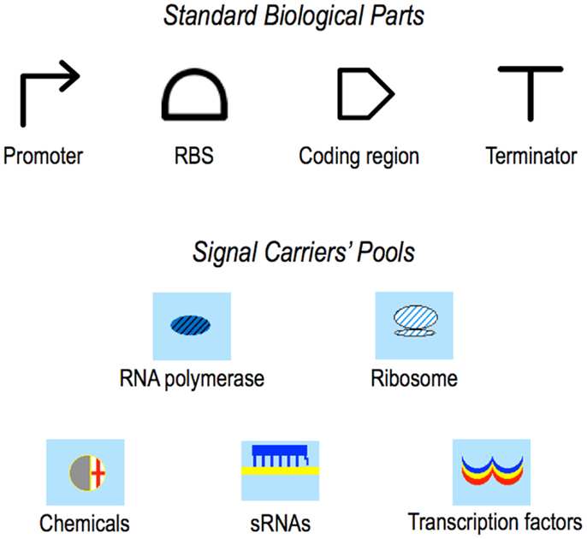
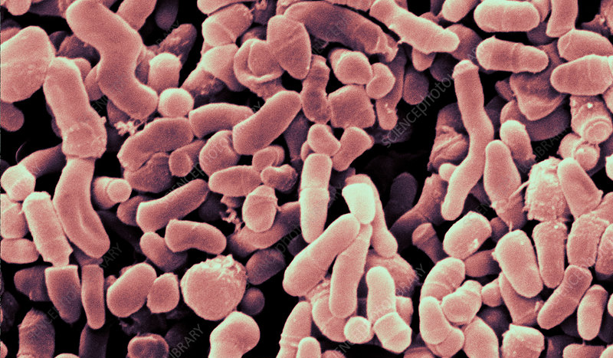
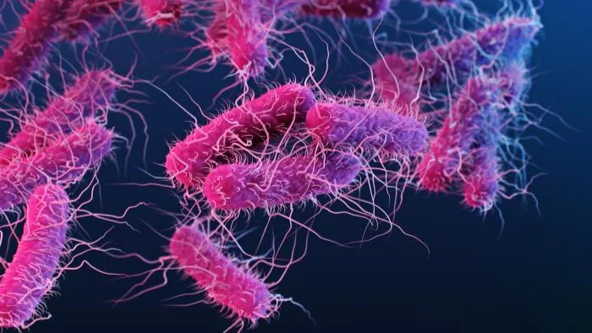







MICROBE MAKEOVER: REDUCING INFLAMMATION FROM HYDROLYSIS OF TRIGLYCERIDES
Elizabeth Hossack, Tia Makary, Camille Petit, Karin Schinkmann, Javin Oza
International School of Boston, Cambridge, MA, USA
P. acnes contributes to acne by releasing lipase GehA, which hydrolyzes sebum triglycerides into inflammatory free fatty acids. This project aims to engineer Staphylococcus epidermidis to secrete a competitive peptide inhibitor targeting GehA. As proof of concept, E. coli will first be modified for inhibitor production and tested via a p-nitrophenyl palmitate (pNPP) assay to measure the reduction of lipase activity. If effective, the system will be adapted for S. epidermidis, offering a microbiome-based acne treatment.
We will engineer E. coli to express and secrete a competitive peptide inhibitor targeting the lipase GehA
Plasmid 1: Expresses the lipase inhibitor peptide, controlled by a T7 promoter and secreted using a PelB signal peptide
Plasmid 2: Produces GehA lipase with a His-tag, enabling purification and allowing us to test the ability of the inhibitor to affect lipase activity
Lipase activity will be assessed via a pNPP assay. If successful, the system will be transferred to S. epidermidis for in situ inhibition of P. acnes lipase.
Next steps:
Clone the genetic circuit into E. coli
Express, purify, and validate the peptide inhibitor
Cloning and expressing GehA enzyme (none commercially)
Test inhibition of GehA using a pNPP assay
Optimize secretion and stability in a skin-like environment (in vitro)
Transfer the system to S. epidermidis and test with P. acnes
Abstract
Science Content
Team Content
√Tia Makary
11th grader, IB
1st year
Camille Petit
11th grader, FR
1st year
√Elizabeth Hossack
11th grader, IB
2nd year
Plasmid 1: Peptide Inhibitor Expression
Introduction/Background
Acne is a common skin condition affecting millions, primarily due to excess sebum production and bacterial activity. P. acnes plays a key role by producing GehA, an enzyme that hydrolyzes sebum into inflammatory free fatty acids, contributing to clogged pores and breakouts. Traditional treatments, including antibiotics and retinoids, often have side effects and disrupt the skin microbiome. This project explores a targeted synthetic biology approach to inhibit GehA and reduce inflammation without disturbing the natural microbial balance.
Promoter (T7)
RBS
Lipase Inhibitor Peptide
PelB Secretion Signal
Terminator (T1)
Plasmid 2: GehA Lipase Production for Testing
Promoter (T7)
RBS
PelB Secretion Signal
GehA Lipase
His-Tag
Terminator (T1)
References and acknowledgements
Scan for references
We’d like to thank Dr. Schinkmann and Dr. Oza.
Propionibacterium acnes
Escherichia coli
Notes:
Underneath the images of the bacteria, please add their scientific names
Color the shapes in the genetic circuits for more visual appeal
Yellow highlight: Change to competitive peptide inhibitor
***change ‘quantify’ to ‘and test the ability of the inhibitor to affect its activity’ or something to the effect
** all scientific names of bacteria should be italicized
*blue: add a step about cloning and expressing GehA enzyme (we are doing this because we couldn’t find it commercially for now, if anyone asks you)

