Slide 1


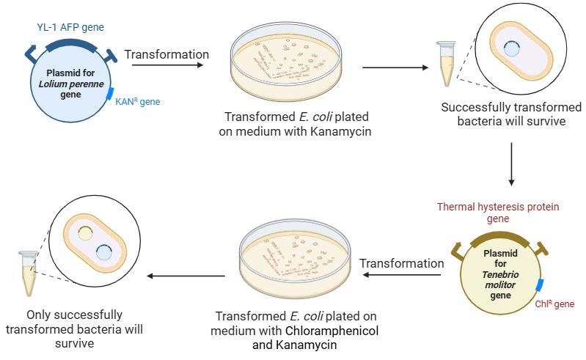
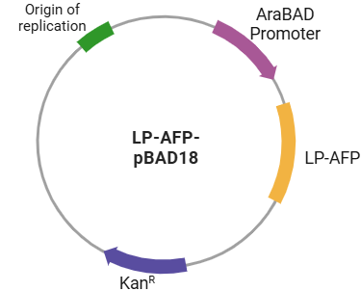



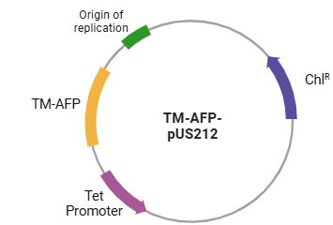
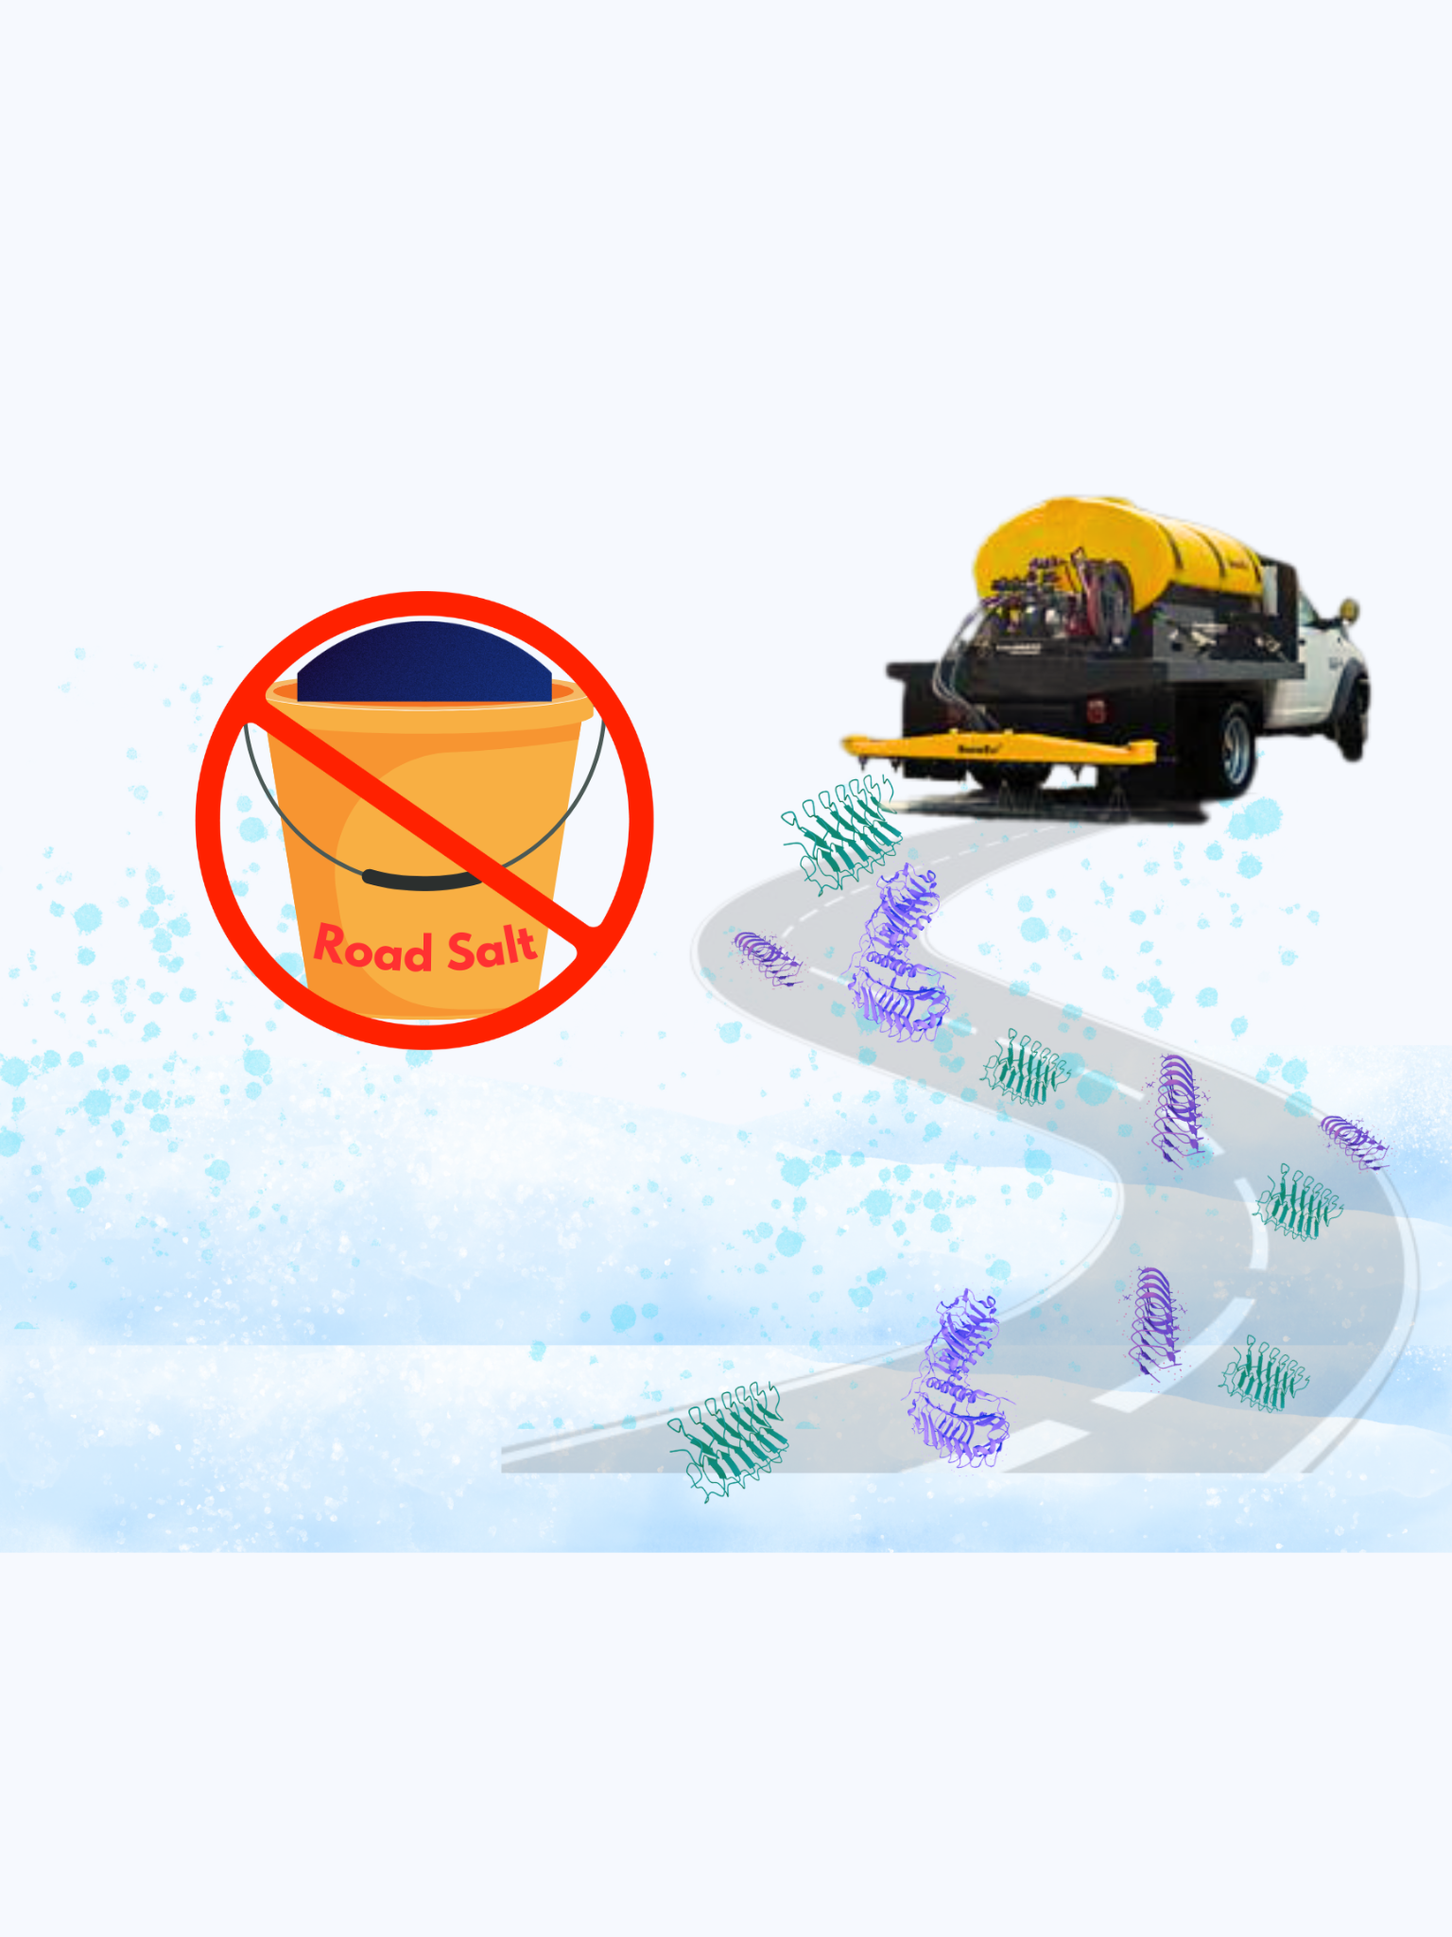
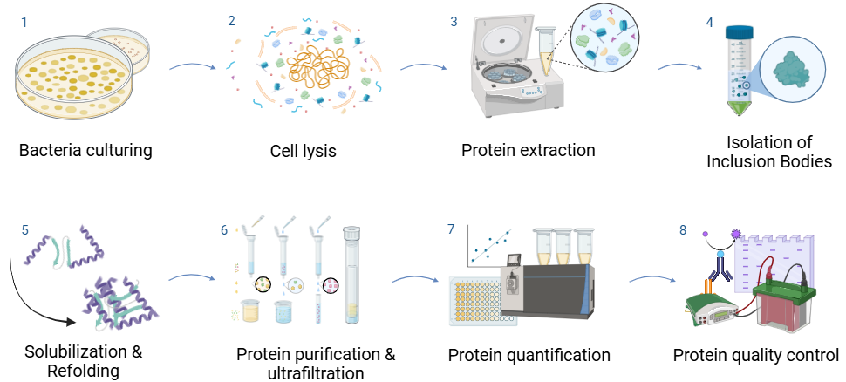

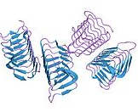






Road Salt Alternative Using AFPs
Arsh Goyal, Hyunwoo (Nicole) Pae, James Vacca, Lingzhen (Loretta) Wang, Dr. Beth Pethel, Dr. Becky Meyer (MIT)
Western Reserve Academy, Hudson, Ohio
Abstract
Annual U.S. vehicle crashes on snowy and icy roads result in more than 1,300 deaths and 116,800 injuries. However, using chemical road salt to prevent accidents has negative consequences, including corrosion and nearby water contamination. Our design, a more eco-friendly solution, utilizes naturally occurring antifreeze proteins (AFPs) to prevent ice formation on road surfaces. This project constructs two plasmids, one expressing an AFP from Lolium perenne (perennial ryegrass) and one from Tenebrio molitor (mealworm). Both genes are controlled by inducible promoters in Escherichia coli chassis. Proteins will be extracted from the transformed E. coli using cell lysis, centrifugation, and solubilization to release the inclusion bodies containing the proteins. AFPs will then be purified through affinity chromatography to ensure high purity for functionality and stability tests. The application of these AFPs offers a sustainable and eco-friendly alternative to traditional road salt, mitigating environmental damage while preventing risks of icy roads.
Workflow of Genetic Engineering to Application of AFPs
Two Components for High Performance AFP
Tenebrio molitor is a freeze-susceptible mealworm that survives the cold winter by producing AFPs. We introduce a YL-1 gene from this species to enable the production of AFP in E. coli.
Perennial ryegrass (Lolium perenne) produces antifreeze proteins to protect itself against the cold. Its gene encoding an ice recrystallization inhibition protein-like protein can be incorporated alongside the other genes to produce super AFPs.
Chassis - E.coli (DH5alpha, BL21)- for its demonstrated efficiency in the pilot-scale production of AFP in several publications.
We ran a gel electrophoresis to verify the purified plasmid DNAs we had. Left to right, we had the pUS212 (2808 bp), λ DNA ladder, and pBAD18-Kan (5437 bp).
The concentrations for pBAD18-Kan and pUS212 were 28.19 ng/μL and 12.33 ng/μL, respectively.
Plasmids Transformation in E. coli
Plasmids Designs
Meet the Team
Next Steps
Confirm the functionality of the newly created plasmids.
Isolate the target proteins from the E. coli cell lysate.
Proceed with protein quality assessments.
Perform functionality tests to verify the effectiveness of the AFPs.
Gather performance data from samples in simulated icy road conditions.
Our team is comprised of three seniors and one junior. Two seniors are returning, while the other two students are new to the team.
Background
Road Salt's Negative Impact: Due to the harmful effects of road salt, including vehicle corrosion, infrastructure, and the infiltration of salt in ecosystems and well water, we are creating an environmentally safe alternative road salt.
Mechanism of AFPs: AFPs adhere to the surface of forming ice crystals. This prevents water molecules from joining the ice nucleus at the attachment sites. The interaction alters ice crystal growth and shape, creating a convex surface on the liquid-facing side where AFPs bind, thus modifying the ice's growth pattern.
Protein Harvesting Procedure
The negative effects of road salts to human health, environments, and infrastructures.
Acknowledgements
We extend our gratitude to Dr. Beth Pethel for her support and guidance throughout our project and to our mentor Dr. Becky Meyer for sharing her valuable knowledge and experiences.
References
AFPs
Application of AFPs on road surfaces to prevent ice formation

