Slide 1

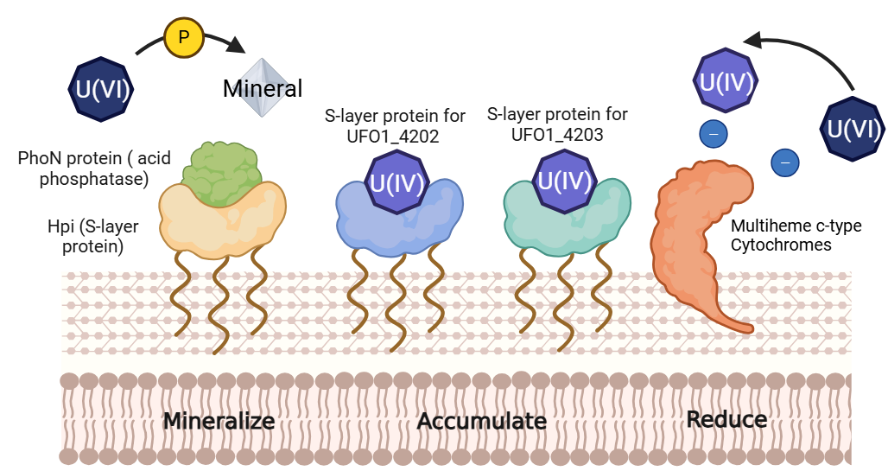
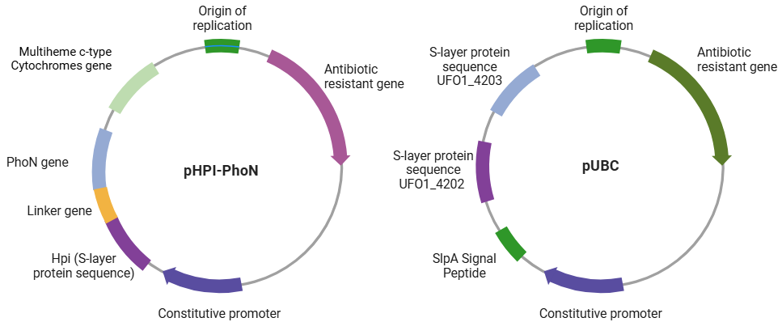
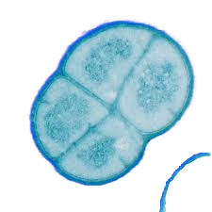
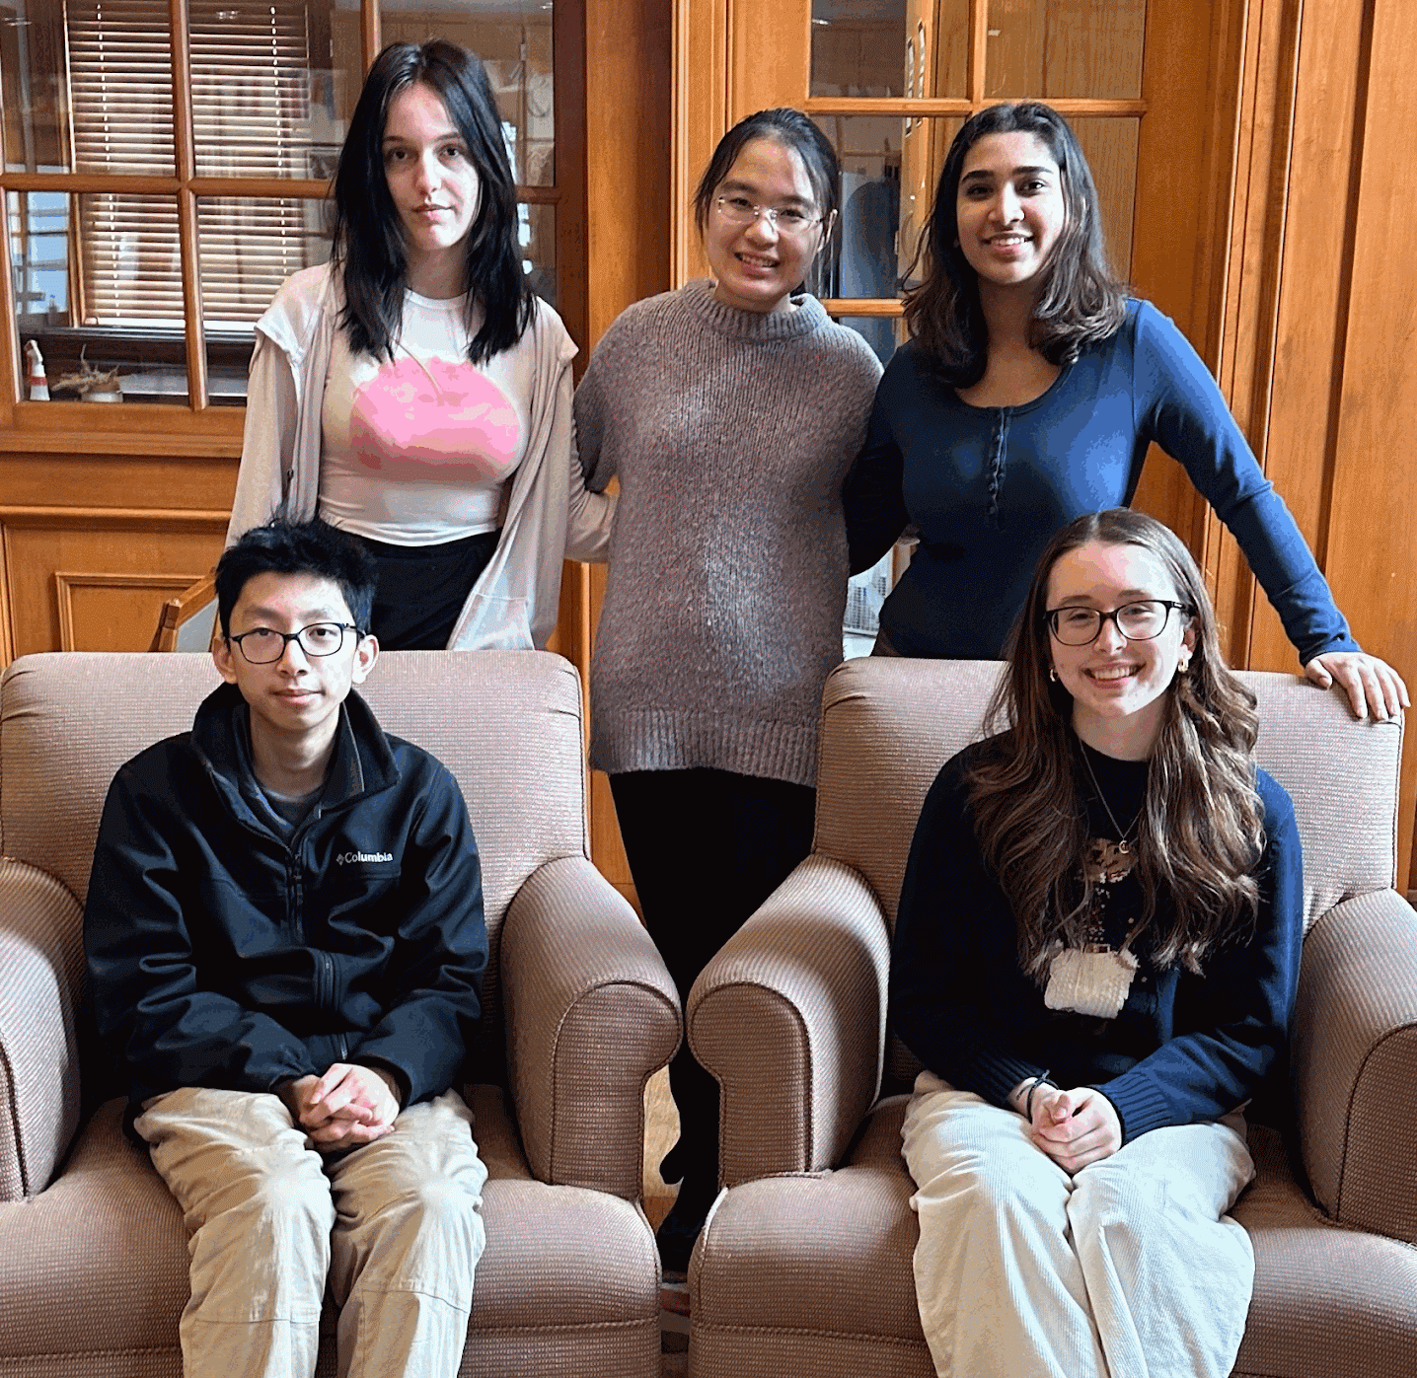
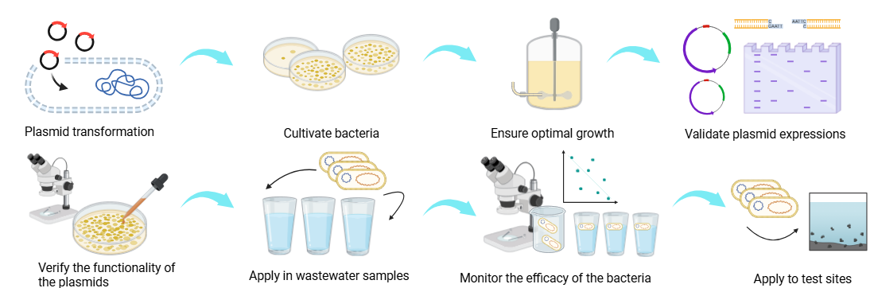







Remediation of Uranium via a Novel Deinococcus radiodurans Construct
Isabella Haslinger Johnson, Sofia Kovačević, Aparajita Shimpi, Lingzhen Wang, Wen Xiao, Dr. Beth Pethel, Dr. Jason Boock (Miami University)
Western Reserve Academy, Hudson, OH, USA
Radioactive metals are natural or synthetic elements that release alpha (α), beta (β), or gamma (γ) rays harmful to both humans and the environment and pose carcinogenic risks to humans. The growth of the uranium mining industry has led to increased amounts of contaminated radioactive wastewater being released into the environment, leading to ecological and public health threats. Our design is a cost-effective and sustainable alternative to traditional wastewater treatment methods. It also offers increased versatility by targeting U(VI) and U(IV). Deinococcus radiodurans, known for its extraordinary genetic repair mechanisms, which allow it to resist extremely high radiation levels, will be engineered as a heavy-metal uranium remediator. Our design introduces a fusion protein construct combining D. radiodurans’ S-layer protein with PhoN, an acid phosphatase enzyme that releases inorganic phosphate (Pi), which reacts with uranium (U) to form a solid uranium-phosphate compound. We will express multiheme c-type cytochromes that reduce uranium from its hexavalent state U(VI) to a less soluble and less toxic tetravalent state U(IV). To enable U(IV) binding, we will also introduce Pelosinus sp. strain UFO1’s uranium binding complex (UBC) encoded by UFO_4202 and UFO_4203. This construct combines bioprecipitation, bioreduction, and uranium binding to enhance the immobilization of uranium in two oxidation states and offers sustainable uranium detoxification and pollutant spread prevention in contaminated environments.
Abstract
Workflow of Genetic Engineering for Uranium Bioremediation
Three Components for Enhanced Uranium Remediation
  Uranium Reduction via Multiheme c-Type Cytochromes: enables the reduction of uranium from its hexavalent state (U(VI)) to its less soluble and less toxic tetravalent form (U(IV)).
  Uranium Mineralization by Fusion Protein: combines D. radiodurans’ S-layer protein with PhoN, an acid phosphatase enzyme. PhoN facilitates the release of inorganic phosphate (Pi), which reacts with uranium to form insoluble uranium-phosphate compounds, aiding in accumulation.
  Uranium Accumulation via Pelosinus sp. UBC System: introduce Pelosinus sp. Strain UFO1’s UBC, encoded by UFO_4202 and UFO_4203, which strengthens the uranium sequestration ability.
Chassis – Deinococcus radiodurans: Chosen for its exceptional radiation resistance and genetic repair capacity, providing a robust platform for uranium bioremediation in radioactive wastewater environments.
Overview of Uranium Remediation
Plasmids Construction and Transformation into D. radiodurans
Team Content
We are a new team made up of five members from Western Reserve Academy. All of us have a love for biology and creative minds connecting us to synthetic biology, which is why we are excited to create novel designs. New students will join us this spring.
Building and Testing Procedures
Next Steps
Validate the expression of the proteins in D. radiodurans.
Test the effectiveness of D. radiodurans to mineralize, reduce, and accumulate uranium.
Background
Uranium’s human health impacts: kidney toxicity, respiratory diseases, and increased cancer risks.
Uranium’s environmental impacts: toxic effects on aquatic life and making water sources unsafe for human consumption.
Current uranium remediation, such as membrane filtration, persulfate reduction, and electrocoagulation require large amounts of electricity to operate continuously. The equipment and material necessary to utilize these methods, namely ion exchange resins and photocatalytic reactors, are expensive to manufacture and maintain.
Continuous monitoring of pH, temperature, and contamination levels requires skilled labor, adding to operational costs.
References and Acknowledgements
We’d like to thank Dr. Beth Pethel for guiding our project and our mentor Dr. Jason Boock for his expertise and advice.

