Slide 1

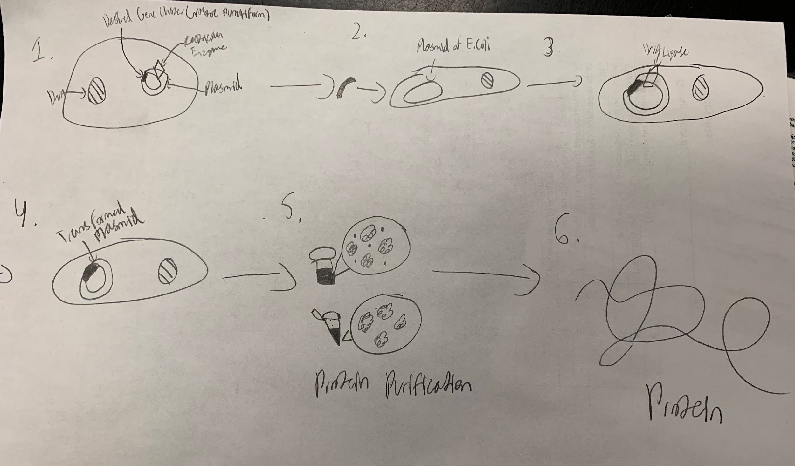






Genetic Engineering of E.coli BL21(DE3) for Sustainable Shinorine-Based UV Protection
Eli Andry, Samved Gazzala, Hannah Hagen, Saranya Mekala, Aarav Patel, Vibhi Rathor,Prabha Sigamani, Mateusz Skoplak, Claire Wright, Yue Zhuang,
Stephen Nelson (Teacher), Rebecca C. Meyer, PhD (Mentor - MIT)
North Forsyth HS, Cumming, GA, USA
Abstract
Shinorine, a UV-absorbing compound, is synthesized from sedoheptulose 7-phosphate via for key genes, with Ava_3855 facilitating its final conversion. To express it in E. coli BL21(DE3), genes are inserted into a plasmid (e.g., pET18) using Golden Gate or Gibson Assembly and induced via the T7 promoter. Co-expression with Scytonemin enhances UV protection. This bioengineered alternative to chemical sunscreens offers a sustainable, water-soluble solution while addressing regulatory and ethical concerns
Science Content
The North Forsyth High School Biobuilder team is planning to make a biodegradable sunscreen by modifying a bacterium to produce a certain protein by inserting a specific gene cluster into it. We were planning on inserting the Nostoc punctiforme, an eighteen gene cluster, into a pET 18 vector in order to produce the AVA_3855 protein. This protein produces shinorine from mycosporine-glycine by attachment of the serine moiety in the E. Coli bacterium. Shinorine can absorb UV rays from 280-360 nanometers. The E. Coli we are planning to use is the BL21(DE3) strain because it can produce proteins effectively. These are the plans of the experiment because the team has not yet conducted it; however, we are planning to continue this project next year.
Team Content
This is the BioBuilder team of North Forsyth High School with 10 members. Throughout the season, our team has done labs on E coli transformation and research on our main idea of using the genes of the shinorine bacterium to produce natural sun protection. We have also met with our mentor from with MIT, Dr. Meyer to further develop our goal.
And maybe some next steps:
• Research Shinorine Production: Investigate the genetic basis of shinorine synthesis, focusing on the Ava_3855 protein and the genes involved for potential cloning.
• Explore the Mechanism of Shinorine: Delve into how shinorine functions as a UV protectant, including its absorption characteristics and role in collagen synthesis.
• Investigate Scytonemin as a Secondary Substance: Research scytonemin's potential as a complementary UV-blocking agent, focusing on its synthesis in cyanobacteria and integration with E. coli.
• Investigate Scytonemin as a Secondary Substance: Research scytonemin's potential as a complementary UV-blocking agent, focusing on its synthesis in cyanobacteria and integration with E. coli.
Introduction/Background
Modern day sunscreen utilizes chemicals such as oxybenzone and octinoxate. These chemicals are able to seep into the skin and cause issues such as cancer from the oxybenzone and hormone issues in animals from the octinoxate. The claims of oxybenzone is supported by the FDA while the octinoxate results are supported by EWG. Although such issues arise from chemical-using sunscreens, alternatives that incorporate natural substances exist to protect one’s self and the environment, these being oils like coconut oil. Although these options have some capabilities, their level of protection is much lower than what sunscreen uses, The Mayo Clinic claims coconut oil only blocks 20% of UV rays. However naturally produced sunscreen such as shinorine, found in creatures like red algae and cyanobacteria, are able to protect their skin from the harsh rays produced by the sun. In our research we will inspect how to create a production of shinorine from such bacterium to use in sunscreen as an alternative to chemically created products, and how to create a sunscreen that can consistently emit the shinorine on the user to protect them.
References and acknowledgements
Kageyama, H., & Waditee-Sirisattha, R. (2018). Mycosporine-like amino acids as multifunctional secondary metabolites in cyanobacteria: From biochemical to application aspects. Studies in natural products chemistry, 59, 153-194.
Jeong H, Kim HJ, Lee SJ. Complete Genome Sequence of Escherichia coli Strain BL21. Genome Announc. 2015 Mar 19;3(2):e00134-15. doi: 10.1128/genomeA.00134-15. PMID: 25792055; PMCID: PMC4395058.
Jin C, Kim S, Moon S, Jin H, Hahn JS. Efficient production of shinorine, a natural sunscreen material, from glucose and xylose by deleting HXK2 encoding hexokinase in Saccharomyces cerevisiae. FEMS Yeast Res. 2021 Oct 12;21(7):foab053. doi: 10.1093/femsyr/foab053. PMID: 34612490.
Garcia‐Pichel, F., & Castenholz, R. W. (1991). Characterization and biological implications of scytonemin, a cyanobacterial sheath pigment 1. Journal of Phycology, 27(3), 395-409.
Sen, S., & Mallick, N. (2022). Scytonemin: Unravelling major progress and prospects. Algal Research, 64, 102678.
Jones, B. (2024, October 3). What is shinorine? IngredientReviewer. https://www.ingredientreviewer.com/ingredient/73112-73-9/
Singh, A., Čížková, M., Bišová, K., & Vítová, M. (2021). Exploring Mycosporine-Like Amino Acids (MAAs) as Safe and Natural Protective Agents against UV-Induced Skin Damage. Antioxidants (Basel, Switzerland), 10(5), 683. https://doi.org/10.3390/antiox10050683
Kim, S., Park, B. G., Jin, H., Lee, D., Teoh, J. Y., Kim, Y. J., ... & Hahn, J. S. (2023). Efficient production of natural sunscreens shinorine, porphyra-334, and mycosporine-2-glycine in Saccharomyces cerevisiae. Metabolic Engineering, 78, 137-147.
We’d like to thank Bob Carnaroli, our school principal, Dr. Brittney Cantrell, our district science specialist, Stephen Nelson, our biology teacher and instructor. Dr. Rebecca Meyer, our mentor from MIT.

