Slide 1

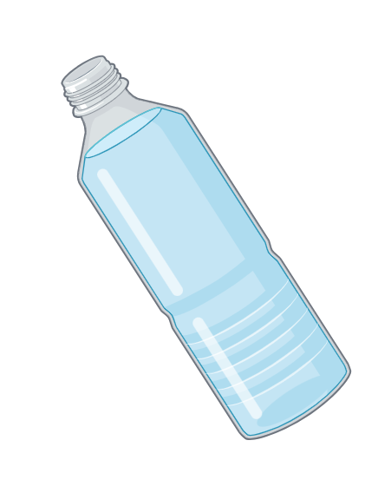
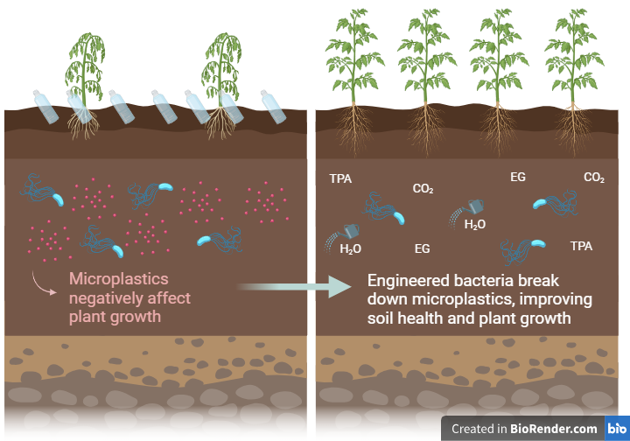
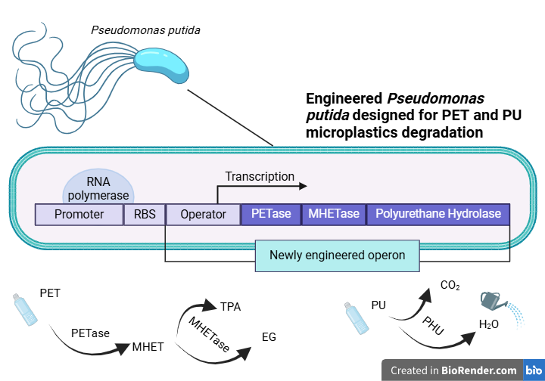
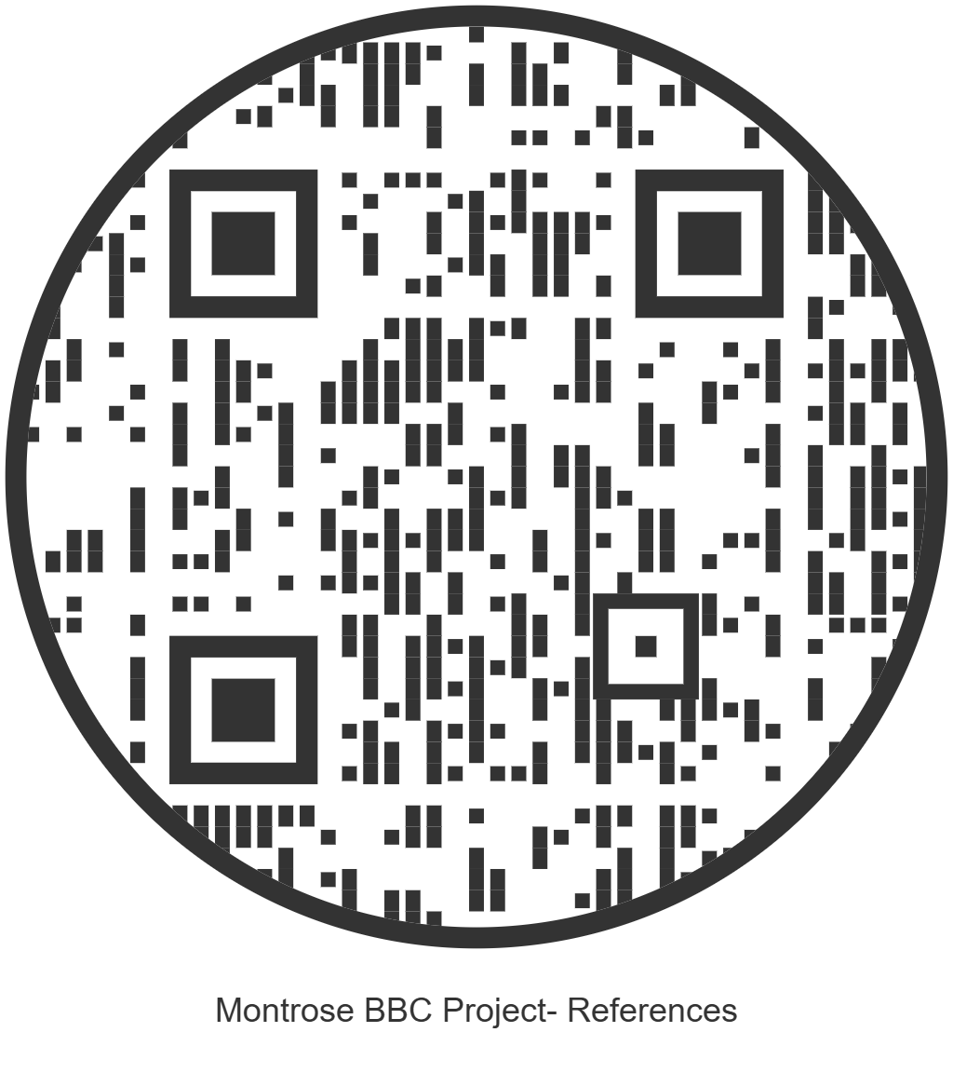






PAC-BAC! A Pseudomonas putida Model for Microplastic Degradation
Siena Elliffe, Ruby Quintiliani, Aneesa Maity, Liesl-Ann Vaz, Megan Cloherty, Tvesha Patel, Chloe Dias, Sarah Hanna (teacher), Paola Favaretto (teacher), Dr. John Kisiday (BioBuilder mentor from the University of Wyoming)
Montrose School, Medfield, Massachusetts, United States
Abstract: Microplastic pollution poses a threat to the earth’s environment by hindering plant growth. The accumulation of microplastics in the earth’s soil is unavoidable, and will accumulate due to air pollutants, use of certain fertilizers and pesticides. This accumulation of microplastics in soil can disrupt water retention, nutrient absorption, and root establishment, leading to a decline in plant productivity and affecting crop yields. While bacteria exist with the ability to degrade plastics, their impact is often limited by only being able to degrade one specific type of plastic. Our project intends to target microplastics more broadly, thereby remediating existing farmland and preventing further contamination in soil. A bacterial model that can degrade a greater number of microplastics, will help achieve this goal. In order to address the microplastic pollution in different soil environments, we propose to engineer a bacterium, Pseudomonas putida, which is adaptable to a variety of conditions such as moderately high temperatures, a wide range of pH levels, oxygen availability, and even toxic pollutants. Given the widespread presence of Polyethylene terephthalate (PET) and Polyurethane (PU) plastics in soil, our team's design incorporates the enzymes PETase, MHETase, and Polyurethane Hydrolase. The concurrent expression of these three enzymes, would allow this engineered bacterium to address more broadly the presence of different microplastics, and thus making it more advantageous to the environment than existing bacteria. In agriculture, this approach could restore soil health and support sustainability.
Team Content
We are a new, eight-member group from Montrose School, consisting of both new and returning members.
Next Steps
The next step in our project is to engineer Pseudomonas putida to enhance its ability to degrade microplastics. This involves inserting the gene encoding Polyurethane Hydrolase (PHU) into an existing operon that includes PETase and MHETase, allowing for the concurrent expression of all three enzymes.
To ensure efficiency, we will design a gene operon with promoters and regulatory elements to balance enzyme production without overburdening the bacterium.
Once the operon is assembled, we will test its effectiveness by measuring enzyme activity, assessing plastic degradation rates, and analyzing bacterial growth under different conditions (various pH levels, temperatures, weather conditions, etc.).
We plan to explore regulatory mechanisms, such as feedback inhibition or inducible expression, to improve efficiency and adaptability. These next steps will help refine our system for real-world application in soil remediation.
Background: Microplastics, particularly PET and PU, enter soil via
mulching, fertilizer and pesticides usage that contain microplastics, or animal waste. Microplastics are less than 5 millimeters in diameter and disrupt soil structure, reducing water retention, nutrient absorption and root establishment. Although numerous bacteria exist that have plastic-degrading qualities, their efficiency is hindered by the limited number of microplastics they can degrade and work only in some climates (i.e. certain pH). Thus, our team sought to create a bacterium that could degrade many plastics under many environments. We chose Pseudomonas putida for its metabolic versatility; it can degrade both organic and inorganic materials and grow across a range of pH levels. To target PET and PU plastics, we used the enzymes PETase, MHETase, and Polyurethane Hydrolase.
References and acknowledgements
We are very grateful to our mentor, Dr. John Kisiday, for his dedication to our weekly meetings and for always providing thoughtful feedback and guidance. His support has been invaluable in helping us refine our project. We also want to thank our supervisors, Sarah Hanna and Paola Favaretto, for always being there to support us throughout this process.

