Slide 1



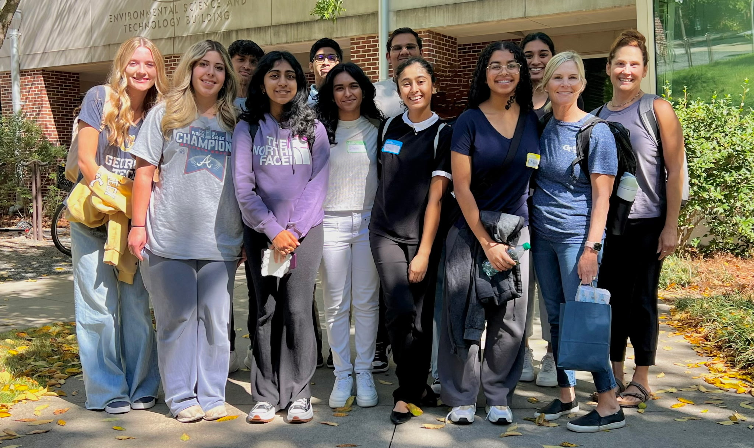
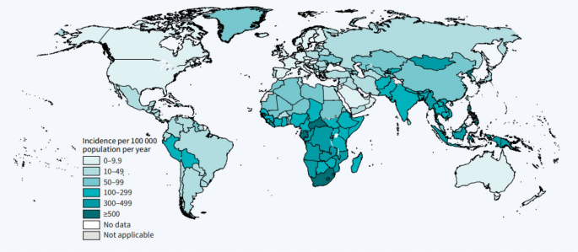
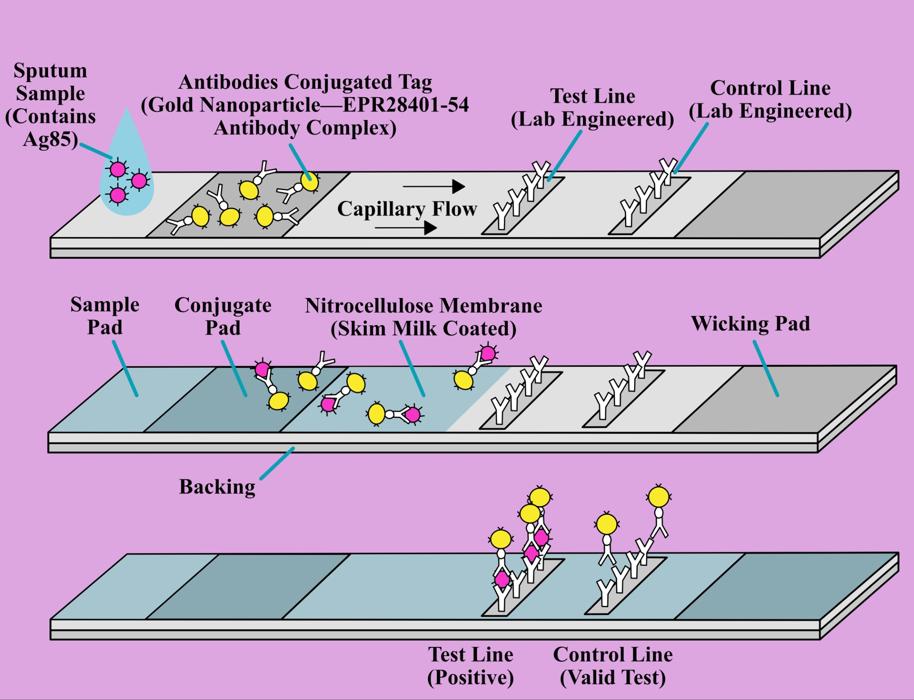
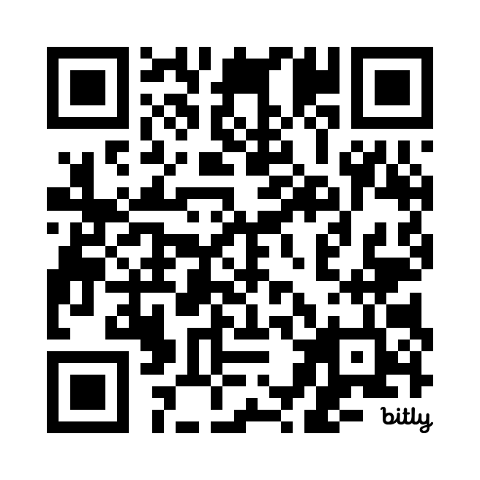






The Detection of Mycobacterium Tuberculosis Using a Modified Lateral Flow Assay
Ismail Allauddin, Chelsea Alonzo-Francis, Aarav Arora, Riya Gupta, Madison Lewis, Disha Maheshwari,
Victoria Semanduyeva, Anika Tapshalkar, Aarya Thakkar, Srihas Tumu, Mary Cartenuto, Peter Horanyi Ph.D. (UCB)
Denmark High School, Alpharetta, GA, USA
Abstract
In Central Africa^{[17]}, tuberculosis^{[18]} is the second leading cause of death in the region, with a staggering 2.5 million cases^{[3]} and over 400 thousand deaths^{[3]} each year. Our solution to this devastating problem is TB-EZ: a portable and cost-effective test to identify the presence of Mycobacterium tuberculosis and its cell wall protein, Ag85^{[1][9]}, in sputum samples within minutes. Our design modifies a lateral flow assay^{[4][8][10][12][15]} to create a rapid antigen test. Results will be displayed through a distinct line that will emerge if positive, along with a control line to ensure functionality. This test will affordably and efficiently reduce deaths caused by the pathogen through the rapid detection of Mycobacterium tuberculosis, allowing for further action to be taken immediately.
Scientific Content
Our test uses a traditional lateral flow assay technique^{[4][8][10][12][15]}. A sample of sputum will be collected and added to a vial of buffer made of 10mM Tris-HCI (pH 7.4), 150 mM NaCl, 0.1% Tween-80 solution. This buffer will lyse the M. Tuberculosis bacteria, so that the Ag85^{[1][9]} antigen will be released and the antibody will attach to it. Through capillary action the sample will move across a nitrocellulose membrane which will facilitate flow and host the antibodies. The first antibody, EPR28401-54 is bound to gold nanoparticles^{[12]}, but not to the membrane. This allows the antigen-antibody complex to move with the capillary flow towards the lines of detection, whether the antigen is present and bound or not. During the capillary flow^{[13]}, if the antigen is present in the sample, EPR28401-54 will bind to it. This antigen-antibody complex will move through the test, and will bind to the detection lines^{[13]}. Once attached to an antibody on the detection line, the gold-nanoparticles^{[12]} will be released and will produce a color. A negative result will produce no color, since there is no antigen-antibody complex that will bind to the detection line antibodies. Then, the complex without the antigen will move to the final line, where the complex will bind to the final detection line antibody and release the gold-nanoparticles, thus proving the functionality of the test.
About Us
Hi, we’re the Lumineers! We’re a team of students exploring synthetic biology for the first time. With our diverse backgrounds and interests, we’ve tackled challenges, asked questions, and had fun learning together. We’re excited to share what we’ve discovered during this journey!
Next Steps
In the future, we plan to:
Test the interaction between the second antibody and the antigen/first antibody-gold nanoparticle complex, ensuring that the binding process occurs as expected.
Analyze the concentrations of proteins, capillary flow dynamics, surfactants, blocking agents, and the lysis buffer to determine their optimal levels for effective performance.
Calculate the appropriate antibody and antigen concentrations by using proportions from established COVID test methodologies to ensure accurate and effective detection.
Conduct thorough experimentation to validate our theoretical design, focusing particularly on whether the timing of capillary flow and binding occurs correctly and at the proper rate for successful implementation.
Introduction
We started our thought process wanting to detect a disease that had a large impact in underserved areas. Tuberculosis has a significant effect on Central Africa and the area does not have adequate access to resources to prevent its spread and help the
We started our thought process wanting to detect a disease that had a large impact in underserved areas^{[17]}. Tuberculosis^{[18]} has a significant effect on Central Africa^{[3][17]}, as the area does not have adequate access to resources to prevent its spread and help the population recover. After deciding
Global Tuberculosis Cases (Olatunji Oladimeji Ojo et al.)
on tuberculosis (sub-lineage one)^{[6]} in Central Africa as our main focus, our initial idea was to create a patch which can be placed anywhere on a cut of injury and detect the Mycobacterium tuberculosis in the blood. We quickly realized that this would not be feasible since tuberculosis is mostly concentrated in the lungs. We then modified the patch to work inside the mouth and detect the bacterium in breathing air. However, tuberculosis is much deeper in the lungs and only small trace amounts of tuberculosis would be present. Discovering that tuberculosis can be found in higher concentration in the sputum led us to using it as a sample for our test. We researched multiple existing tuberculosis tests to confirm that sputum would work best, and began creating a more efficient one. Most of the tests took a long time or required laboratory equipment, both of which would make it harder for people in underprivileged areas to get diagnosed quickly. We decided to modify a rapid antigen test using lateral flow assay^{[4][8][10][12][15]} to work for tuberculosis because of its fast results and its familiarity to people around the world due to its use during the COVID pandemic^{[12][13]}.
This diagram shows the mechanism by which the test works. There are different “phases” that depict the antigen moving along the test due to capillary flow. As the liquid travels, it carries the antigen through each phase, triggering reactions that ultimately reveal the test result.
Acknowledgements
We’d like to sincerely thank Dr. Peter Horanyi Ph.D. for the time and knowledge he invested in our project. His expertise was truly invaluable to our team’s understanding of synthetic biology and the research process in general. This team would also be incomplete without our compassionate and ingenious mentor, Mrs. Mary Cartenuto. Her unwavering support and guidance has challenged us to think critically and push the boundaries of our research.
References

