Slide 1

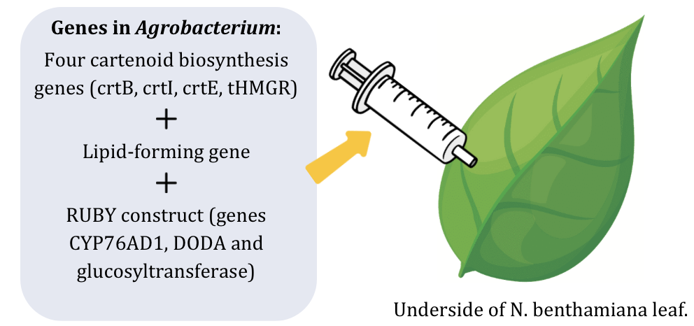









Combating Vitamin A Deficiency: Biofortification of Tobacco Leaves
Tanya Jay, Annabel Volpe, Frances Dunn, Charvi Talupuru, Esther Kim, Tee Jarukulvanich, Tasheen Kashem, Aarav Phadnis, Mr. Reginald Hobbs,
Dr. Tianhu Sun from East Tennessee State University
Lexington High School, Lexington, MA, USA
Abstract
Vitamin A deficiency is caused by an insufficient intake of vitamin A in the diet. A possible solution is the genetic engineering of crops containing vitamin A precursors, such as beta-carotene. The stability of carotenoids ultimately determines how much can be used by the human body, and is considered a critical issue in genetically engineered crops. Using the model plant Nicotiana benthamiana, we aim to increase the stability of beta-carotene in the cytosol of the plant, in order to improve the nutritional availability of the vitamin and combat the global deficiency. Our project aims to introduce lipid droplets into the cytosol of N. benthamiana leaves, while simultaneously expressing four key genes that are involved in the synthesis of carotenoids in the cytosol: crtB (bacterial phytoene synthase), crtI (phytoene desaturase), crtE (lycopene cyclase), and a cytosolic version of hydroxymethylglutaryl-CoA reductase (tHMGR). We hypothesize that their incorporation in the biofortified N. benthamiana leaves will improve the stability of beta-carotenoids in the cytosol, leading to greater carotene availability in the plant and more efficient conversion into vitamin A upon human consumption in genetically engineered crops.
Introduction
Problem:
Vitamin A deficiency is a significant global health issue (~23.1 million cases reported in 2019).
Particularly affects developed countries, with high rates of malnourishment.
Goal: Enhance beta-carotene stability by successfully implementing lipid droplets in the cytosol.
Beta-carotene:
Type of carotenoid pigment present in several fruits and vegetables.
Converted to vitamin A in the body, in a cleavage process taking place primarily in the intestines and liver.
Lipid droplets:
Provide protective environment that reduces the exposure of carotenoids to oxidative conditions, consequently increasing for availability for human absorption.
Figure 1: diagram of agroinfiltration in N. benthamiana.
Next Steps
We hope to proceed with our project through experimentation and observation of our results, to test if our proposed method of increased beta-carotene stability produces expected results.
Use our results to either refine or redesign our experiment:
Redesign: If our experiment does not yield the desired results, we could alter the lipid treatment, use different base genes, or redesign the method through which the lipid droplets are introduced.
Future steps include: refining our lipid treatment to further increase beta-carotene stability; learn how to use our method to create a safe and edible plant; or find a sustainable way to introduce the engineered genes into a large plant batch.
Design and Procedure
Gene cloning of crtB, crtI, crtE, tHMGR → have proven to increase beta-carotene levels in model plant N. benthamiana (Morelli et al.)
Lipid droplet engineering: utilise construct that expresses proteins known to induce lipid droplet formation (Zheng et al.) and co-infiltrate with carotenoid biosynthesis genes.
Agroinfiltration: co-infiltrate grown N. benthamiana plants with agrobacterium cultures harboring: biosynthesis constructs for beta-carotene accumulation; lipid-forming gene for stability; and RUBY plasmid (genes CYP76AD1, DODA and glucosyltransferase) to observe color change.
Carotenoid and leaf analysis: use eppendorf tube weekly to gather leaf discs and measure carotenoid concentrations using HPLC or spectrophotometric analysis.
Team Information
Acknowledgements and References
We’d like to thank our mentors Dr. Tianhu Sun and Mr. Reginald Hobbs. We would also like to thank our generous sponsor, AOPS Academy Lexington. To learn more, check out their website here.
References: scan here.
We are a new team with 8 members from Lexington High School.

