Slide 1


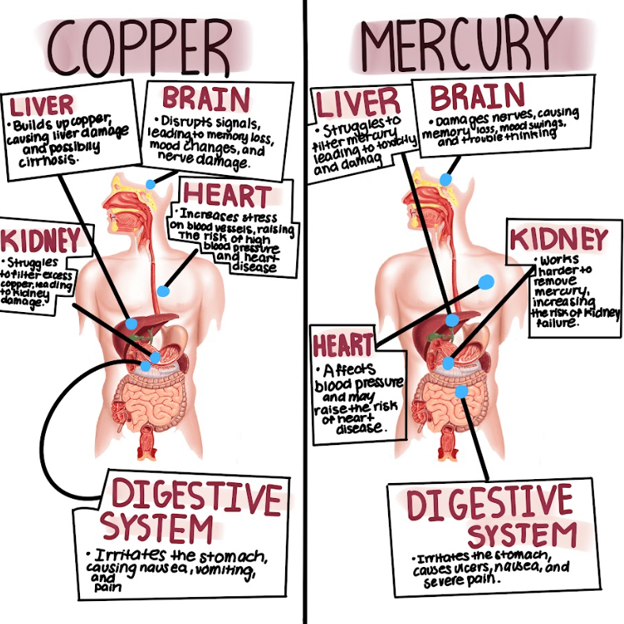
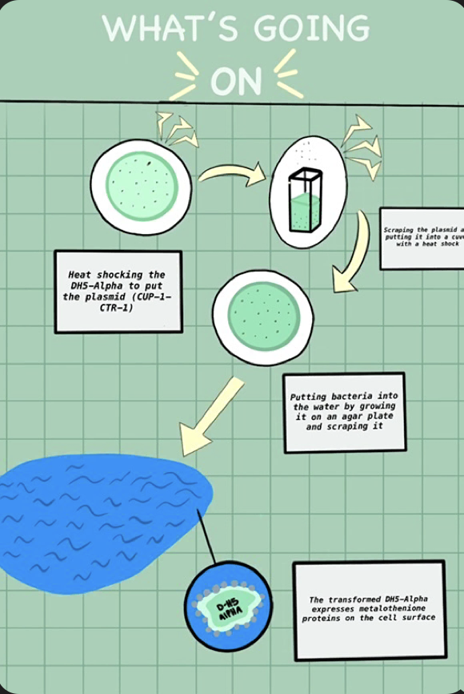
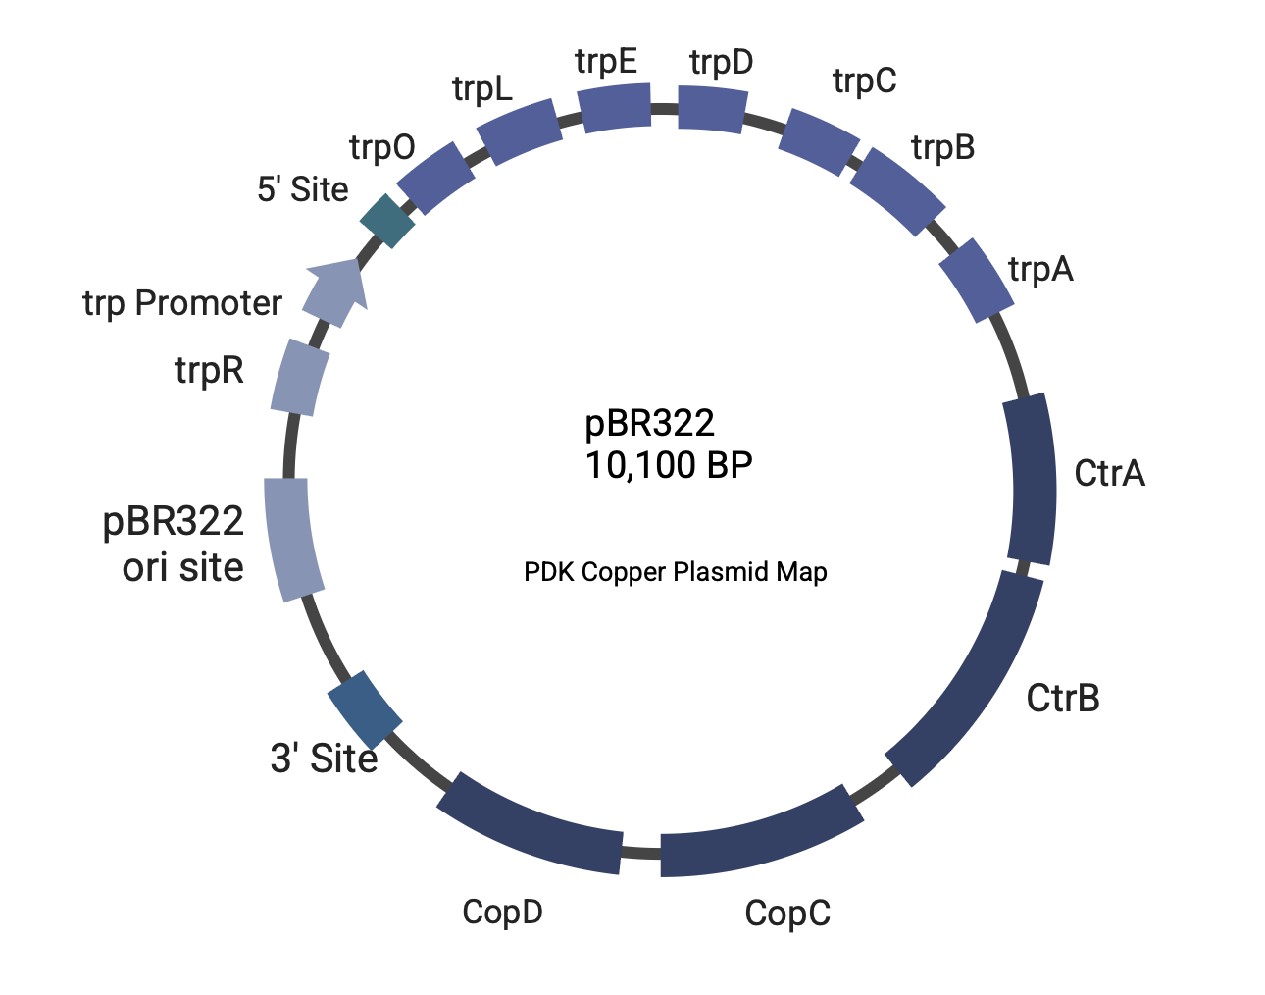







Bio Busters
Names: Hansika Ajjarapu, Priyanka Bose, Ayanna Das, Rishik Devana, Alekhya Doddapaneni, Sujaal Gelle, Prisha Karani, Dheyanesh Krishnamoorthy, Aditi, Pabbidi, Advay Shende
Lambert High School, Suwanee, Georgia, United States
Dr. Meghdad, Bill Schuyler, Kate Sharer
TEAM CONTENT
ABSTRACT
In regions across the developing world, heavy metal contamination in drinking water poses a tremendous threat to under-monitored public health systems. While conventional remediation technologies exist, they remain costly and are restricted for certain communities. Bio Busters aims to utilize efficient and cost-effective technology to resolve the rampant issue of heavy metal water pollution in developing countries. Lambert GA-2 attempts to bioremediate water with particular attention to copper and mercury due to their high potency in water bodies worldwide. In our lab, we plan to use genes ctrA and ctrB in tandem with copC and copD in order to allow E. coli DH5-alpha to diffuse extracellular Cu2+ ions into the cytoplasm. Resistance genes will be introduced as well in order to provide increased defense against the heavy copper influx. This strain will be grown on an agar plate and then colonies will be placed in contaminated water. Once the E. coli takes in the Cu2+ ions, microfiltration techniques supported by material with smaller pore sizes will filter out E. coli and, thus, the heavy metals with it. Lambert GA-2 will use a colorimetric assay reliant on bathocuproine before and after to measure relative effectiveness.
We are a new team with 10 members, with two returning from last year. Our experience with iGEM and BioBuilder has been very inspiring, and we have enjoyed working together to find new solutions.
SCIENCE CONTENT
E. coli was engineered to express copper-transporting channel proteins using the copC and copD genes. These genes were introduced into E. coli via plasmids using heat shock transformation.
The modified E. coli produces channel proteins on the extracellular surface that allow for the diffusion and sequestration of copper ions in the periplasm. This process prevents copper toxicity and facilitates bioremediation.
To further enhance copper uptake and regulation, the ctrA and ctrB genes were introduced, improving the transport and homeostasis of copper within the bacterial cells.
A colorimetric assay using bathocuproine was employed to detect and measure copper levels in treated water.
This approach provides a sustainable and eco-friendly solution for reducing copper contamination in water systems.
These modifications improve bioremediation effectiveness and offer potential expansion to other heavy metal contaminants in polluted water sources.
NEXT STEPS
Optimizing mercury bioremediation allows us to expand our project’s impact, providing a sustainable solution for heavy metal contamination. Using the merP and merT system, our engineered E. coli can efficiently absorb and detoxify mercury, reducing its environmental and health risks. To implement this technology globally, we seek collaborations with environmental companies like Intertek, as well as nonprofit and industrial partners, ensuring commercialization and regulatory compliance. Through these efforts, our modified E. coli presents a scalable, eco-friendly solution for mercury contamination, advancing global water safety.
a
REFERENCES AND ACKNOWLEDGMENTS
PROBLEM
Heavy metal contamination (copper, mercury) in water sources is a significant environmental issue.
Toxic metals harm aquatic life, ecosystems, and human health.
Traditional methods for metal removal are costly and environmentally harmful.
SOLUTION
Use genetically engineered E. coli for bioremediation of copper and mercury.
Copper: Express copper-binding proteins (copC and copD).
Mercury: Use mercury transport proteins (merP and merT).
E. coli absorbs copper and mercury from contaminated water.
Eco-friendly and cost-effective approach to heavy metal removal.
Copper levels detected using a colorimetric assay with bathocuproine.
Potential for scalability in large-scale environmental cleanup.
PLASMID MADE WITH BIORENDER
HOW COPPER AND MERCURY AFFECTS THE HUMAN BODY

