Slide 1


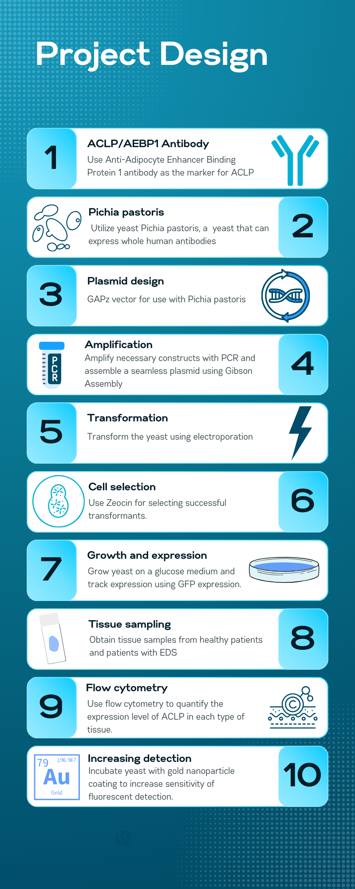
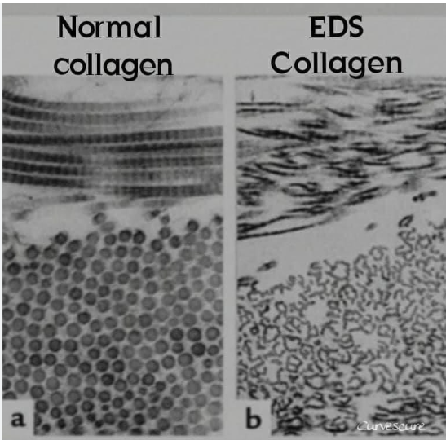
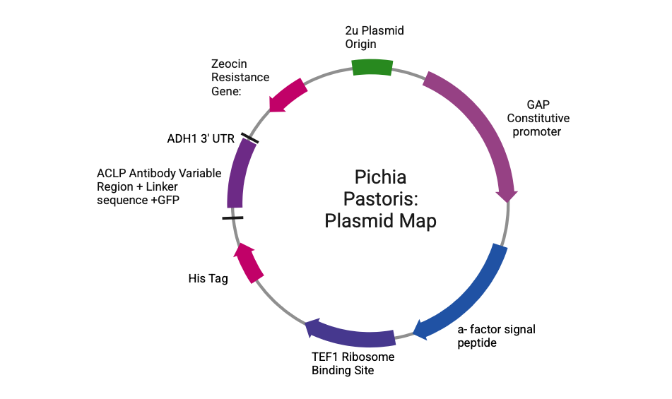
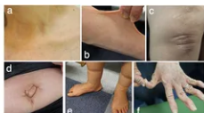







“Diagnostic GeneYeast” : A Biosensor for EDS
Katherine Dalphin, Cecilia Geyer, Vasiliki Gioldasis, and Ariana Ortega
Team Leader: Mary Johnston, Mentors: Michael Sheets, Biobuilder; Susana Donkor, Gentibio
Haverhill High School, Haverhill, Massachusetts, USA
Abstract
Our project focuses on discovering how collagen becomes defective in Ehlers-Danlos Syndrome (EDS). Research indicates that the gene AEBP1 encodes Aortic Carboxypeptidase-Like Protein (ACLP) which associates with collagen in the Extracellular Matrix and has roles in development, tissue repair, fibrosis and overall structural integrity of joint tissue. Variants in AEBP1 have been associated with EDS, which causes joint laxity, hypermobility, abnormal wound healing, and hyperextensible skin. ACLP enhances collagen polymerization and binds to several types of collagens through its discoidin domain. We hypothesize that EDS patients will have lower levels of ACLP and this is the source of the defective collagen, which is driving EDS disease progression. Our study will seek to advance EDS research through the creation of a biosensor that expresses the antibody for ACLP as well as Green Fluorescent Protein ( GFP) in order to quantify the levels of ACLP in joint tissues of both healthy patients and patients with EDS. Due to the complex nature of the folding needed to express the fusion protein, we utilize the eukaryotic chassis (Pichia pastoris). This is a methylotrophic yeast that is commonly used for high-level expression of recombinant proteins, including full-length antibodies, in place of the traditional E. coli. chassis.
Introduction/Background
As a patient with Ehlers- Danlos Syndrome, HHS Senior Katie Dalphin knows what it means to be in a wheelchair, to have hypermobile joints, loose skin, a racing heart beat, and many other difficulties. Doctor visits, misdiagnoses, and frustrations have been a constant in her life. If she had a way to get diagnosed sooner, much time, money, and heartbreak would have been saved. If doctors knew all the reasons why EDS happens, she might quickly be on her way to a cure or at the very least a treatment.
Science Content/ Project Design
Research Question: Can a biosensor developed using yeast detect differences in ACLP levels between patients with EDS and healthy individual controls?
Figure 3: Comparison of normal collagen (left vs. EDS defective collagen (right). The normal collagen has strong, and organized fibers and the EDS collagen is much weaker and unorganized, which leads to joint hypermobility and fragile tissues.
Figure 2: Plasmid map displaying the engineered yeast that is used to express the ACLP antibody. Key features include the TEF1 promoter, HIS TAG, and the GAP constitutive promoter.
Figure 4: EDS symptoms including (a)thin skin over bones (b) hyperextensible skin (c)keloid formation (raised scars after skin injuries) (d) an umbilical hernia (e) pes planus (flat arch) and edematous(swelling) lower legs and (f) acrogeria-like skin (premature aging) on the hands, with hypermobile phalangeal joints
Figure 1: Schematic of Human ACLP. DLD is the discoidin like domain that binds collagen. Full sequence in Resources section.
Notes:
Labels 32 B- writing 26-28
References ~15

Slide 2
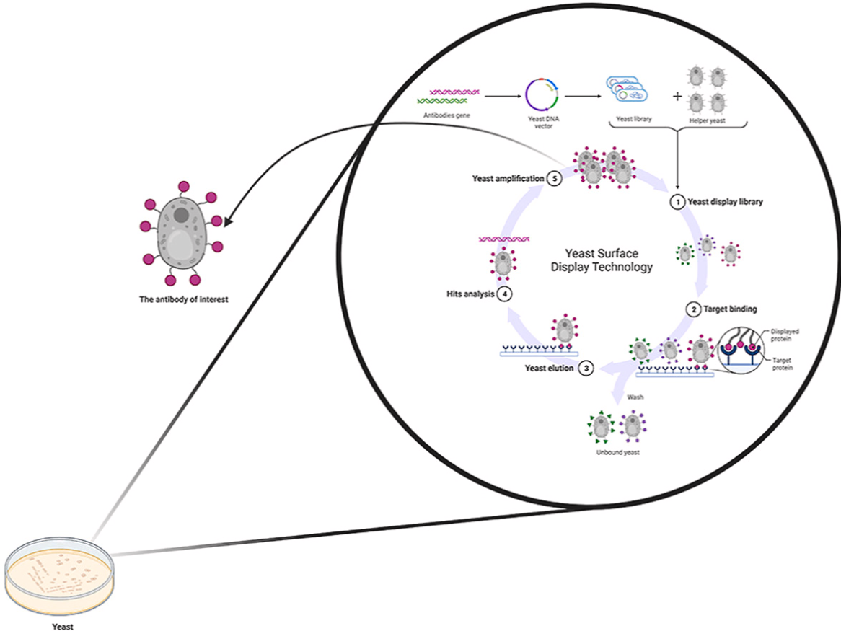
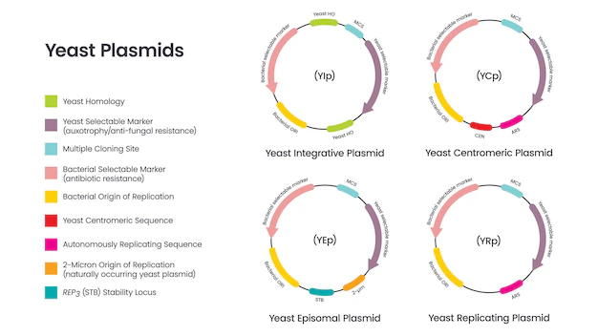
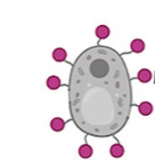
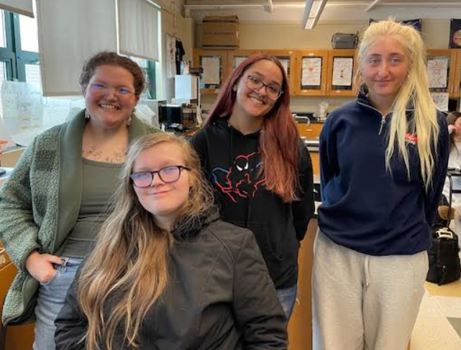

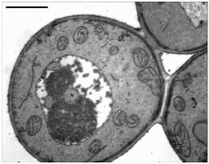
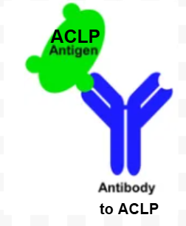
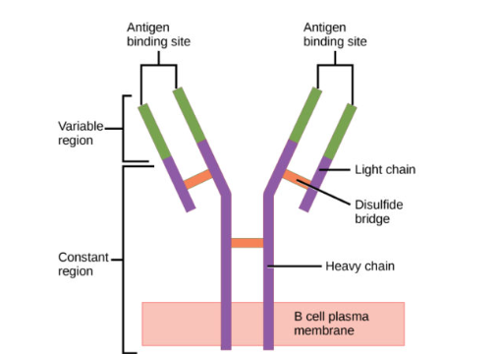
“Diagnostic GeneYeast” : A Biosensor for EDS
Katherine Dalphin, Cecilia Geyer, Vasiliki Gioldasis, and Ariana Ortega,
Team Leader: Mary Johnston, Mentors: Michael Sheets,Biobuilder Susana Donkor, Gentibio
Haverhill High School, Haverhill, Massachusetts, USA
Figure 5: Yeast Surface Display Technology: A powerful platform for engineering and selecting high-affinity recombinant antibodies, enabling targeted protein binding and analysis.
What we Learned: Our team learned how to approach a complex biomedical challenge by combining biological engineering and diagnostic technology. Specifically, we gained a deeper understanding of ACLP, collagen, antibodies and EDS and how they are connected. This involved in-depth research, learning about technical skills, collaboration, problem solving, creativity, and perseverance in scientific research.The purpose of our research was to create a biosensor that can detect ACLP, which has a role in extracellular matrix and collagen regulation. Defects in this protein lead to Ehlers-Danlos Syndrome (EDS).This project is important to us because one of our team members has EDS and she had a difficult time getting diagnosed. There are not a lot of treatments available. The disease has forced her to be in a wheelchair for the last three years and has greatly affected her mobility. This makes it hard as a teenager to be different and to not move around as freely as her peers. If we could contribute to the research for this disease, we would be helping our team member, but also anyone who is affected by this disease. When someone is counting on you, you are more motivated to get the job done and Katie provides us with great motivation for our research.
"Alone we can do so little; together we can do so much." -
Helen Keller
Vector
Library
Helper Yeast
Amplification
Yeast Display Library
Yeast Surface
Display
Hits Analysis
Target Binding
Antibody of interest
Displayed protein
Yeast elution
Wash
Target
Unbound Yeast
Yeast
According to, “Development of Recombinant Antibody by Yeast Surface
Display Technology” yeast surface display can be used to engineer high-affinity recombinant antibodies that specifically bind to ACLP, a biomarker implicated in Ehlers-Danlos Syndrome and extracellular matrix remodeling. By optimizing yeast expression and antibody selection, the biosensor will qualitatively detect ACLP levels in biological samples,which we can then cross- reference against disease state, providing a potential diagnostic tool for EDS.
Figure 8: A comparison of four different types of yeast plasmids, YIp, TCp,YEp, and YRp. Highlights their own unique characteristics of their replication and integration sites. Each plasmid has its own advantages for gene expression in yeast. We utilize a YIp.
Next steps: We will take aspirations from joints from healthy patients and patients with hypermobile EDS and use the transformed yeast to quantify and compare the levels of ACLP in both groups.
Proof of Concept: After the yeast is transformed, if it glows we know that the yeast uptook the plasmid to express the antibody to ACLP.
Acknowledgements
Special thanks and appreciation to Team Leader Mary Johnston and Susana Donkor, our mentor from Gentibio as well as Michael Sheets, our mentor from Biobuilder, who supported us in this project.
Team members: (From Left:) Cecilia Geyer, Arianna Ortega, Vasiliki Gioldasis, Front Row: Katie Dalphin
Figures 6 & 7: Depicts how the ACLP antigen binds to the antibody.
Resources
Figure 9: An electron micrograph of Pichia Pastoris, a type of methylotrophic yeast, which means it uses methanol as its sole carbon source. It is a recombinant host expression system, commonly used to manufacture enzymes and
pharmaceuticals.

