Slide 1




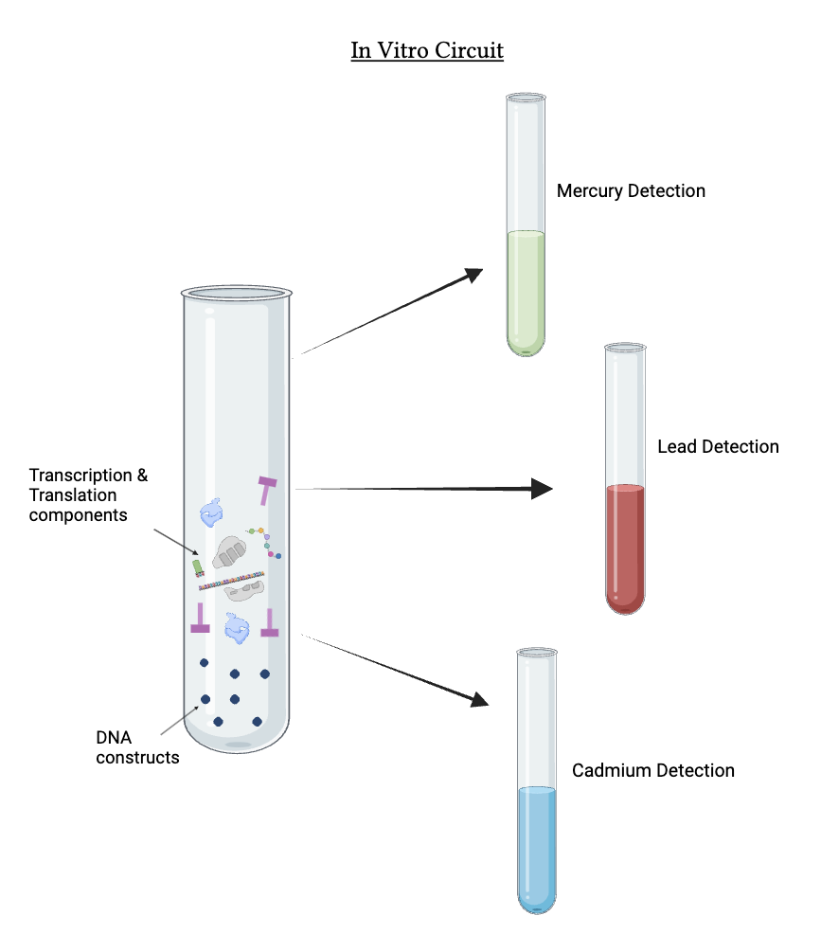
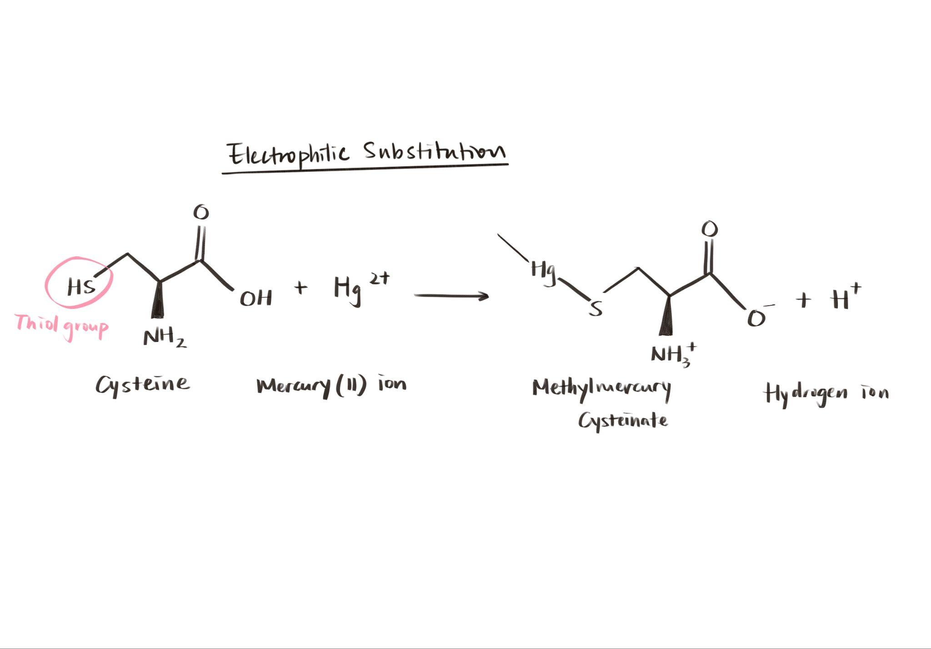







Cosmetics Heavy Metal In Vitro Biosensor
Ruihan Qin, Yewon Kim, Jungin Yoon, Maya Vaden, Riya Patel, Dr. Kosuke Seki (UCSF), Dr. Beth Pethel
Western Reserve Academy, Hudson, Ohio, United States
Abstract
Heavy metal use in cosmetics poses severe health risks. In the United States, over 90% of cosmetics contain mercury, lead, or cadmium. Heavy metals are often used to boost cosmetic function, but metal ions can easily enter the body through hair follicles and sweat pores, reaching the bloodstream. Current testing often requires specialized laboratories, trained personnel, and complex procedures. Existing biosensors are mostly used in environmental pollution and are not adapted for cosmetics. Our project aims to develop an in vitro test solution that detects heavy metals in cosmetics. This test includes the necessary genetic components in a test tube. The presence of metal ions in cosmetics will bind to metal-responsive proteins, triggering the corresponding promoter that initiates the translation of fluorescent protein genes. Each heavy metal is signaled by a different color. This innovative solution will not only empower consumers to test products at home for user safety but also enable cosmetic manufacturers to evaluate the composition of raw materials.
Science Content
Mercury whitens the skin by inhibiting melanin production, a substance responsible for skin pigmentation. Lead is a color additive ingredient in lip products and eyeliners, which enables cosmetics to feature a variety of colors (Raza-Naqvi et al., 2022). Cadmium expands color tones in eyeliners, lip gloss, and beauty creams (Omenka & Adeyi, 2016, p. 1). Excessive intake of 0.005 mg/kg/day of these for more than two weeks (U.S. Environmental Protection Agency, n.d., p.3) can lead to kidney disorders, proteinuria (high levels of protein in urine), carcinogenicity, and inheritance deflections (Raza-Naqvi et al., 2022).
MerR, a Mercury binding transcriptional regulator, activates in the presence of Hg ions, and initiates transcription of promoter pMerT down the gene, coding for Green Fluorescent Protein (GFP). Similar processes happens in the case of lead and cadmium. Each metal will trigger a distinct color change for easy identification.
Team Content
Hi! We are the Heavy Metal Heroes from Western Reserve Academy!
Ruihan (Stephanie) Qin, Yewon (Alice) Kim, Jungin (Janie) Yoon, Riya Patel, and Maya Vaden.
Introduction
The global cosmetics market was valued at 374.18 billion US dollars in 2023 and is estimated to reach 417.24 billion by 2030 (Cosmetics Market, n.d.). However, this rapidly growing industry is responsible for exposing humans to heavy metals that can harm our health. Since cosmetics are directly applied to the skin, metals ions can easily enter the body through hair follicles and sweat pores to the blood capillaries. Over time, these metals accumulate in the body and interfere with biological processes by displacing normal functional groups by competing for electrons (Raza-Naqvi et al., 2022).
Combining three circuits simultaneously can result in plasmid incompatibility, burden, reduced stability, and competition in cloning sites. In vitro circuits, on the other hand, mitigate these issues. Since the circuit does not rely on microbes, concerns on maintenance are eliminated, allowing safe and easy use.
This enables the manufacturers to evaluate the composition of their cosmetic products and empowers consumers by giving them control and the ability to assess products that were previously unknown to them, allowing them to evaluate their own risks.
Next Steps
Finalize the genetic pathway for In Vitro System solution: Ensuring promoter compatibility and efficient expression of fluorescent proteins.
Assemble the transcription and translation pathways.
Sensitivity testing - Making sure that our genetic pathway is sensitive enough to trace the Heavy Metal components in cosmetics.
References
We would like to extend our gratitude to Dr. Pethel for guiding our project and to our mentor, Dr. Seki, for his invaluable advice.

