Slide 1


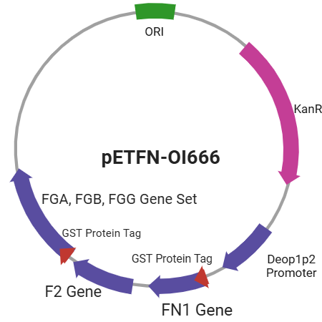
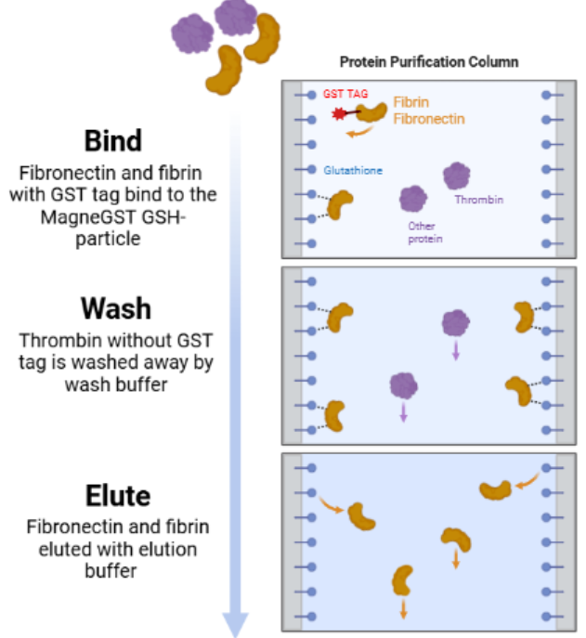
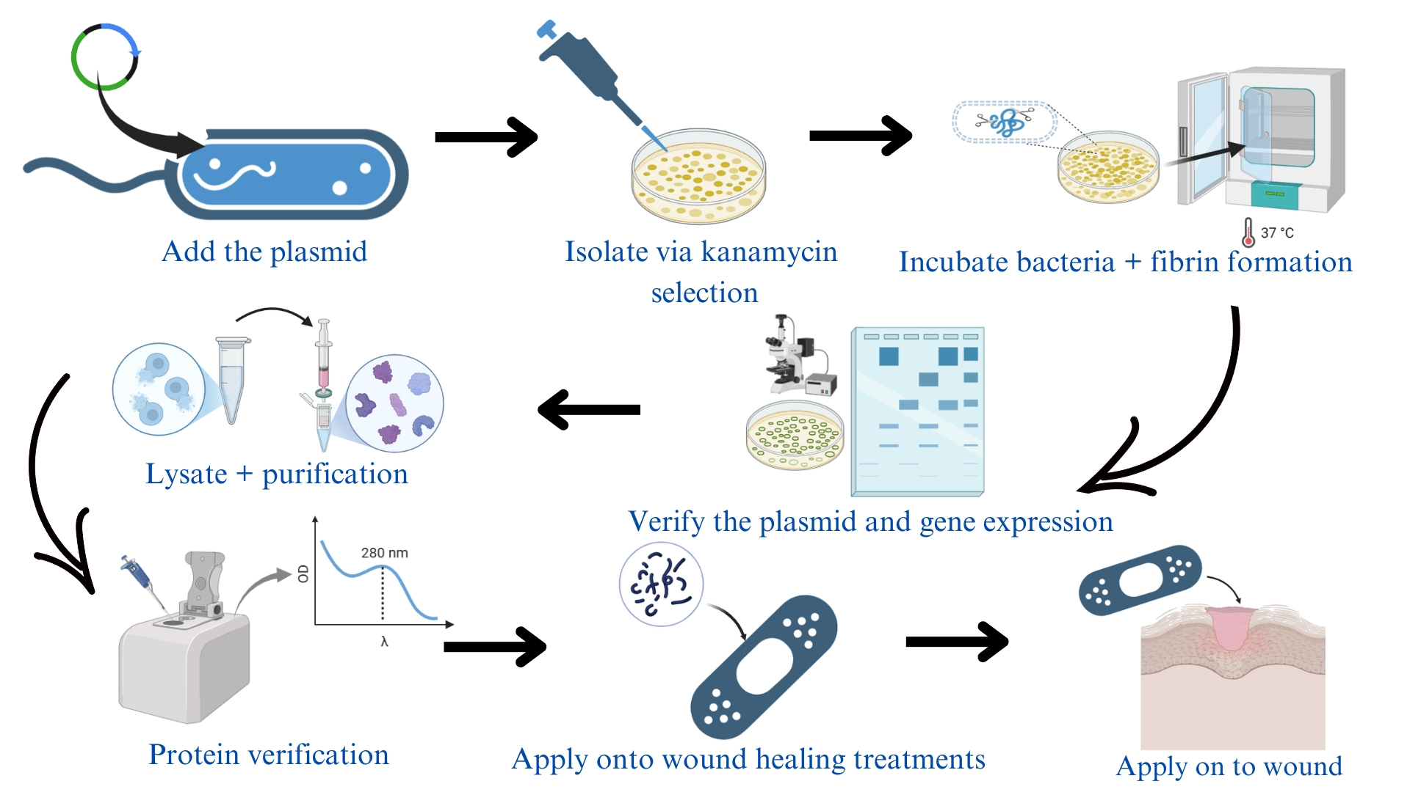
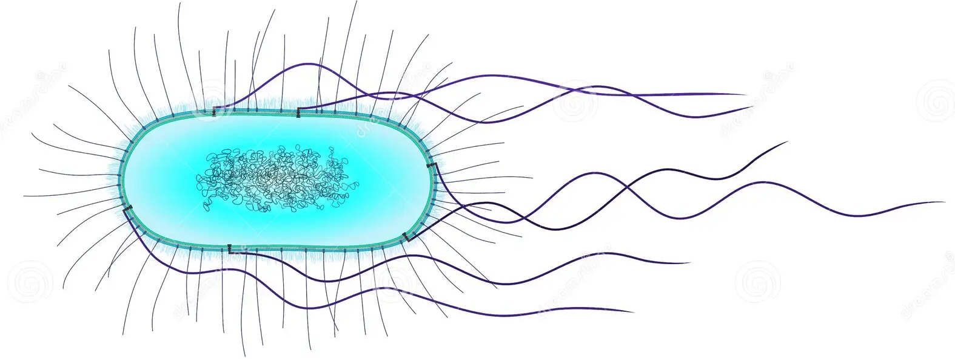
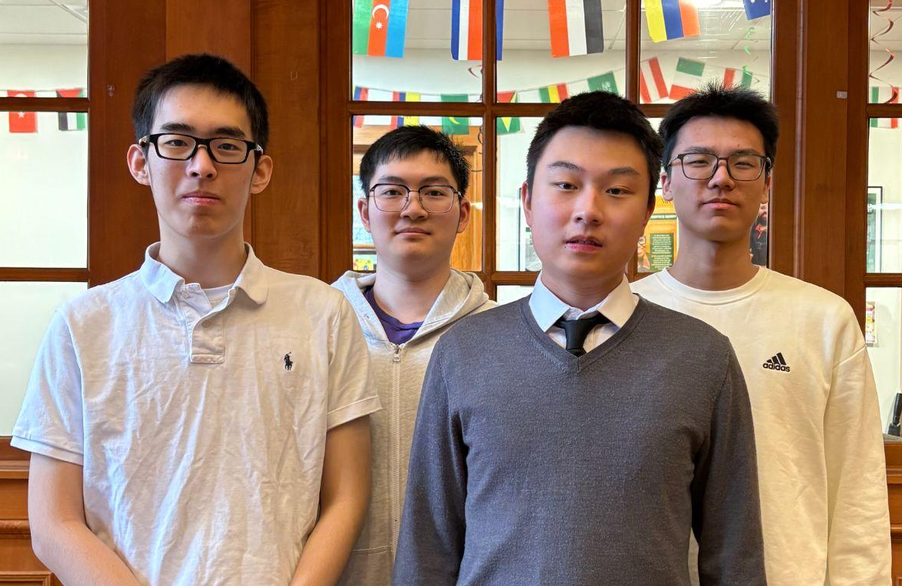







Wound Healing Enhancement Using Recombinant Extracellular Matrix Proteins Produced by Escherichia coli
Zhongchen Cai, Chun Chan, Ruiwen Wang, Xinyu You, Dr. Beth Pethel, Joe Switzer (BioBuilder)
Western Reserve Academy, Hudson, OH, USA
Abstract
Injuries pose a significant safety issue in daily life. Annually, unintentional injuries cause approximately 200,000 deaths in the U.S. and affect around 11 million people in the world. The risks of open wounds come from bacterial infection and over-bleeding, causing inflammatory reactions and dilution of healing factors. Current debridement methods that remove damaged tissues from the wound site are unsuitable for large or severely infected wounds, and the lack of healing factors extend the wound exposure. Fibrin and fibronectin, proteins naturally found in the human body, are critical in the wound-healing process. Fibrin supports clot formation and cell migration, while fibronectin stimulates angiogenesis, enhances the integrity of the extracellular matrix (ECM), and recruits macrophages to clean the wound site. Unlike fibronectin which is directly encoded by a gene, thrombin is needed to cleave fibrinogen to form fibrin monomers which then polymerize. Our project aims to establish a system that simultaneously produces fibronectin, fibrin, and thrombin, proteins essential for the wound healing process. The BL21 (DE3) strain of Escherichia coli functions as the chassis for a genetically engineered plasmid that possesses the genes encoding fibronectin, fibrinogen, and thrombin. By enabling the stable production of key wound healing proteins and advancing fibrin cleavage and polymerization, this project will enhance advanced wound care, significantly lowering death rates and setting a new standard in medical innovation.
Science Content
Our project aims to construct a sustainable ECM supply line by utilizing the efficient strain BL21 (DE3) Escherichia coli as chassis to produce fibronectin, fibrinogen, and thrombin. The system involves the insertion of the pETFN-OI666 plasmid into E. coli for protein production. This will allow surplus fibrin and fibronectin to be available for accelerated wound healing. Additionally, after lysating the E. coli, by utilizing the Glutathione-S-Transferase (GST) Protein Tag, thrombin can be filtered via an affinity chromatography system, leaving only polymerized fibrin and fibronectin.
Plasmid Transformation of E. coli
Protein Purification Process
Next Steps
Quantify the transformation efficiency of the plasmid in the E. coli.
Quantify the efficiency of ECM proteins produced by E. coli.
Optimize the affinity chromatography system to isolate fibronectin and fibrinogen from bacteria culture.
Design and Experiment
Introduction/Background
Approximately 200,000 people in the United States die annually from unintentional injuries, with burns, falls, and motor vehicle accidents ranking the top three causes of death. Among injuries, blood loss is a leading cause of death in trauma cases, with more than 30 percent of trauma patients experiencing infections during their initial hospital stay.
In 2019, the estimated economic impact of injuries in the U.S. reached 4.2 trillion dollars. Moreover, visits to emergency departments and physicians’ offices for injuries total around 50 million annually.
Current wound care methods such as debridement methods, bandage, and surgical stitching each have particular drawbacks: debridement actions are not suitable for large and severely infected wounds; bandage and surgical stitching lack the ability to refill the diluted healing factors.
Team Content
We are a new team made up of 4 members
from Western Reserve Academy.
All of us have a love for biology and
scientific research connecting us to
synthetic biology. Since we are all seniors,
this project will likely be picked up by
new students next year.
References and acknowledgements
We’d really like to thank Dr. Pethel and Mr. Switzer
for their unwavering support and guidance throughout
this project. Their effort made this project possible.

