Slide 1
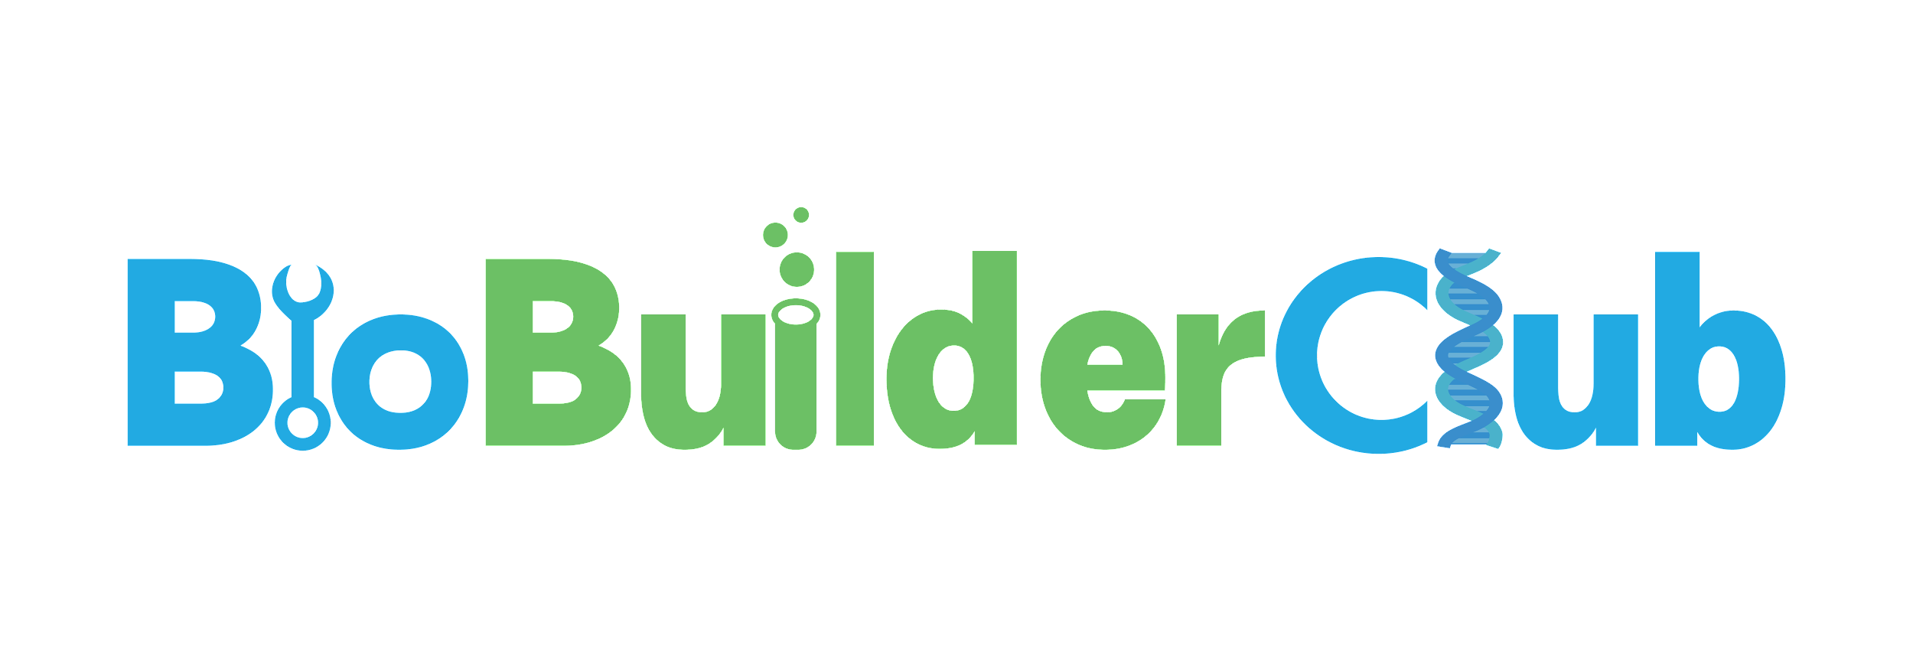
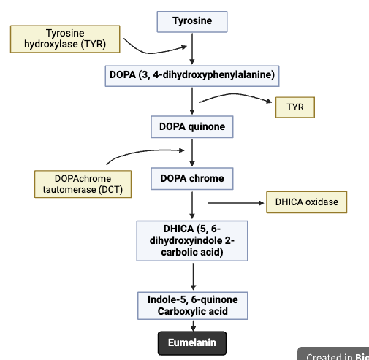

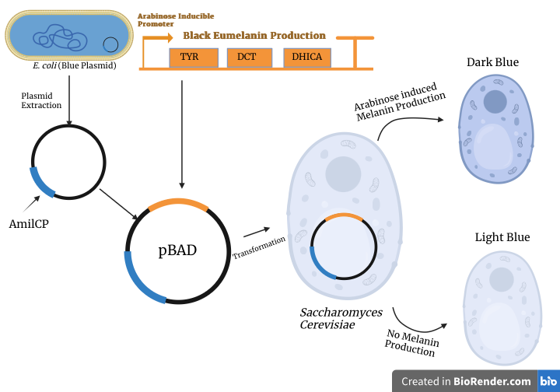

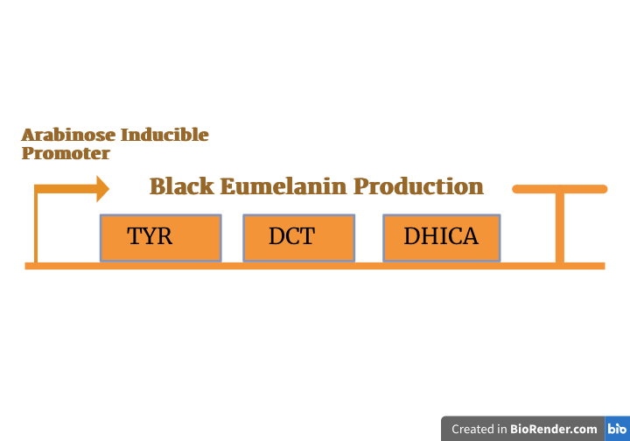





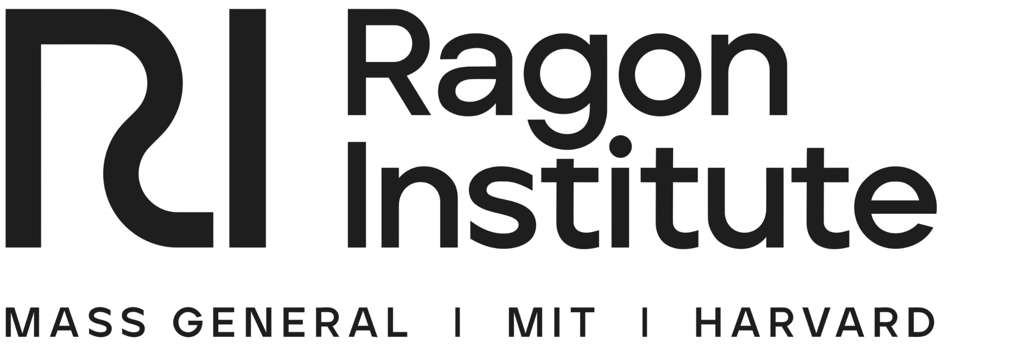
Die Hard Dyers
Tavin Jones, Miranda Wang, Alex Le Rouge, Dr. Beth Pethel, Joseph Switzer (BioBuilder),
Western Reserve Academy, Hudson, Ohio, United States
Abstract
The widespread use of conventional hair dye pigments raises significant concerns regarding their safety and long-term effects. Many hair dyes include harmful chemicals such as ammonia, hydrogen peroxide, and p-Phenylenediamine, which have adverse side effects, including allergic reactions, skin irritation, and potential carcinogenicity. Our design addresses these safety issues through a new lens: creating a hair dye using melanin–the natural pigment responsible for hair coloration– and chromoproteins produced via genetically modified Escherichia coli. Chromoproteins are proteins that contain a colored prosthetic group, giving them a vivid color to enhance E. coli’s color variety. A team in the United Kingdom, Cutiful, designed an E. coli color palette of these proteins on plasmids. Through the utilization of their plasmid palette, we hope to combine their plasmids with our design to produce eumelanin. By extracting the plasmid from E. coli, we can utilize this innovation to create the desired color through these proteins. Once extracted, the plasmid is cut open, allowing us to insert a melanin-producing DNA sequence. The new modification expands the range of pigments we can generate. When the engineered plasmid is introduced to the pigmented yeast, where we can achieve the optimal hue for our synthetic hair dye, the yeast produces a color we can isolate and extract. This process yields a broad range of hues while reducing health risks associated with typical hair dye chemicals. Using this method, we hope to achieve safer coloring solutions; if further development in our experiment proves viable, melanin-based hair dye could become a feasible alternative in the global hair dye industry.
Team Content
The Die Hard Dyers are a new three-person team composed of two seniors and one junior–Miranda Wang, Tavin Jones, and Alex Le Rouge (from left to right). Our team formed in late 2024, where we collectively agreed on the significance of finding an alternative to conventional hair dye due to its detrimental effects on safety. Prior to working on this project, only one of our members had experience writing a scientific paper in a previous class; we faced challenges and difficulties but ultimately overcame them and adapted to one another’s work styles.
By working on this project, we learned the significance of allocating time efficiently and effectively both in and out of class. We also learned the importance of communication and contributing our ideas effectively to accomplish our goals.
One experiment that would benefit the project would be to do a comparison test between the yeast and E. coli to see which one provides a better yield when it comes to melanin and protein production.
Melanin Production Pathway
Background
Conventional hair dye provokes concern in the general population for numerous reasons, primarily being safety
Hair dye contains detrimental chemicals which impose various health effects on its consumers
With hair dye’s high demand, a call for a more cost-effective and safer alternative is necessary
Eumelanin Gene Sequence
References and acknowledgements
We’d like to thank Dr. Pethel and Mr. Switzer for their continuous support throughout the creation of this project.
The color production process

