Slide 1


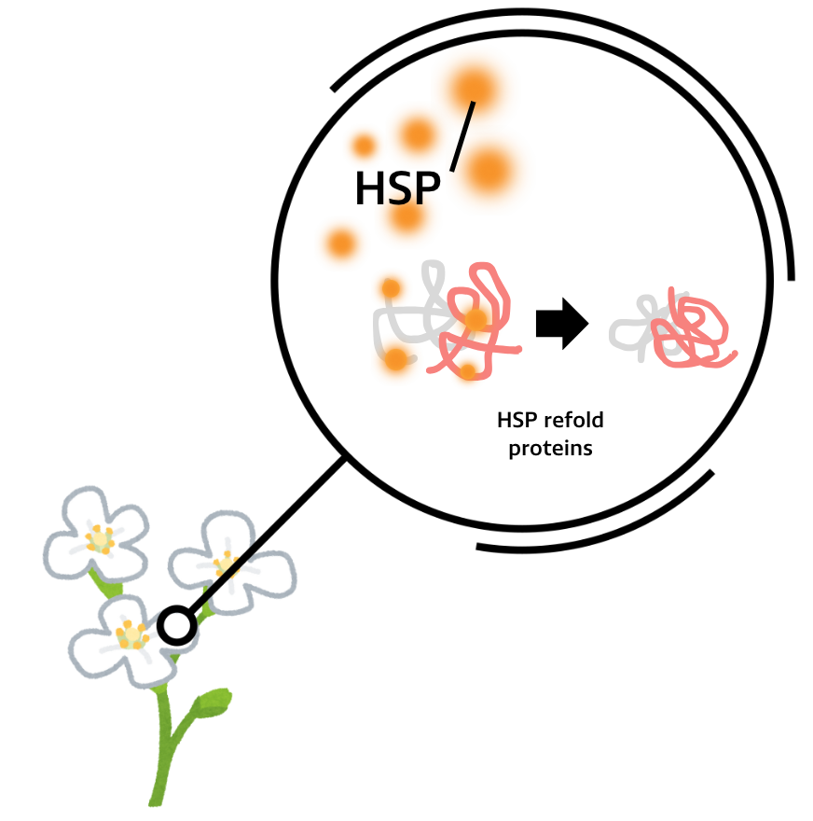

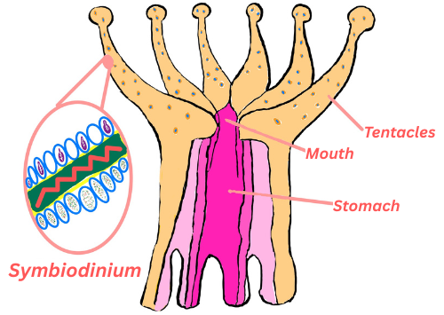
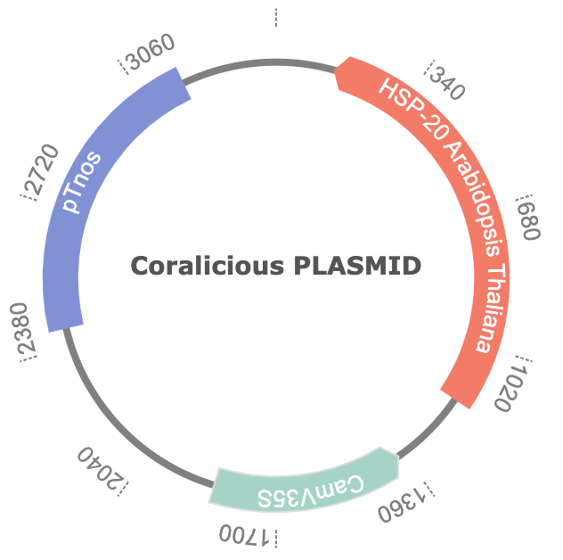







Coral Reef Resilience to Climate Change: Utilizing Arabidopsis thaliana HSPs to Improve Symbiodinium Thermal Tolerance
Regina Rubiano, Tucker Marshall, Hayden Walmsley, Beth Pethel, Leah Davis (NOAA)
Western Reserve Academy, Hudson, Ohio, United States of America
Abstract
Coral reefs are critical to marine biodiversity, supporting approximately 25% of marine species and a $2.7 trillion global economy, including fishing and tourism. However, coral bleaching, driven by rising ocean temperatures, threatens ocean ecosystems. Bleaching occurs when thermal stress forces coral to expel their symbiotic algae, Symbiodinium (Zooxanthellae). These algae are crucial for coral survival as they provide energy, disease protection, and vibrant coloration - critical for photosynthesis and UV protection. Without these algae, corals become vulnerable to disease and death. As of 2024, 77% of corals have experienced bleaching-level heat stress, with temperatures projected to rise by 2.4 C° by 2050. Current strategies such as reef-safe sunscreens, carbon-sequestration seagrass, and emission cuts offer localized relief but don't tackle coral heat resistance directly. Our design boosts coral heat tolerance by transferring heat shock proteins (HSPs) from Arabidopsis thaliana into Symbiodinium. HSPs are proteins that maintain cellular homeostasis under stress, protecting against thermal damage by folding and repairing damaged proteins, preventing cellular dysfunction. A. thaliana exhibits advanced HSP mechanisms, including high oxidative stress management and protein repair, making its HSPs ideal candidates for boosting Symbiodinium heat resistance. Our approach offers a scalable method to increase coral resilience to rising ocean temperatures by strengthening the coral at a cellular level. Unlike short-term emission reductions, our solution strengthens coral biology by enhancing heat resistance mechanisms. This approach reduces thermal stress on Symbiodinium and promotes long-term coral survival, boosting marine ecosystem health and the global economies reliant on healthy reefs.
Science Content
Figure1: Symbiodinium in Coral Polyp Figure 2: Arabidopsis HSP
Figure 3: Coralicious PLASMID
Team Content:
Hayden Walmsley: Emerging enthusiast in BioBuilder and synthetic biology, eager to deepen expertise in the field.
Tucker Marshall: Two years of experience in cancer immunology, bringing a strong biomedical foundation while newly exploring synthetic biology.
Gina Rubiano: Three years of advanced study in cancer immunology, now expanding her interdisciplinary knowledge into synthetic biology.
To incorporate HSP20 to Symbiodinium, we are targeting its chloroplast genome using a biolistic (gene gun) transformation method.
Our system uses the Cauliflower Mosaic Virus 35S (CaMV35S) promoter, a constitutive promoter that ensures continuous expression of HSP20.
This allows for stable and high-level gene expression in Symbiodinium, independent of temperature fluctuations.
Introduction
Corals consist of polyps with stinging tentacles and build limestone skeletons that form reef structures.
Hard corals, which build reefs, are under threat primarily due to coral bleaching caused by rising ocean temperature
Introducing heat shock proteins (HSPs) from Arabidopsis thaliana into Symbiodinium (zooxanthellae) to enhance coral heat resistance.
A. thaliana HSPs can potentially improve energy production, reduce oxidative stress, and help corals maintain internal stability during heat events.
Strengthens corals' long-term survival and adaptation to rising temperatures, offering lasting protection for coral ecosystems.
References and Acknowledgements
We would like to thank Dr. Pethel and Dr. Leah Davis for their support and guidance throughout the project

