Slide 1

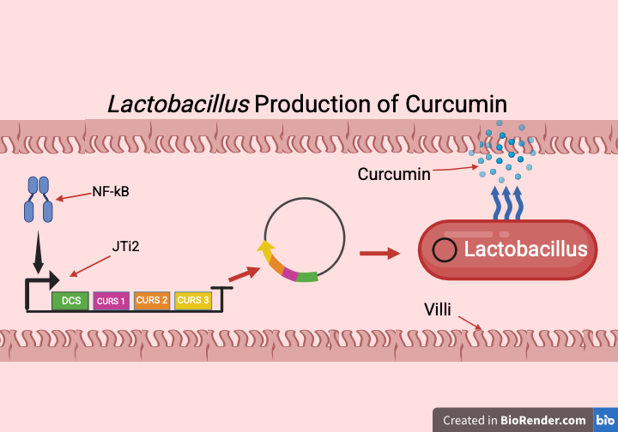
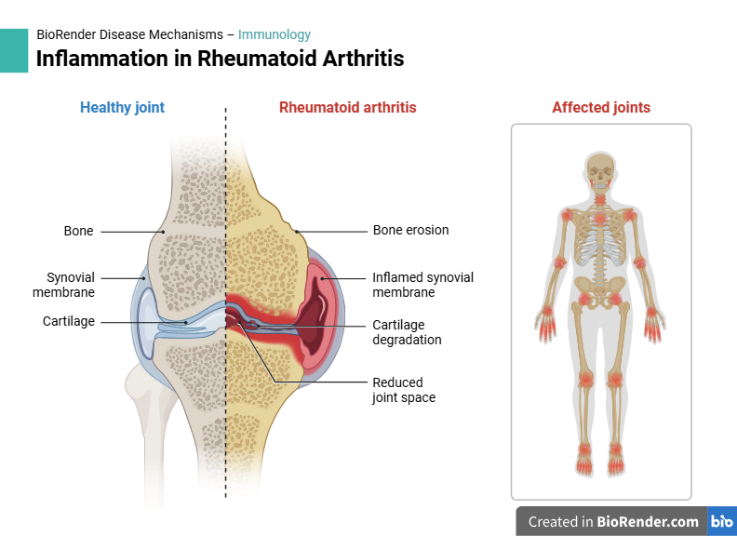
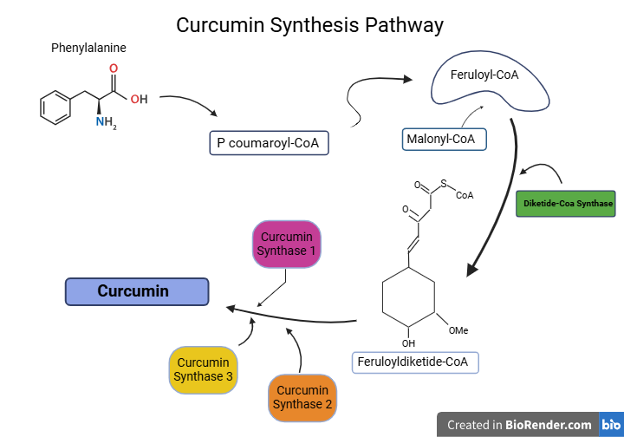








Utilizing Engineered Curcumin for Targeted Suppression of Inflammation in Rheumatoid Arthritis
Gavin Gall, Ben Grant, Adrian Alfirevic, Kaden Haslinger, Abbi Bernhardt, Dr. Beth Pethel, Dr. SitaRam Meena (UCB)
Western Reserve Academy, Hudson, Ohio, United States
Abstract
Eighteen million people worldwide suffer from rheumatoid arthritis (RA), a chronic autoimmune disease that attacks joint linings, causing swelling, inflammation, and damage to the affected area. As of now, RA cannot be cured, but disease-modifying antirheumatic drugs (DMARDs) or nonsteroidal anti-inflammatory drugs (NSAIDs) are used to limit symptoms. However, DMARDs increase the risk of infection by suppressing the immune system, while NSAIDs should only be used in the short term. In most cases, RA is found in joints; however, in some rare cases, it can spread to other parts of the body. When inflammation occurs, the body responds by releasing high levels of nuclear factor-kappa B (NF-kB), a group of proteins that promotes the expression of proinflammatory cytokines and chemokines. Our project aims to reduce the body's inflammation response to RA by developing a response mechanism utilizing NF-kB. This design engineers Lactobacillus to produce curcumin, the anti-inflammatory molecule from the plant Curcuma longa, to significantly reduce the inflammatory response. By pairing the production of curcumin with the NF-kB-inducible promoter JTi2, our design becomes a self-regulating machine. Our goal is to create an automatic regulator and responder to abnormal levels of inflammation in the body, serving as a long-term treatment for those suffering from RA and possibly other autoimmune disorders.
Lactobacillus Production of Curcumin
Rheumatoid Arthritis
Background
-Rheumatoid arthritis (RA) is a chronic autoimmune disease that attacks the synovium, leading to joint pain, swelling, and damage. While the exact cause is unknown, genetic, hormonal, and environmental factors contribute to its onset.
NF-kB proteins that mediate inflammation, leading to excessive immune responses and joint damage.
Our solution proposes utilizing curcumin, a natural anti-inflammatory compound found in turmeric, to target inflammation. We aim to engineer a gut microbe, Lactobacillus (LGC), to produce curcumin in response to high NF-kB levels. By incorporating promoter BBa_K3661006, which activates curcumin production only during inflammation, our system offers a targeted, regulated approach to RA treatment. Delivered as a probiotic pill, this approach could provide a self-regulating alternative to current therapies, and potentially reduce inflammation and disease progression in RA patients.
Curcumin Synthesis Pathway
Our Team
Our team consists of five members, Abbi Bernhardt, Gavin Gall, Kaden Haslinger, Adrian Alfirevic, and Ben Grant (Left to right). We are all seniors new to BioBuilder and synthetic biology.
Acknowledgements
We would like to thank our teacher, Dr. Beth Pethel, for her guidance and support, We also extend our gratitude to our mentor, Dr. Sitaram Meena, for his expert feedback and assistance during our writing process.
Sources

