Slide 1

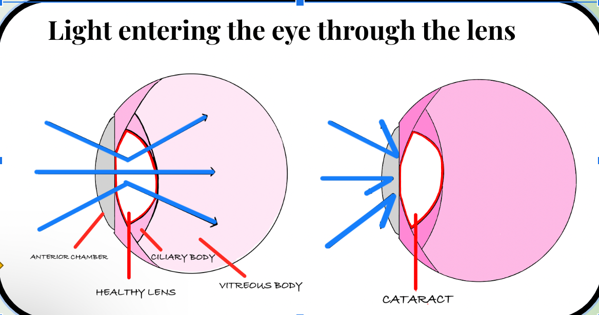
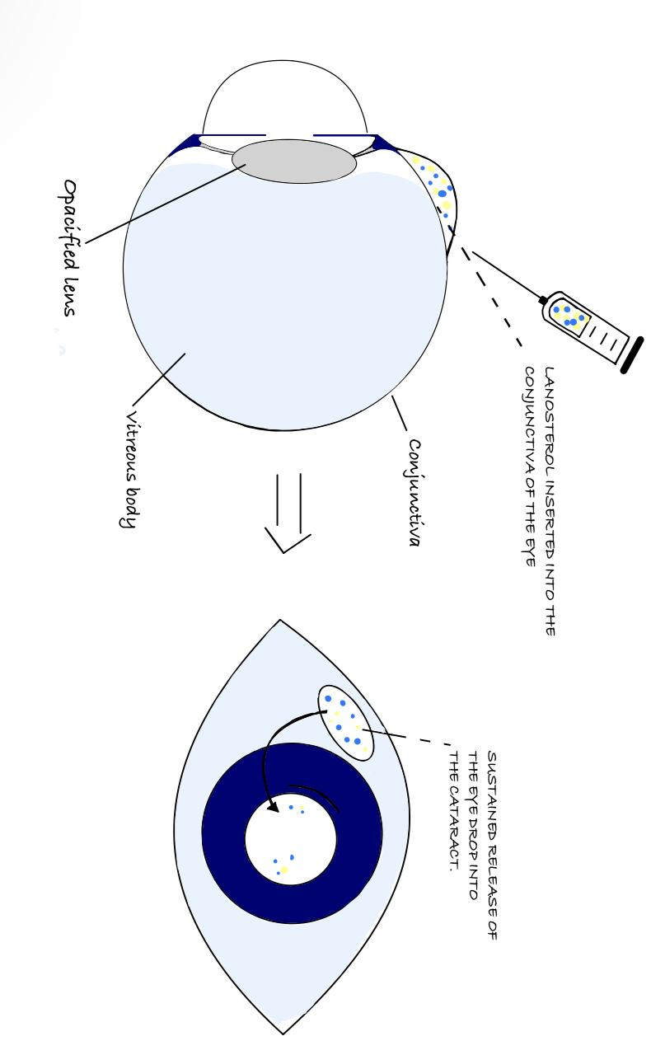





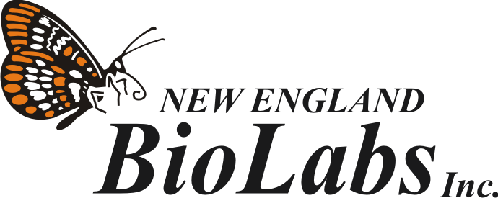

Innovative Enzyme-Based Yeast Therapy for Lifelong Cataract Prevention in Canines
Daryn Amos, Yunwoo Choi, Phalak Dhingra, Suzanna Gebhart, Dongyeon Kim, Xochi Nandi, Dr. Beth Pethel, Dr. Kissaou Tchedre (Austin Community College), Western Reserve Academy, Hudson, Ohio, United States of America
Abstract
Cataracts are a common disease in dogs, causing vision impairment and extreme pain. Cataracts develop when the crystallin proteins that make up the lens of the eye clump together, leading to decreased quality of vision and often blindness. Risk factors for cataracts include old age, genetic predisposition, and certain diseases, such as diabetes at advanced stages. Current treatments include daily lanosterol eye drops, phacoemulsification surgery, which removes just the cataract, and even enucleation to remove the eye as a whole. Phacoemulsification surgery is effective but costly – ranging from $2,700 to $4,000 – making it inaccessible to most pet owners. While current lanosterol eye drops come at a relatively low price, the multiple daily applications are burdensome for both the pet and the owner, and cataract recurrence is possible. Lanosterol, a naturally occurring tetracyclic triterpenoid, has shown great potential in reversing the aggregation of proteins within the eye and thus restoring lens transparency. Our innovative solution for lifelong cataract prevention in dogs utilizes an engineered yeast, part of the normal flora of dogs’ eyes, to produce lanosterol, ensuring long-term drug delivery within the eye. This treatment would be administered once shortly after birth, and the yeast, Candida albicans, would live in the eye, producing lanosterol consistently. The sustained production of lanosterol spares surgery's risk and recovery time and the financial and logistical burden of conventional cataract treatments, ultimately enhancing the dog's quality of life.
Figure 1. Comparison of light entering through affected and unaffected eyes.
Figure 2. Mechanism of lanosterol eye drops.
Figure 3. Zuri with cataracts
Background
The leading cause of blindness in dogs, cataracts, develops when proteins clump together within the lens which leads to impaired vision and discomfort. Pet owners frequently find current treatment methods with financial and logistical challenges. Research shows lanosterol as a natural sterol can treat cataracts by dissolving protein clumps and returning lens clarity. The research introduces a permanent treatment with a genetically modified yeast system that produces lanosterol throughout the animal's eye after birth. This novel method removes the necessity for repeated medical interventions and surgical procedures which makes treatment more accessible and enhances dogs' quality of life.

Slide 2
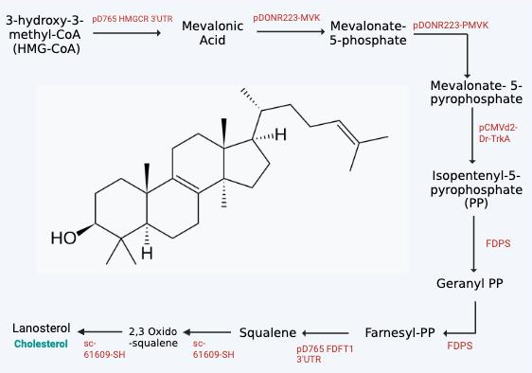
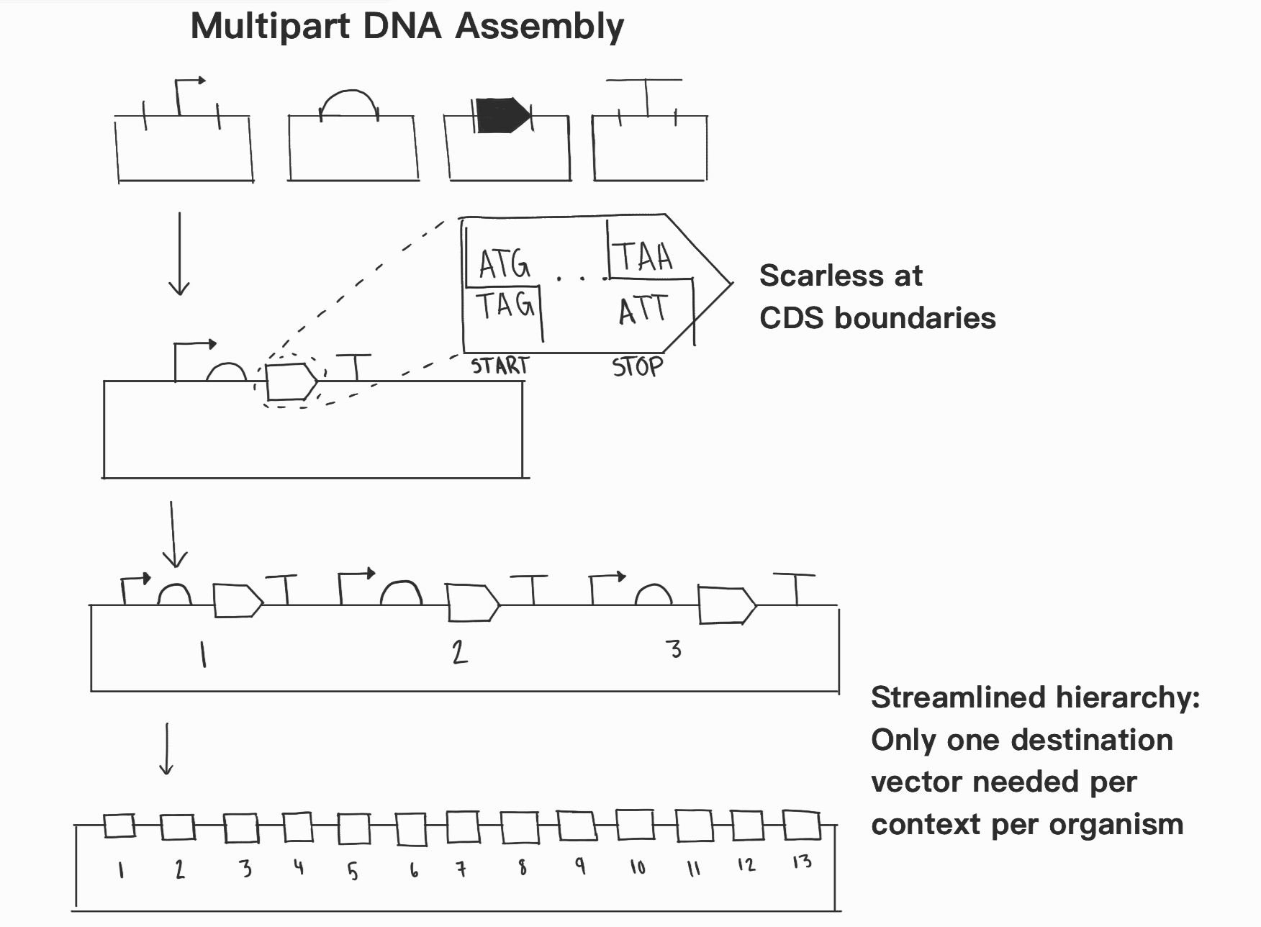
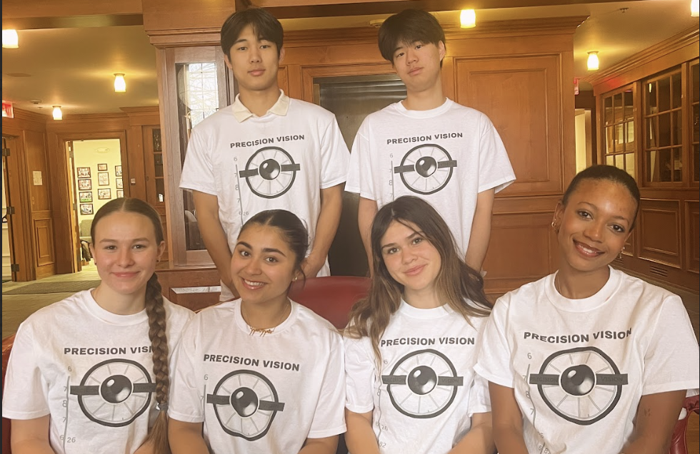

Innovative Enzyme-Based Yeast Therapy for Lifelong Cataract Prevention in Canines
Daryn Amos, Yunwoo Choi, Phalak Dhingra, Suzanna Gebhart, Dongyeon Kim, Xochi Nandi, Dr. Beth Pethel, Dr. Kissaou Tchedre (Austin Community College), Western Reserve Academy, Hudson, Ohio, United States of America
Figure 4. Lanosterol pathway and Chemical Structure
Figure 5. Start-Stop Assembly
Meet the Team!
(From left to right)
Top: Dongyeon Kim, Yunwoo Choi
Bottom: Suzanna Gebhart, Phalak Dhingra, Xochi Nandi, Daryn Amos
Design
In this solution, a genetically modified yeast produces lanosterol, which keeps cataracts at bay by breaking down protein clumps in the lens, before they have the chance to build up and obscure the lens. The yeast chosen, Candida albicans, is part of the normal flora of canine eye. Once administered, this yeast strain would live in the eye and continuously supply lanosterol, eliminating the need for continuous administration. We plan to innovate the treatment by genetically modifying yeast, a normal part of the canine eye lens, using the start-stop assembly method to secrete lanosterol directly into the eye so protein clumps are prevented in advance or during their formation and lens clarity is maintained for optimal natural lens activity.
Scan QR code for
access to References
and sources OR
access with this Link

