Slide 1

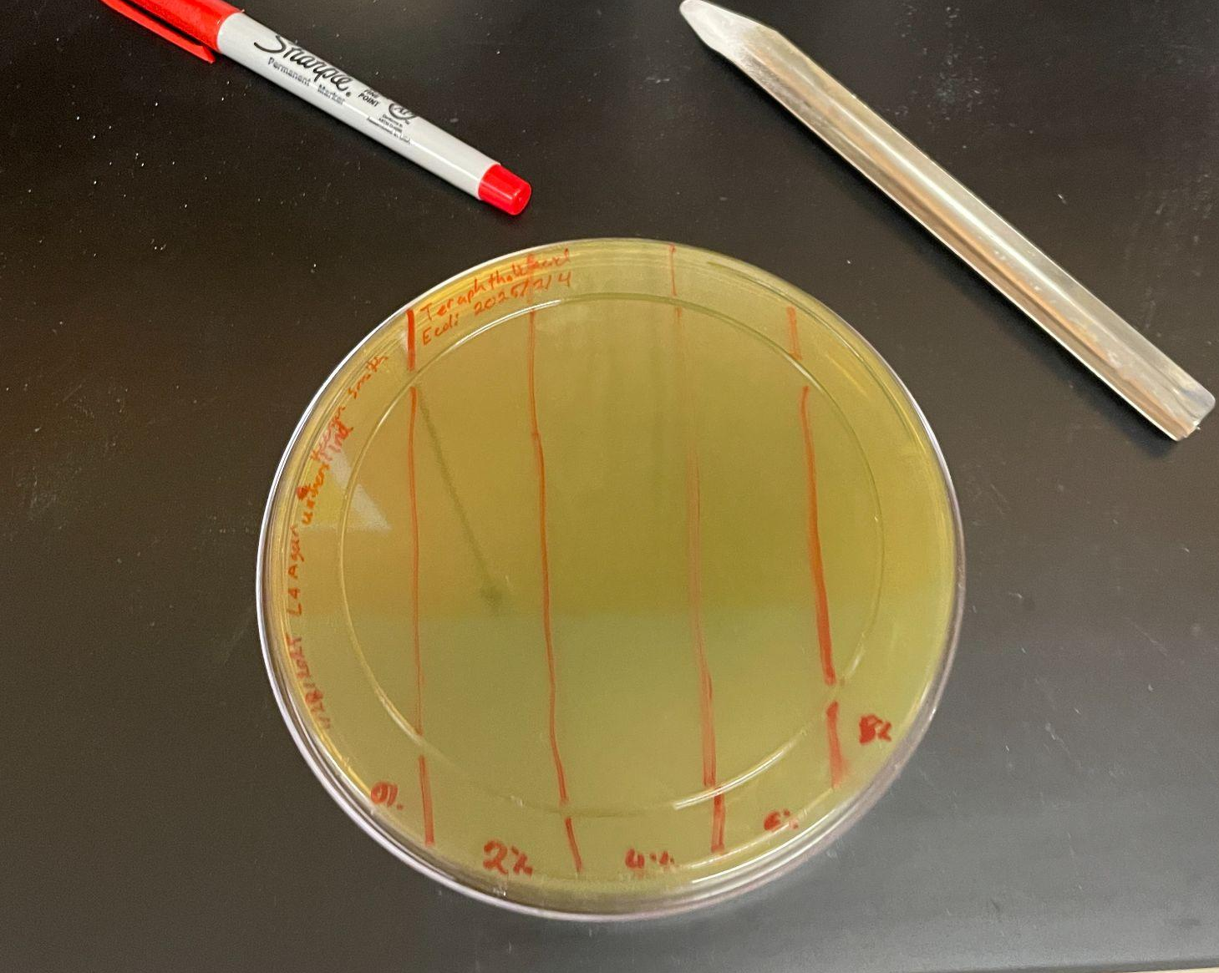
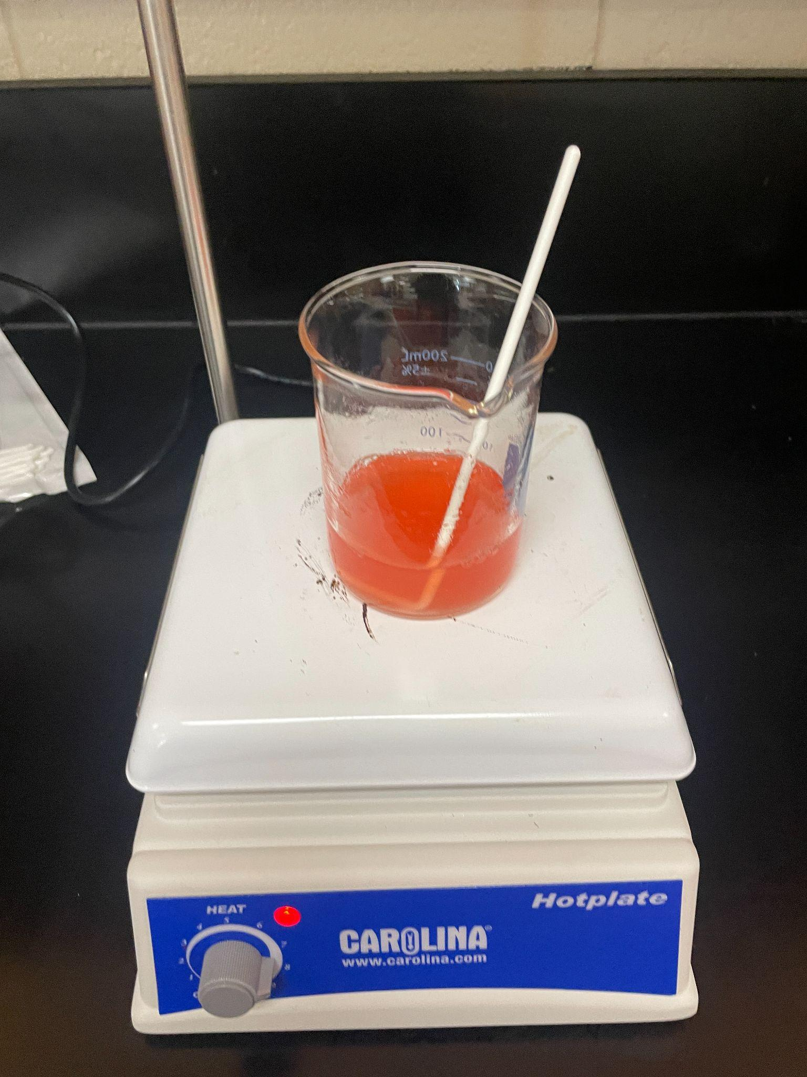






PROBLEM SOLVING POLLUTION with PETase
Keenan Smith, Amanda Barrett, Irene M.B. Reizman, Ph.D. (Rose-Hulman Institute of Technology)
Marietta High School, Marietta, Georgia, United States
Abstract
With the rise in plastic use and still no way to properly recycle plastics, they have found their way into sensitive ecosystems. Previous research has found that there are 2 enzymes (PETase and MHETase) that can metabolize polyethylene terephthalate plastic but the breakdown produces an acidic environment that the microorganism cannot survive.This project aims to first build resistance to Terephthalic acid in a strain of E. Coli and second, insert both PETase and MHETase genes through plasmid uptake.
Team Content
This is a new team with only one team member.
Highlights: This was an amazing learning experience where I got to work on an experiment of my own design and got to expand it according to how budgeting and materials would allow, much like in the real world.
Challenges: Trying to maintain a sterile environment and delay of experimentation due to shipping times of materials impacted by environmental catastrophes.
Next steps:
To insert the gene of interest into the plasmids from Ideonella sakaiensis and have a 70% or above transformation efficiency of the acid resistant E. coli bacteria.
Cultive the modified bacteria in bioreactors where PET plastics would be ground up and used as a fuel source to be broken down by the enzymes produced by the bacteria.
Experiments
This project was divided into two sections, the first was to develop a specialized strain of E coli and the second was to use that specializes strain. The first experiment will expose E. coli to increasing concentrations of terephthalic acid on an LB agar medium. As E. coli spreads across the plate, it will need to develop greater resistance to the terephthalic acid in order to access more of the nutrients available. The second experiment will insert a plasmid containing DNA from Ideonella sakaiensis that code for the 2 enzymes - PETase and MHETase into a genetically modified strain of E. coli that has developed resistance to a byproduct produced by both enzymes. While E. coli has successfully taken up plasmids containing these genes of interest before, this was previously done only to replicate the plasmids, not to produce the enzymes.
Introduction/Background
The universal problem of plastic pollution is threatening many ecosystems. Likewise the technology and methods of recycling plastics is not truly sustainable. Even so the organism Ideonella Sakaiensis has developed a method of surviving in such environments. Ideonella Sakaiensis has two enzymes called PETase (polyethylene terephthalate)ase and MHETase (mono(2-hydroxyethyl) terephthalate hydrolase)ase. These enzymes are responsible for breaking down (polyethylene terephthalate) into mono(2-hydroxyethyl) terephthalate which is further broken down into Ethylene glycol (EG) and Terephthalic acid (TPA). This process allows for PET plastics to be broken down into less environmentally dangerous products. These enzymes can be inserted into a plasmid for standard E. coli to uptake, however standard E. coli is not able to survive high concentrations of Terephthalic acid. Because of this E. coli will need to build resistance to the acid. E. coli is used for duplication of the plasmids but not expressing the genes that cause the production of PETase and MHETase because of the intolerance to terephthalic acid. We aim to change that.
References and acknowledgements
Chakrabarti, S., Müller, T., & Sauter, M. (2019). Nature
Communications, 10(1), 1608.
https://doi.org/10.1038/s41467-019-09326-3
Gassmann, O., & von Zedtwitz, M. (2020). Dynamic capabilities and
innovation in the digital age. Journal of Business Research, 120,
194-205. https://doi.org/10.1016/j.jbusres.2020.08.012
We’d like to thank Irene M.B. Reizman, Ph.D. for her guidance and mentorship throughout this entire process.

