Slide 1

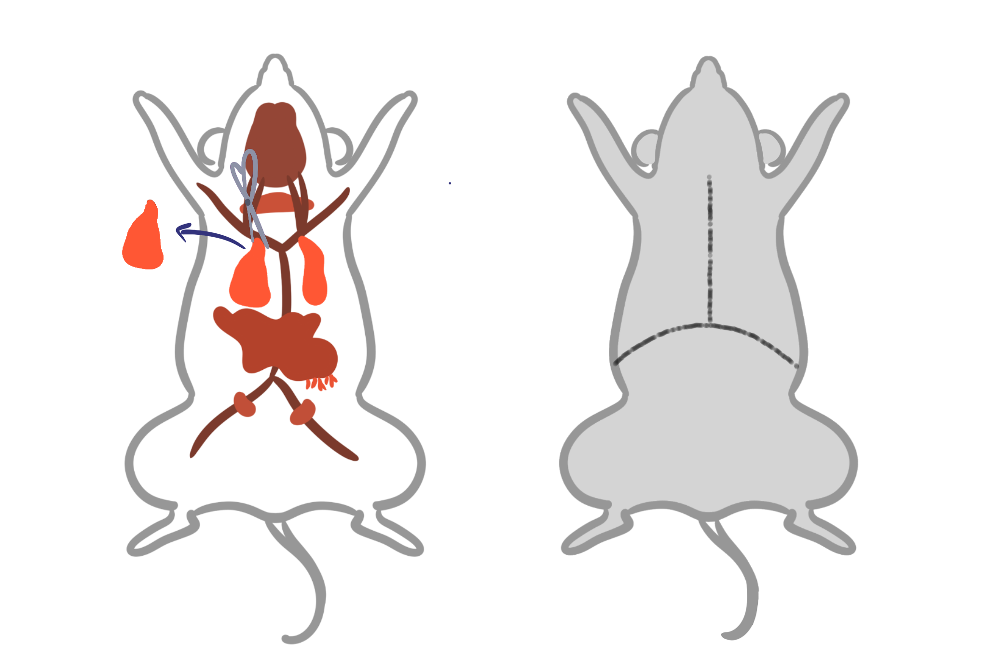
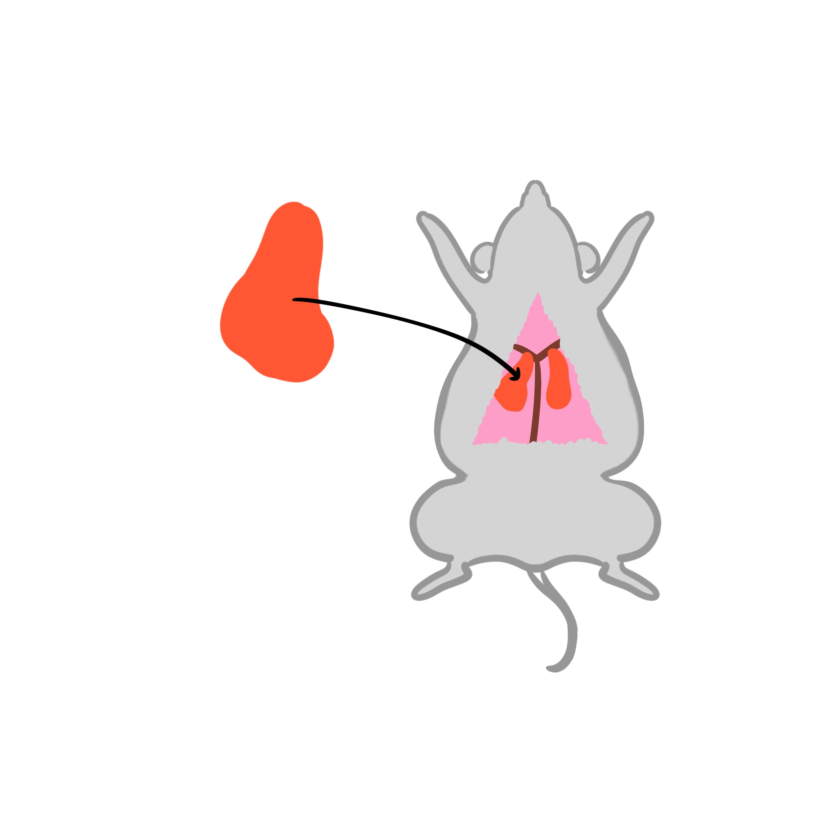
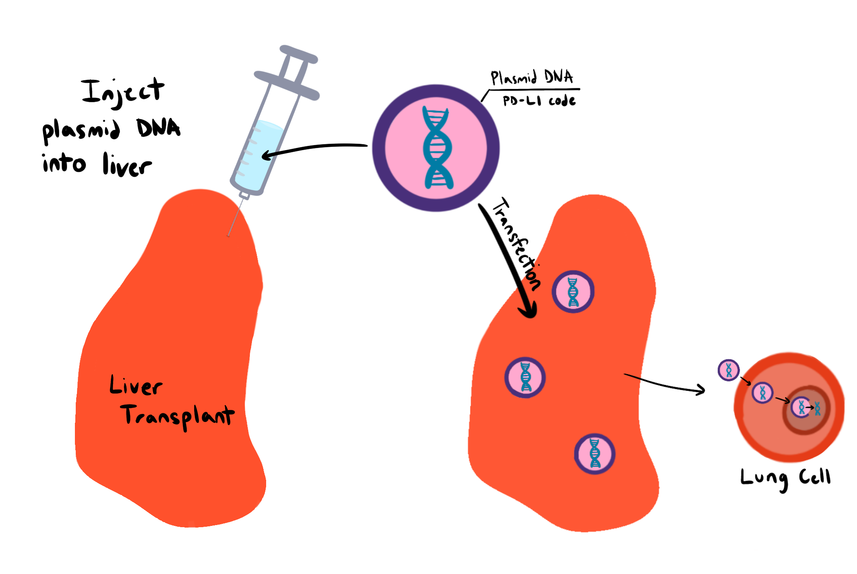






Localized Immunosuppressants For Lung Transplants
Tanishka Singh, Meileen Trinh, Kirsten Choi, Komal Jasuja. Mary Liu (Teacher). Dr. Peter Horanyi (UCB).
Assumption: Experiment in animals with similar immune systems
Main Objective: Create localized immunosuppression for lung transplants by studying cancer cells
Start
Express + Purify Proteins
Extract transplantable organ from donor mouse + prepare mouse to receive organ
1.
3.
Adjust dosage size + check every day
Experiment Process
2.
Analyze results over time + Troubleshoot
Treat transplantable organ by injecting the plasmid DNA into it
Lung
Lung
Measure results, focusing on immune response/rejection
Do Surgery

