Slide 1

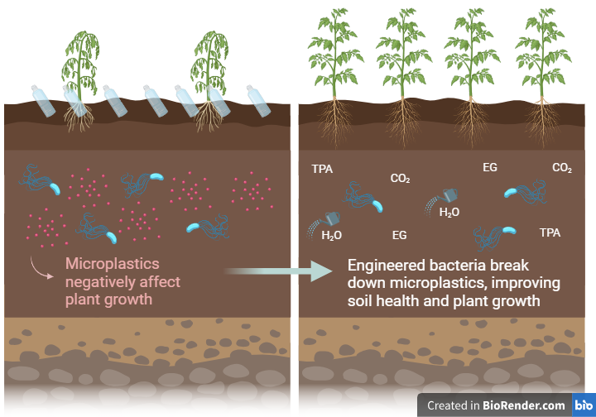
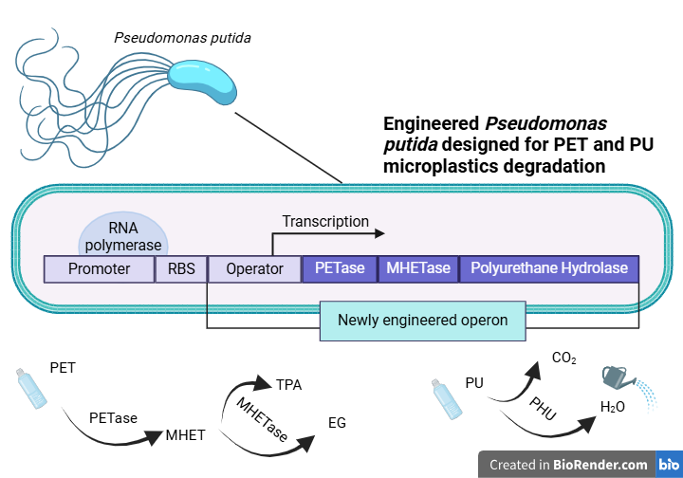






PAC-BAC! A Pseudomonas putida Model for Microplastic Degradation
Tvesha Patel, Siena Elliffe, Ruby Quintiliani, Liesl-Ann Vaz, Megan Cloherty, Chloe Dias, Aneesa Maity, Sarah Hanna (teacher), Paola Favaretto (teacher), Dr. John Kisiday (BioBuilder mentor from the University of Wyoming)
Montrose School, Medfield, Massachusetts, United States
Problem: Microplastics, especially PET and PU, accumulate in soil from various sources (mulching, fertilizers, pesticides, animal waste), disrupting soil health by reducing water retention, nutrient absorption, and root establishment.
Objective: Develop a bacterial solution using Pseudomonas putida to degrade a range of microplastics, targeting PET and PU plastics commonly found in soil.
Solution: Engineering P. putida with three enzymes: PETase, MHETase, and Polyurethane Hydrolase (PHU). Enabling the bacterium to degrade multiple types of microplastics effectively in diverse environments.
Benefits: This engineered bacterium offers a broader spectrum of microplastic degradation compared to existing strains, making it more adaptable to different soil conditions and improving overall soil health.
Next Steps: Test the engineered bacteria in various soil environments to evaluate the efficiency of degradation and assess the impact of byproducts on soil quality and plant productivity.

