Slide 1


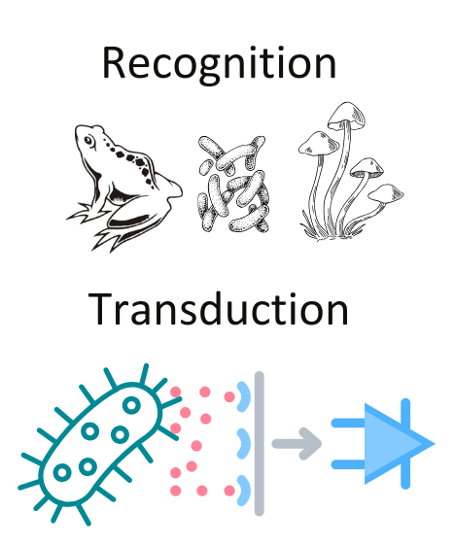
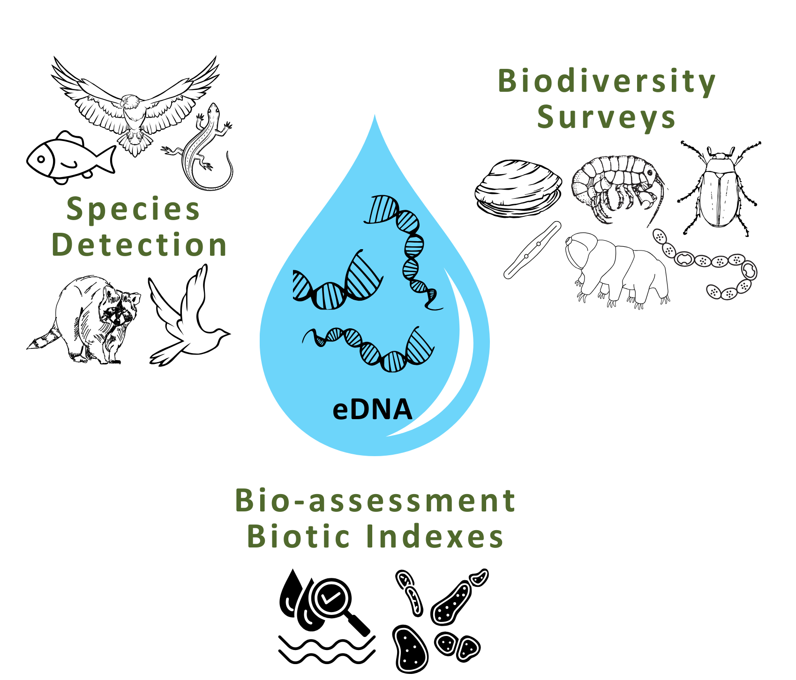
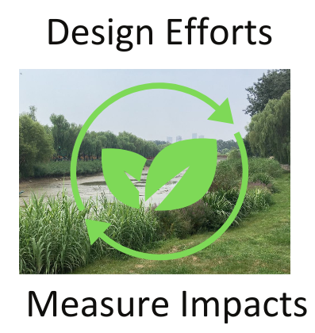








eDNA BIOSENSORS FOR URBAN REWILDING
Ryan Zhang, Ethan Guo, Mia Li, Ernest Zhou, Chris Hayden &
Robyn Novorolsky (Moderna Therapeutics & Northeastern University)
Western Academy of Beijing, Beijing, China
Objective: Use eDNA-based biosensors to enhance biodiversity monitoring & impact of steps taken in rewilding efforts
Techniques: Environmental DNA (eDNA) sequencing across habitats & time- both urban & natural
Biosensor design is long term goal; initial eDNA sampling to identify keystone or indicator species
eDNA analysis across sites to inform focus of project and sensor development

